Slide 1

Counterpulsation, IMPELLA, ECMO for acute heart failure
Prof. Alessandro Santo Bortone
MD, PhD, FESC, FAHA, FACC, FSCAI
DIRETTORE
Unità Interdipartimentale di Emodinamica Interventistica
Università degli Studi di Bari

Slide 2
I don’t have any conflict of interest

Slide 3
Proactive Counterpulsation

Slide 4
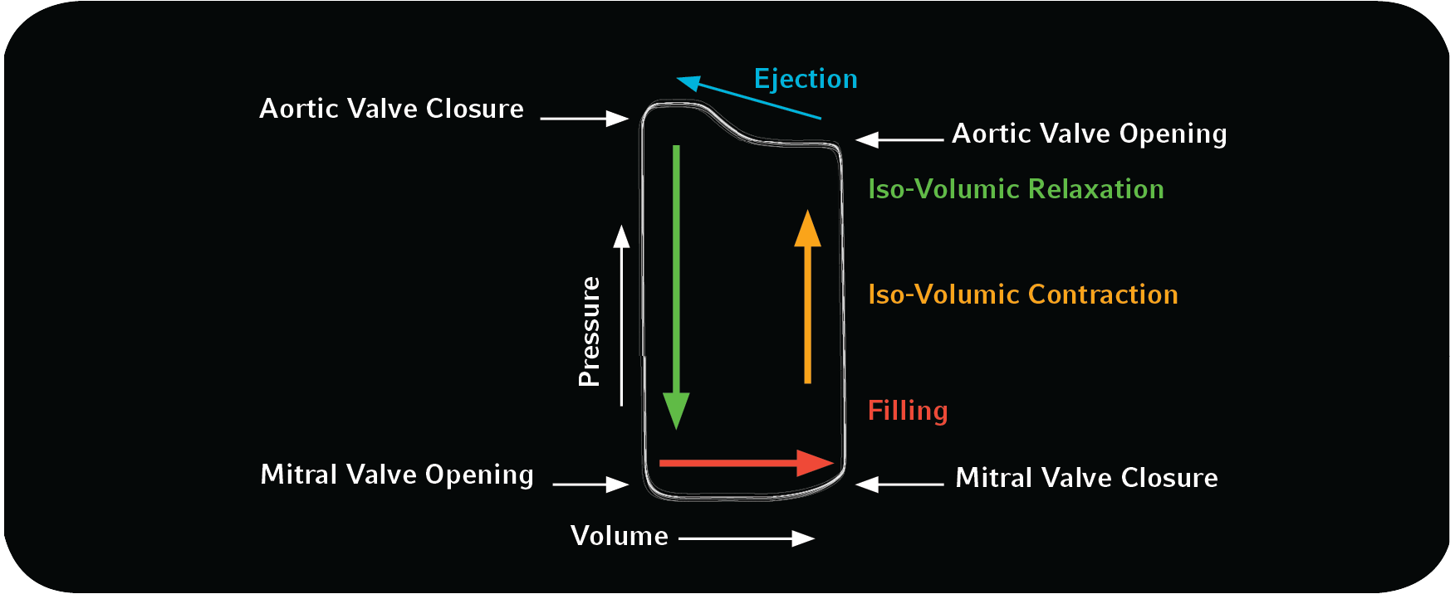
Analysis of the heartbeat seen through the volume pressure curve

Slide 5
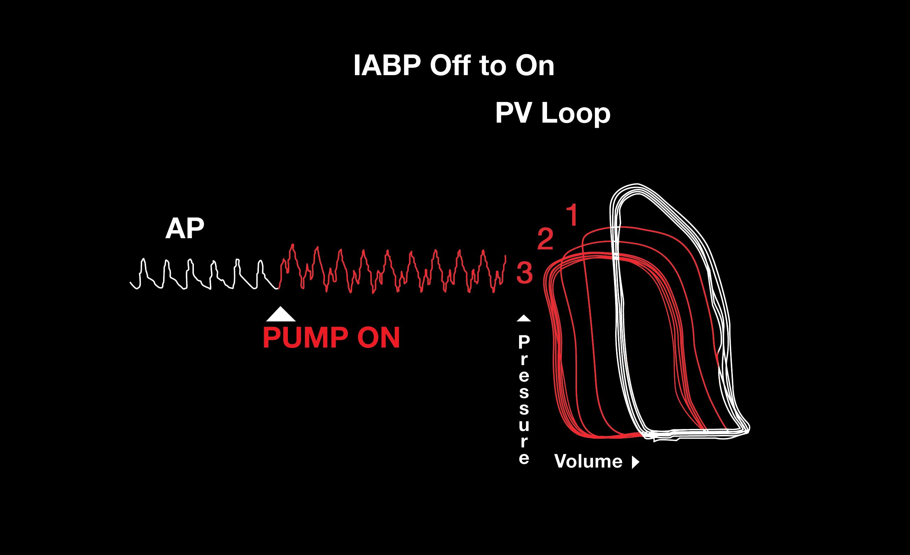
Effect of a correct counterpulsation on the volume-pressure curve

Slide 6
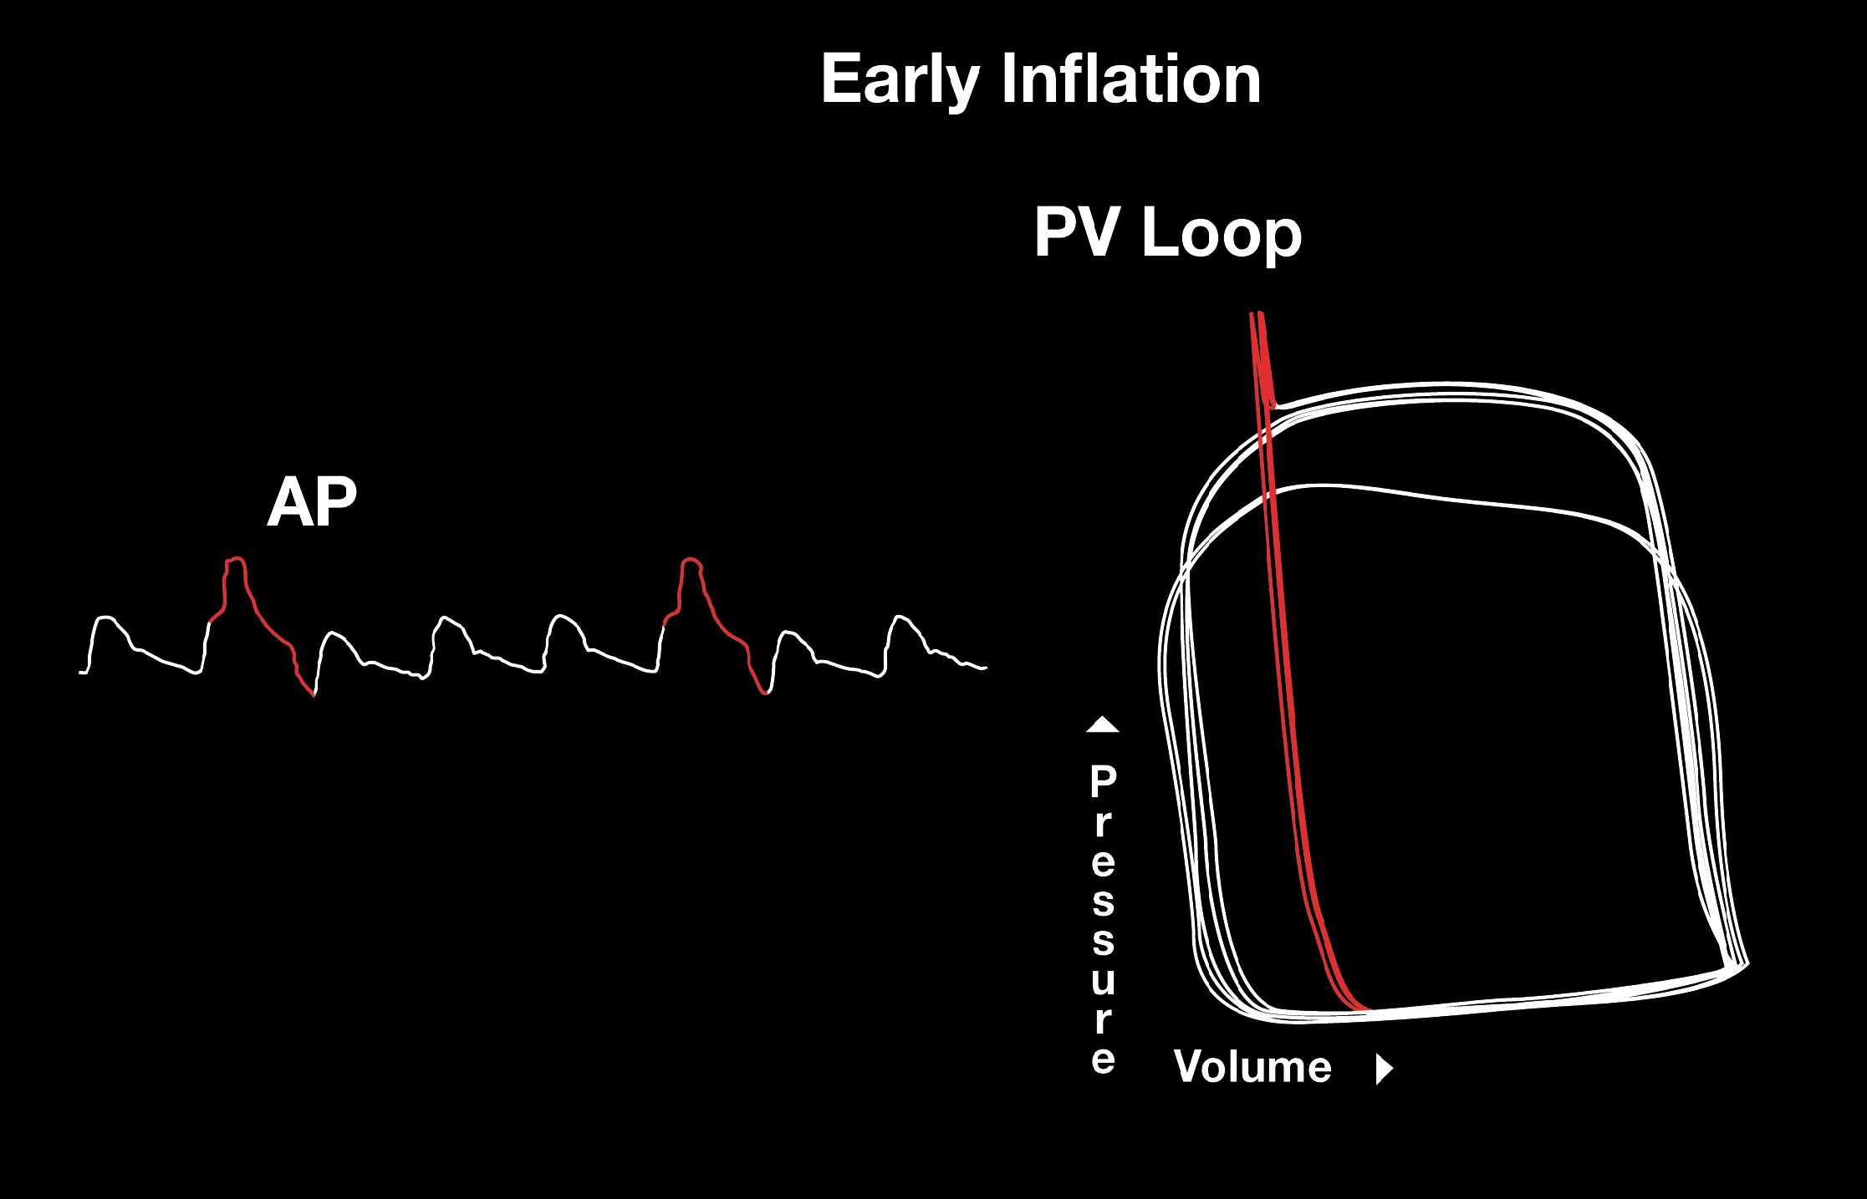
Effect of an early inflation

Slide 7
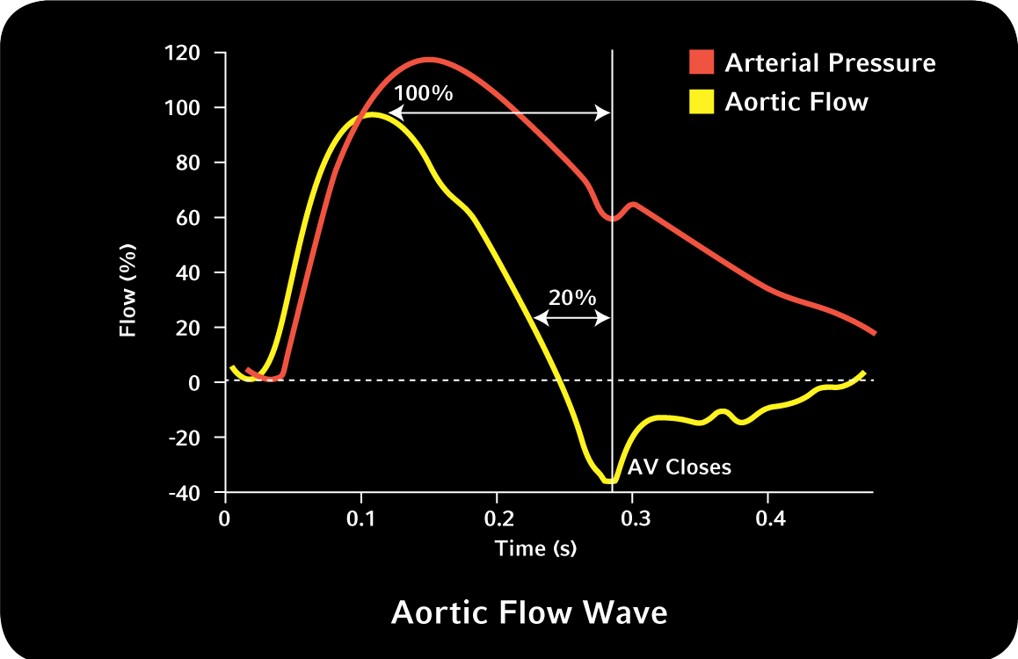
Arterial pressure and aortic flow curves

Slide 8
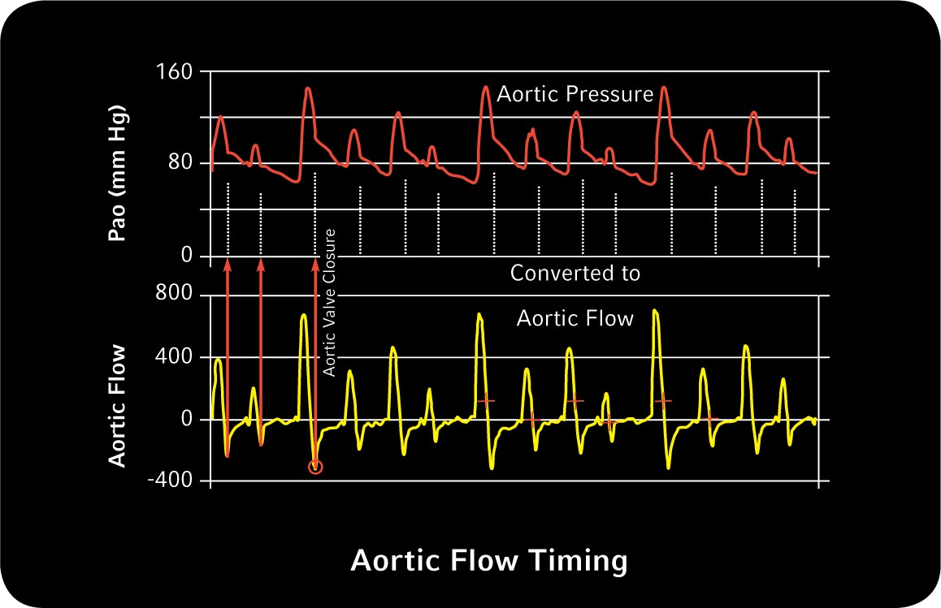
Flow curve converted from a pressure curve

Slide 9
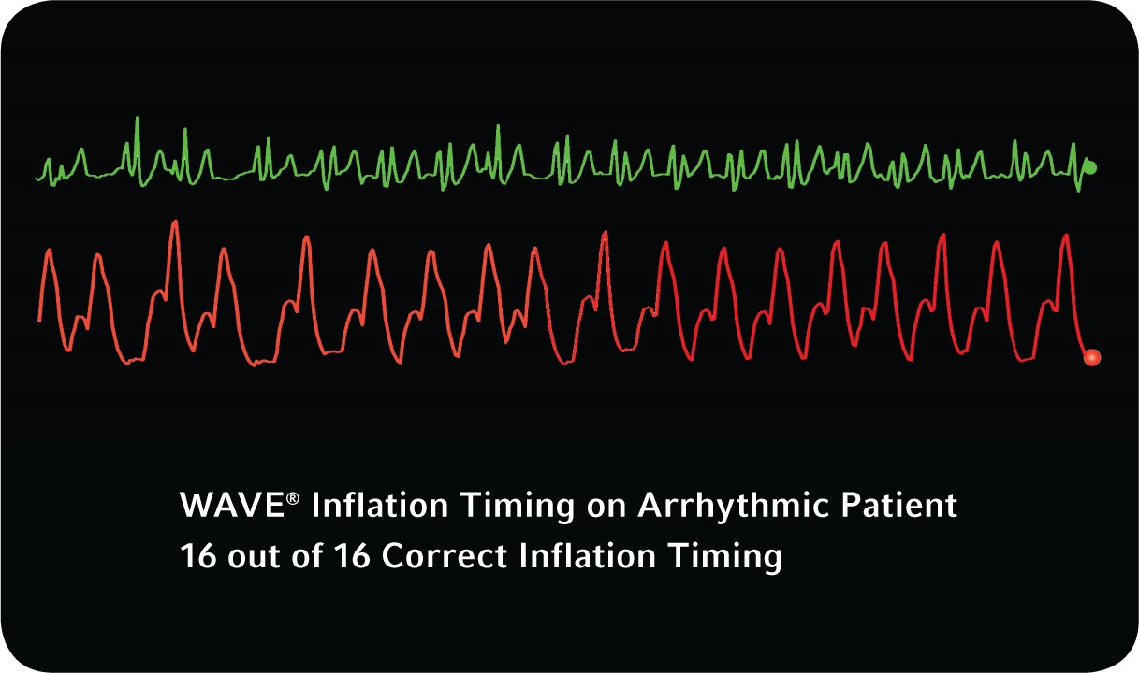
Effects of a proactive counterpulsation
*Representative of study. Individual results may vary.

Slide 10
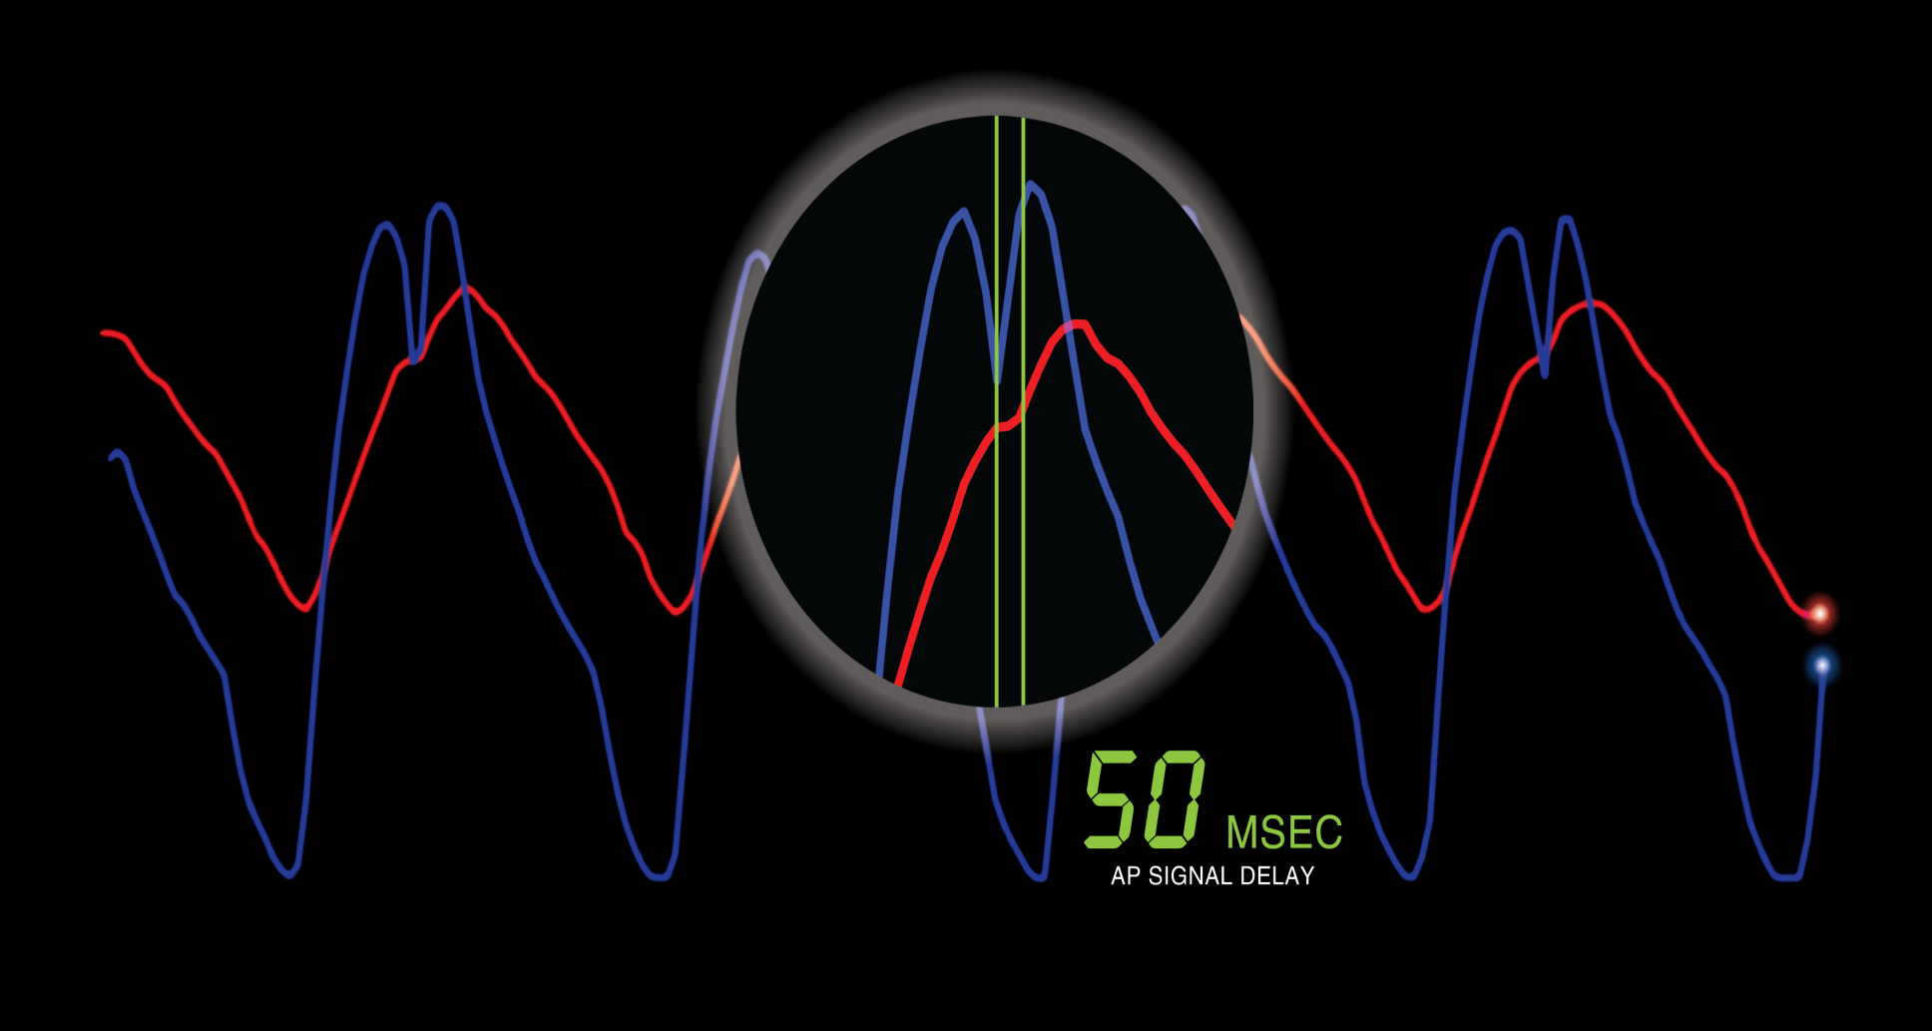
Fiber optic and fluid-filled catheters

Slide 11
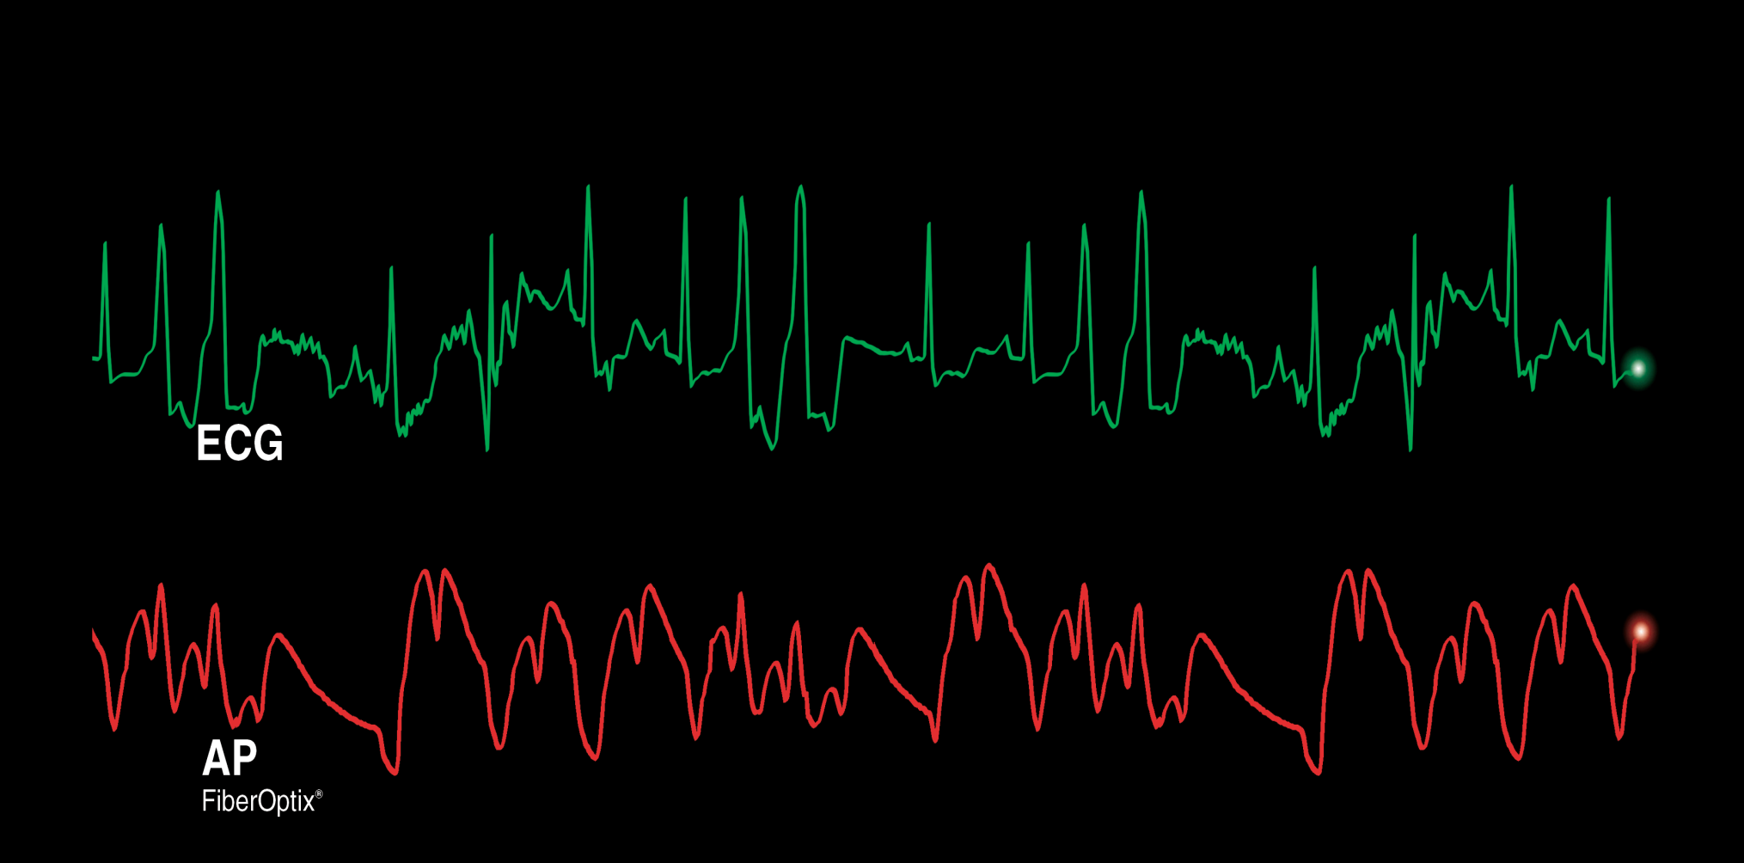
ProActive CounterPulsation Technology Patient Performance

Slide 12
IMPELLA

Slide 13
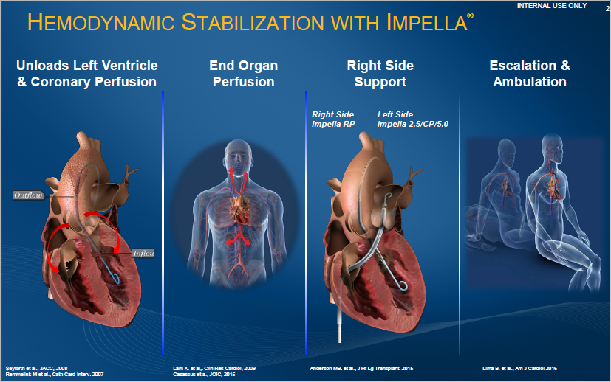
AMI - Clinical Goals
Restore Stable Hemodynamics
  reversing decline of end-organ perfusion, reducing risk of end-organ failure, breaking cycle of cardiogenic shock
Minimize Infarct Size
  reducing myocardial ischemia, halting cell damage, maximizing residual cardiac function
Ease-of-Use & Safety
  consistent with critical treatment time scenarios and risk-benefit considerations of emergency care
Notes:
13

Slide 14
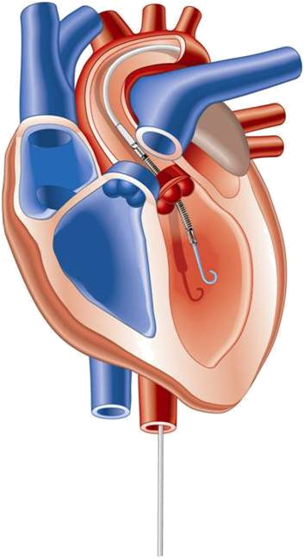
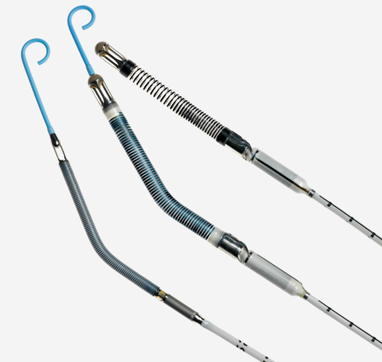
Impella Technology
Intravascular microaxial catheter based blood pump that supports a patient’s circulatory system.

Slide 15
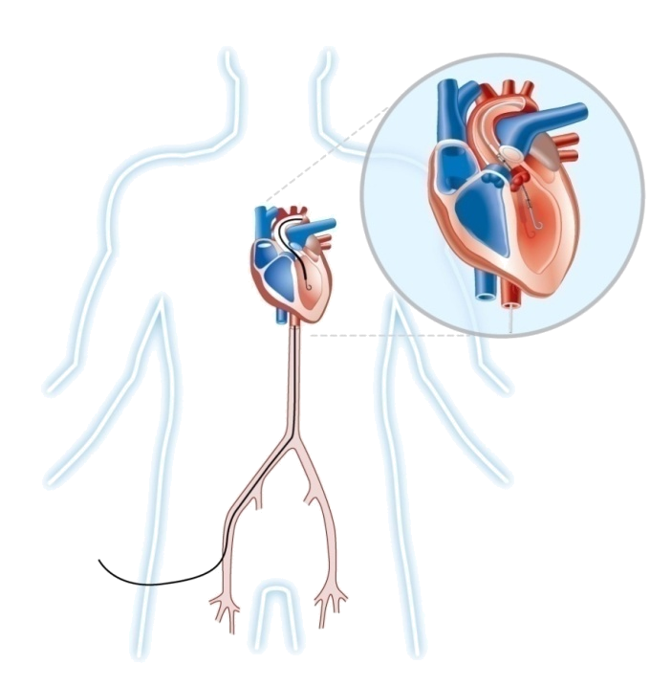
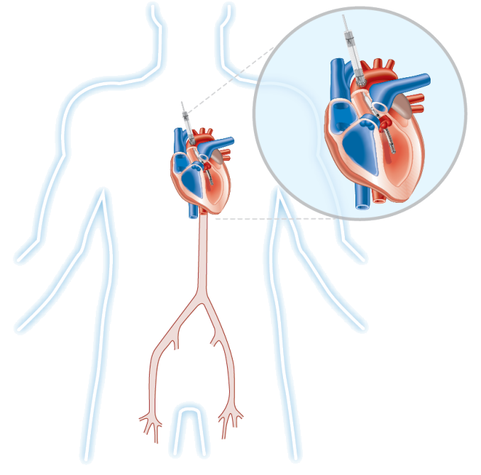
Impella Technology
The cannula portion of the device sits across the aortic valve
The impeller is rotated to produce a negative pressure
Blood is drawn from the LV, across the aortic valve
Directly unloads left ventricle; maintains diastolic pressure
Impella Family Animation 1080p.mov

Slide 16
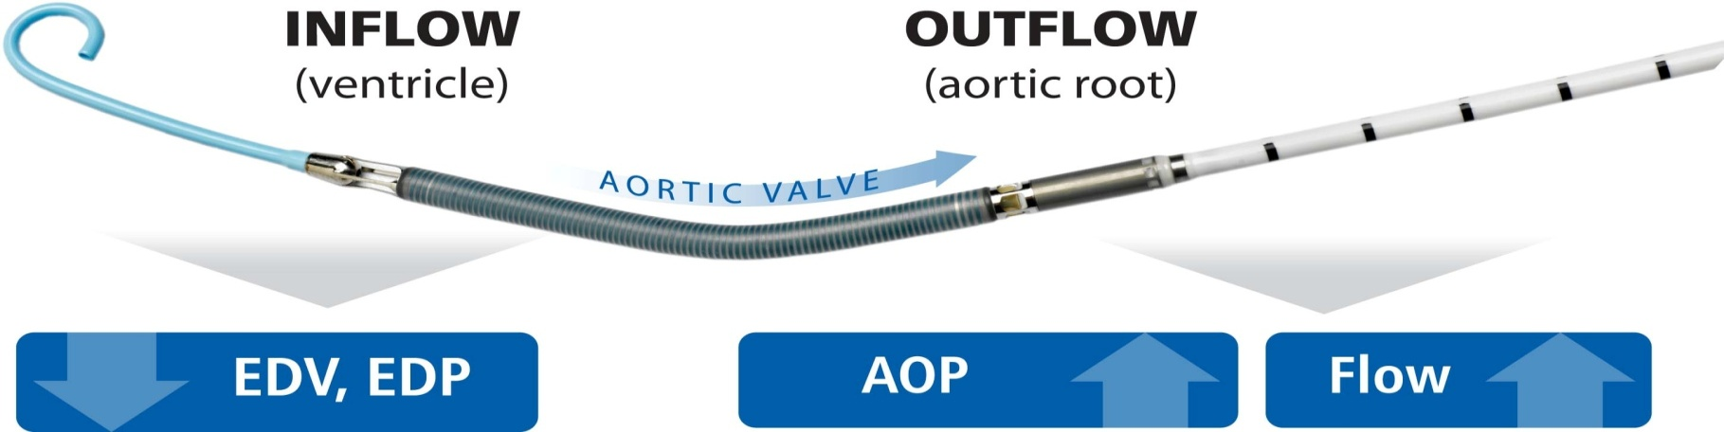
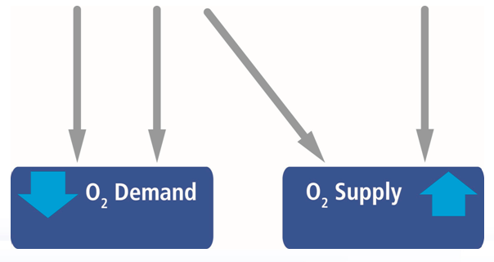
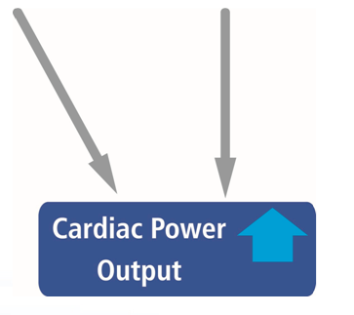
Physiological Results of Impella Support
16
Notes:
Impella is the only device that transports blood in the same way as the natural heart.
It pulls blood from the ventricle, sends it through the aortic valve and deposits it in the root of the ascending aorta.
In doing so, it reduces ventricular end-diastolic volumes and pressures, and it increases the mean aortic pressure and flow.
This all leads to protection of the myocardium by changing the oxygen demand-supply balance and systemic hemodynamic support through increases in net cardiac output
16

Slide 17
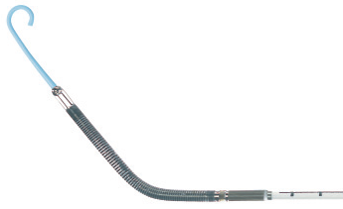
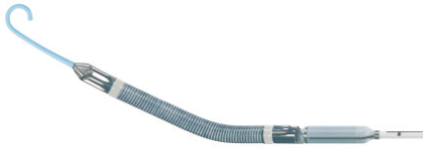
Impella Circulatory Support Platforms
 | Impella 2.5 | Impella 5.0 | Impella LD
Flow Rate (L/min, max) | 2.5 | 5.0 | 5.0
Circulatory Support | Partial | High-flow | High-flow
Catheter Size | 9 Fr | 9 Fr | 9 Fr
Pump Size | 12 Fr | 21 Fr | 21 Fr
Insertion Method | Percutaneous via Introducer Sheath | Peripheral via Arterial Cut-down | Direct, Surgical Insertion
Guidewire thickness | 0.018” | 0.025” | N/A
Placement Measurement | Fluid-filled Pressure Lumen | Differential Pressure Sensor | Differential Pressure Sensor
Cannula Geometry | Curved, Pigtail | Curved, Pigtail | Straight
Micro-axial Pumps
Notes:
17

Slide 18
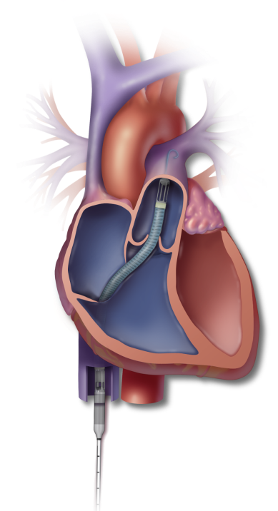
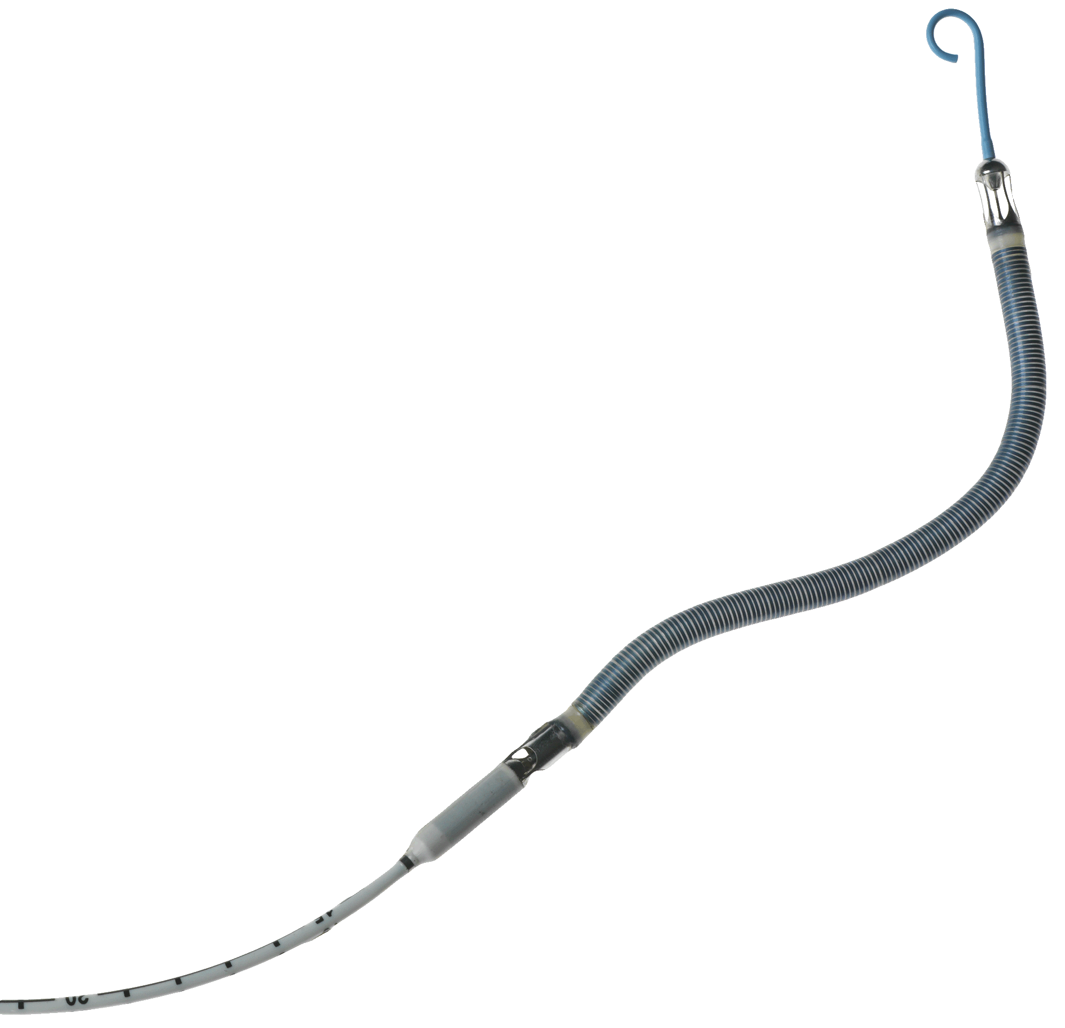
18
Impella RP
outflow
Catheter-based percutaneous VAD (22 Fr pump mounted on a 11 Fr catheter)
Treatment: Right ventricular dysfunction
Flow: > 4 L/min
Duration of support: up to 14 days
Pump Inflow: Inferior Vena Cava (IVC)
Pump Outflow: Pulmonary Artery (PA)
inflow
Notes:
18

Slide 19
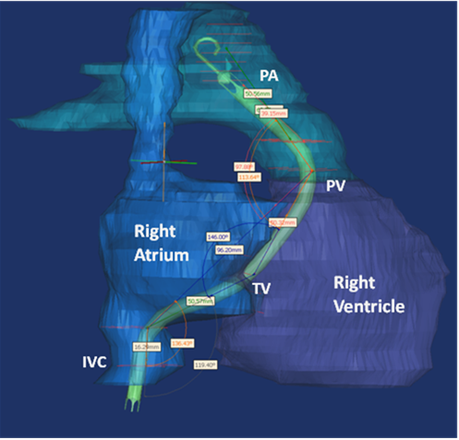
Product Design - Cannula
19
Cannula build based on “average” 3D shape from CT scans
Verified by cadaver measurements
Inflow at diaphragm- allows high flows at low CVP
Outflow location: Distal to the PV
Should “fit” >95% of adult population
*Impella RP is not approved or cleared for use in the United States

Slide 20
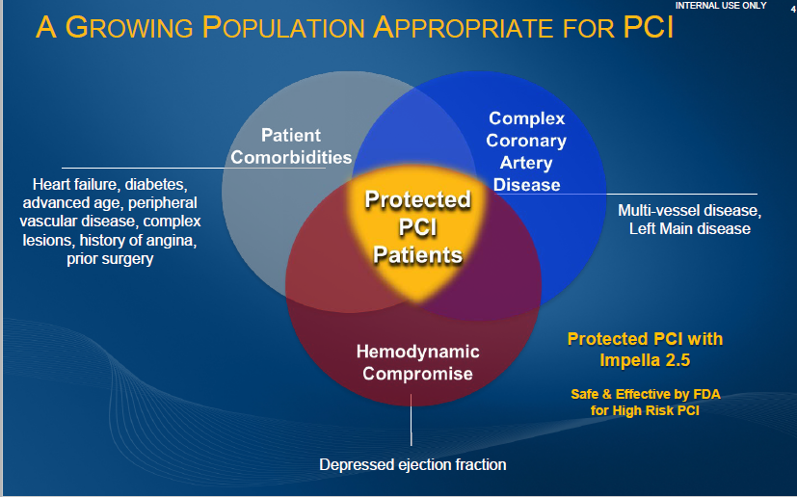
AMI - Clinical Goals
Restore Stable Hemodynamics
  reversing decline of end-organ perfusion, reducing risk of end-organ failure, breaking cycle of cardiogenic shock
Minimize Infarct Size
  reducing myocardial ischemia, halting cell damage, maximizing residual cardiac function
Ease-of-Use & Safety
  consistent with critical treatment time scenarios and risk-benefit considerations of emergency care
Notes:
20

Slide 21
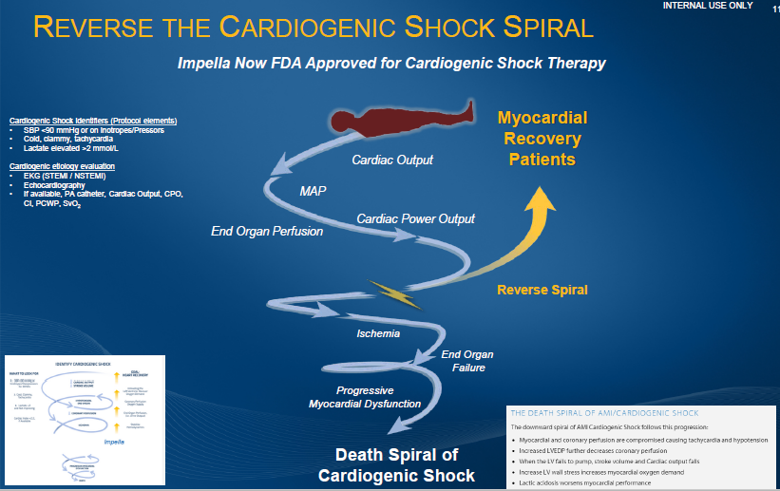
AMI - Clinical Goals
Restore Stable Hemodynamics
  reversing decline of end-organ perfusion, reducing risk of end-organ failure, breaking cycle of cardiogenic shock
Minimize Infarct Size
  reducing myocardial ischemia, halting cell damage, maximizing residual cardiac function
Ease-of-Use & Safety
  consistent with critical treatment time scenarios and risk-benefit considerations of emergency care
Notes:
21

Slide 22
How Does Impella Design Avoid Hemolysis?
Range of RBC Break Points (above 400 Pa)
Range of Impella Shear Forces
(below 400 Pa)
Distribution of Impella shear forces
Distribution of RBC break point in normal human blood
Shear force (Pa)
Impella shear forces not strong enough to destroy RBCs
Notes:
This slide then illustrates the real safety factors applied in the Impella design relative to red blood cell damage. The RED distribution represents the forces that red blood cells have been characterize to rupture at through physical testing. So over a range from ~ 425 to 700 pascals (pascals= like lbs, this is just a scale of measurement for force). 1 Pa = 1N/m² approx 1kg = 10N.
On the left part of the slide , the blue bars represent a distribution of the shear forces that Impella is designed to impose on red blood cells. The gap in between the high blue bars and the start of the red semi circle is the “Safety factor”. You can see that the majority of the shear forces are imposed well below 200 pascals so there is a factor of two safety before you even approach the RBC minimum destructive force.

Slide 23



Protect II Trial Design
Patients Requiring Prophylactic Hemodynamic Support
During Non-Emergent High Risk PCI on
Unprotected LM/Last Patent Conduit and LVEF≤35% OR
3 Vessel Disease and LVEF≤30%
R
1:1
IABP +
PCI
IMPELLA 2.5TM +
PCI
Primary Endpoint = 30-day Composite MAE* rate
Follow-up of the Composite MAE* rate at 90 days
*Major Adverse Events (MAE) :
Death, MI (>3xULN CK-MB or Troponin) , Stroke/TIA, Repeat Revasc, Cardiac or Vascular Operation or Vasc. Operation for limb ischemia, Acute Renal Dysfunction, Increase in Aortic insufficiency, Severe Hypotension, CPR/VT, Angio Failure
O’Neill et al, Circulation. 2012;126(14):1717-27
Notes:
Protect II trial design including the composite endpoint.
23
15/09/2019
HCS-PMA-PP00915 rB_Protected PCI with Impella 2.5 Educational Material_FINAL

Slide 24
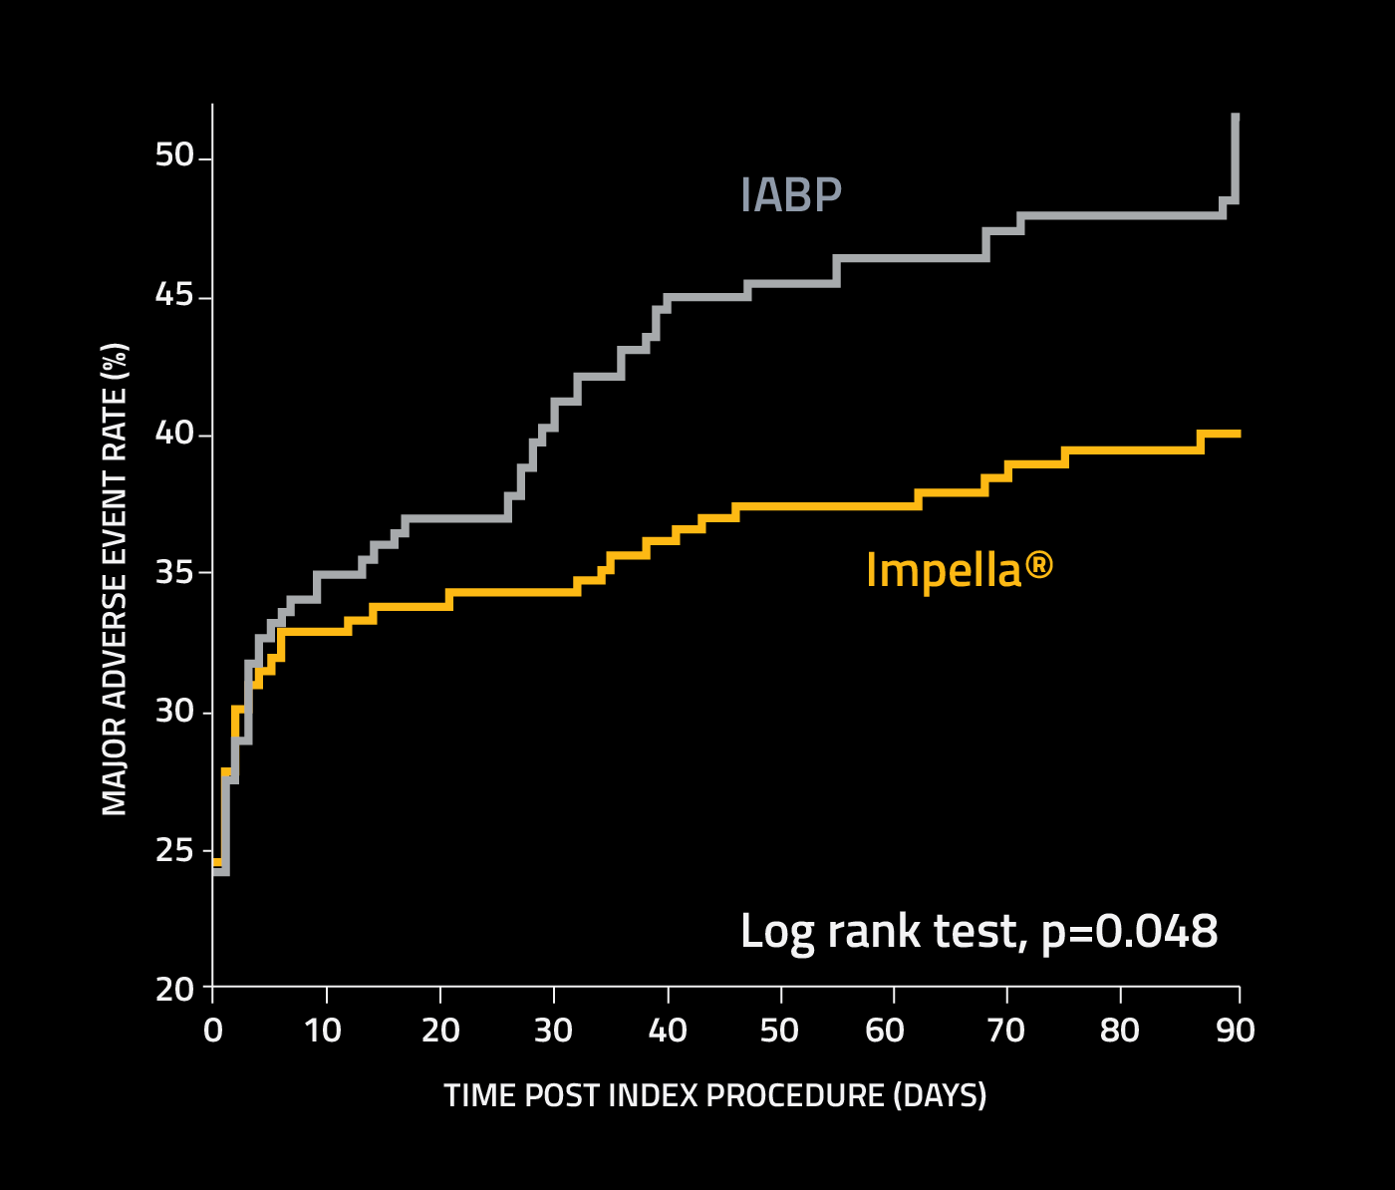
PROTECT II: Per Protocol MAE (N=427)
IABP
IMPELLA
p=0.023
p=0.092
N=211
N=216
N=210
N=215
O’Neill et al, Circulation. 2012;126(14):1717-27
Notes:
24
15/09/2019
HCS-PP00611 rA_Impella Technology - Clinical Evidence and Investigations_DRAFT, SF edits incorporated

Slide 25
Hemodynamic Support Effectiveness
Cardiac Power Output
Secondary Endpoint
Maximal Decrease in CPO on device Support from Baseline (CPO= (CO x MAP)/451 Watts)
IABP
Impella
N=138
N=141
- 4.2 ± 24
p=0.001
- 14.2 ± 27
O’Neill et al, Circulation. 2012;126(14):1717-27
Notes:
The secondary endpoint of the study was maximum decrease in cardiac power output while on support, which was a measure of hemodynamic stability. Impella was able to maintain stability better than IABP.
25
15/09/2019

Slide 26
Impella Maintains Better Patient Hemodynamics
As Ischemia Increases
Procedural Decrease in Arterial Pressure from Baseline
Baseline
Protected
PCI
IABP
Impella
N = 325
p <0.001
p =0.007
p =0.026
FDA Approved Randomized Controlled Trial
Protect II
Kovacic, et al. J Interv Cardiol. 2015 Feb;28(1):32-40
Notes:
The other aspect of how Impella protects hemodynamics during a case (as seen in the simulated case) is that it maintains arterial pressure after coronary balloon inflation even if the heart’s contractility is lost. This concept is validated in the data from the PROTECT II study. This slide looks at the maximum decrease in mean arterial pressure as you treat differing numbers of coronary vessels. The yellow bars are the Impella-protected patients, and you can see that these patients had smaller decreases in mean arterial pressure across all subsets of patients treated which enable operators to perform a more extensive or complete revascularization.
In fact, Impella protected patients experienced the most benefit when three vessels treated.
26
15/09/2019

Slide 27
Impella Reduces Peri & Post Procedural MACCE
30
MACCE = Death, Stroke, MI, Repeat revasc.
29% reduction
In MACCE
25
IABP
N=211
MACCE (%)
20
Impella®
15
N=216
10
p=0.042
0
10
20
30
40
50
60
70
80
90
Time Post Procedure (day)
FDA Approved Randomized Controlled Trial
Protect II
Dangas GD. Am J Cardiol. 2014 Jan 15;113(2):222-8
Notes:
This slide shows the overall MACCE Kaplan-Meyer curves from the PROTECT II study. Use of Impella during the PROTECT II trial resulted in a 29%, overall reduction in MACCE events as compared to use of the IABP at 90 days.
27
15/09/2019

Slide 28
Impella Reduces MACCE with More Complete Revascularization
MACCE
at 90 Days
p=0.747
p=0.015
44%
Reduction
IABP
N=80
Impella
N=77
IABP
N=130
Impella
N=130
1 Vessel Treated
2 or 3 Vessels Treated
FDA Approved Randomized Controlled Trial
Protect II
Protect II FDA PMA data
ULM Included in 2 or 3 Vessels
Notes:
The largest reductions in MACCE rates were demonstrated with more extensive revascularization. The bars on the left show patients where one vessel was treated. The patients on the right side of the slide, where two or three vessels were treated, did show a difference. In the Impella protected arm, MACCE rates were decreased by 44% in patients having two or three vessels treated. This result is statistically significant.
28
15/09/2019

Slide 29
Unprotected left main experience
M2-041-17

Slide 30
Conclusion
Prophylactic placement of percutaneous left ventricular hemodynamic support seems to be appropriate in high-risk patients with ULM and adverse clinical risk profile.
Use of Impella enabled nearly complete revascularization with favorable MACCE rates across all Syntax Score tertiles and with low complication rates
30 day mortality was ~ 50% lower than the predicted STS mortality for CABG in these patients
M2-041-17

Slide 31
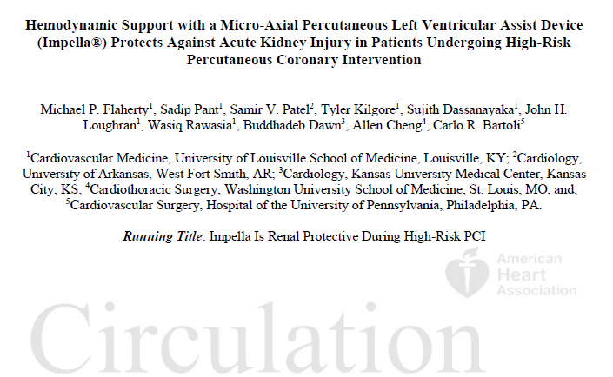
Impella 2.5 Heart Pump Can Reduce Risk of Acute Kidney Injury in HRPCI
IM2-024-17
Notes:
31

Slide 32


Renal protective effect

Slide 33
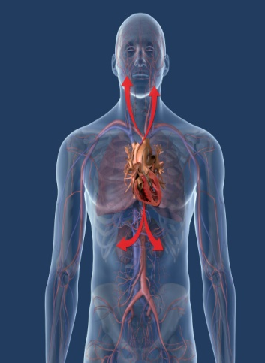


Heart Failure & Coronary Artery Disease (CAD)
Depressed Ejection Fraction
New Treatment Option
Elective PCI
Urgent PCI
Advanced Heart Failure
&
Coronary Artery Disease
Unstable
Angina/NSTEMI
&
Coronary Artery Disease
Protected PCI
with the Impella®
Heart Pump
Active Chest Pain
Low Ejection Fraction
Safe & Effective
Better Quality of Life¹
Home Faster ²
Common Fatigue
Low Ejection Fraction
Poor Quality of Life
Inoperable or Surgery unlikely
O’Neill WW et al. Circulation. 2012 Oct 2:126(14):1717-27
Gregory D, et al. American Health & Drug Benefits 2013 Mar;6(2):88-99
IMP-1112-16 .v3
Notes:
Coronary disease is the most common cause of heart failure and is an important therapeutic target for improving morbidity and mortality associated with heart failure.
Protected PCI with Impella heart pump is a new treatment option found safe and effective for patients with depressed LV function an coronary artery disease amenable to PCI.
The procedure benefits patients presenting with advanced heart failure an CAD for Elective PCI or with UA or NSTEMI for an urgent PCI.
The data shows that protected PCI with Impella in these patients is associated with shorter hospital stay and improvement of quality of life post PCI
33

Slide 34
What Patients are We Talking About – Surgeons View = Surgical Ineligibility
Patient
Comorbidities
“Non-Graftable”
Coronary Artery
Disease
advanced age, recent ACS or NSTEMI, prior surgery, pulmonary or renal disease, high STS or Euroscore, frailty, hepatic disease, contrast nephropathy, “mild dementia”, ineligible for cardiac surgery, DAPT, JW
CTO, Poor targets, poor conduit, atretic LIMA, Subclavian stenosis, Left arm AV fistula
Protected
PCI
Patients
Hemodynamic
Compromise
Protected PCI with Impella 2.5 & Impella CP deemed
Safe & Effective by FDA for High Risk PCI
Depressed ejection fraction (LVEF<35%), High LVEDP
IMP-1112-16 .v3
Notes:
Surgeons have a similar approach when assessing patient’s surgical ineligibility. They assess the severity of the CAD, the left ventricular ejection and the patients comorbidities. However different criteria are considered when assessing the coronary artery disease and patients co-morbidities as shown in this VEEN diagram.
34

Slide 35

Hemodynamic Support For High Risk Patients
Patient
Comorbidities
Complex
Coronary Artery
Disease
Heart failure, diabetes, advanced age, peripheral vascular disease, unstable angina/NSTEMI, renal insufficiency, prior CABG, ineligible/prohibitive CABG risk
Protected
PCI
Patients
Multi-vessel disease and left main disease, complex lesion characteristics (bifurcations, calcification), CTO esp. retrograde approach
Stable but, depressed LV ejection fraction (LVEF<35%), elevated LVEDP
Hemodynamic
Compromise
PCI
HEART TEAM ASSESSMENT
CABG
Need for Hemodynamic Support Confirmed
NO
YES
Protected PCI
Conventional PCI
Post Procedure Management
Stable Hemodynamics
Transient Hemodynamic Instability
Multiple hypotensive events
No reflow
Dissection/Perforation
Unstable Hemodynamics
Right Heart Catheterization
Wean in Lab
Continue Impella and Transfer to CCU
Reassess support needs after 6 hours
Stabilize Hemodynamics
Continue Impella and Transfer to CCU
Best Practice: Complete Revascularization with Optimal Lesion Treatment
IM2-027-17

Slide 36
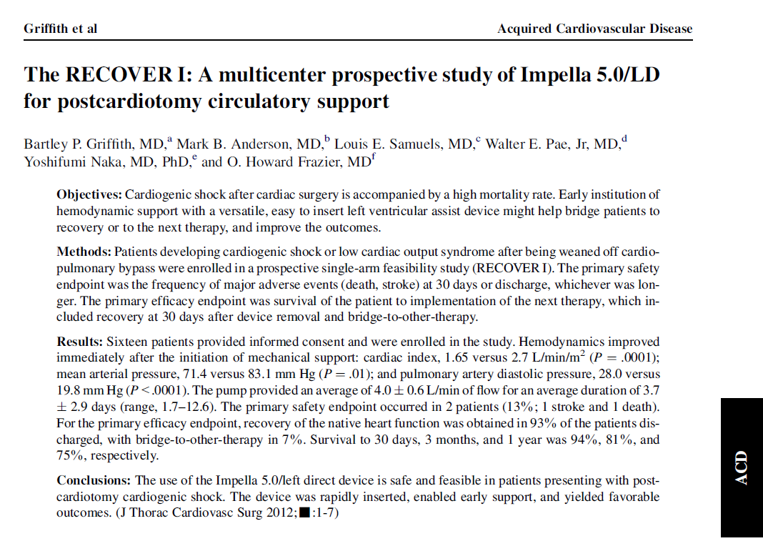
Griffith et. al. J Thorac Cardiovasc Surg. 2013 Feb;145(2):548-54

Slide 37
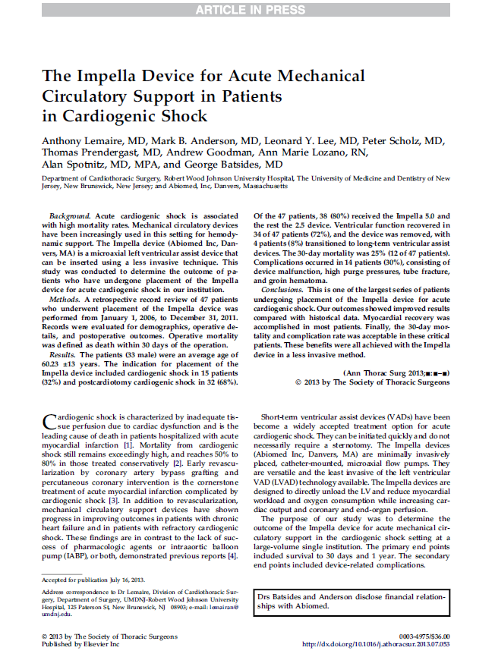
Myocardial Recovery is the Most Likely Outcome with Impella
30 Day Survival = 72%
4/34
Bridge to Bridge (12%)
30/34
Heart recovery (88%)
N=47 underwent Impella placement from Jan 1, 2006 to Dec 31, 2011
HCS-PMA-PP00611-079 rD
Lemaire, A, et. al. Annals of Thoracic Surgery, 2013

Slide 38
implantation of Impella on top of may improve survival of patients with cardiogenic shock
157 ECMO pts, 34 ECMO+Impella pts.
Propensity match 2:1 42 ECMO vs 21 ECMELLA
Hospital mortality was 48% vs. 74%
Bridging to recovery or next therapy 62%vs.36%
Patients who had myocardial recovery and weaning
had a higher LVEF at discharge 52.5% vs. 37.5%
No significant difference in SAVE score
SAVE is a survival prediction tool for refractory CS patients receiving VA-ECMO, obtained from a database of ∼3800 patients.

Slide 39
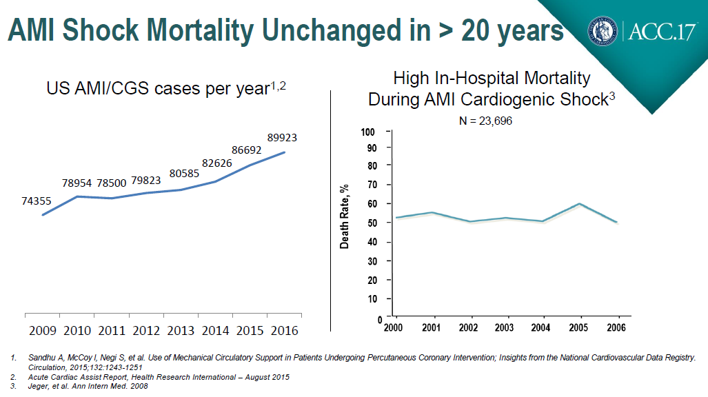
Mortality Plateaued and Incidence is Increasing
Notes:
39

Slide 40
Inotropes and Vasopressors Increase Myocardial Oxygen Demand by Increasing Heart Rate and Afterload
 | HR | BP | SVR
Norepinephrine | 0 or
Dopamine
Epinephrine
Milrinone
Dobutamine
IMP-1221-16
Notes:
15/09/2019
40

Slide 41
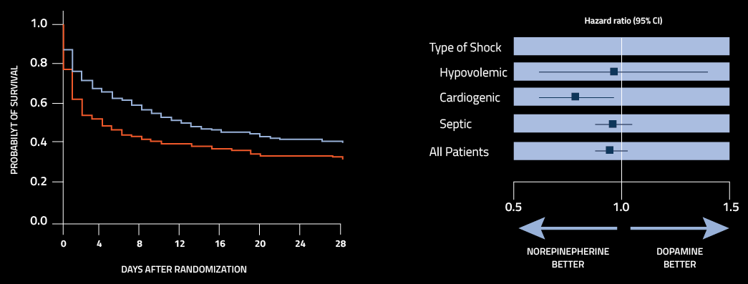
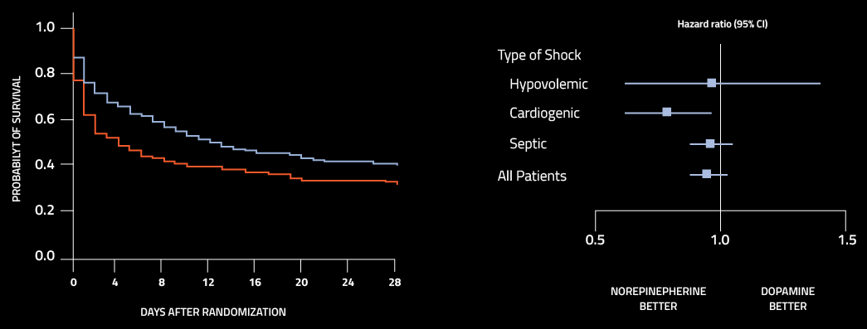
Dopamine is Associated with An Increased Risk of Mortality in Cardiogenic Shock
Norepinephrine
Dopamine
log-rank p value = 0.03
De Backer et.al. NEJM 2010
IMP-1221-16

Slide 42
High dose Vasopressors/inotropes Associated with Increased In-Hospital mortality
Mortality Risk
N = 3462
80%
42%
21%
2%
3%
7.5%
No Inotrope
Low
Dose
Moderate
Dose
One High
Dose
Two High
Dose
Three High
Dose
Samuels LE et al , J Card Surg. 1999
IMP-1221-16
Notes:
42
Conventional therapy is largely driven by the use of inotropes and vasopressors, which have long been known to be associated with high mortality rates as both dosage and number is increased.

Slide 43

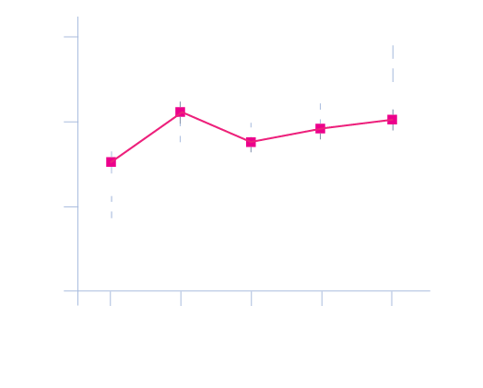
No Hemodynamic Benefit of IABP when Compared to Medical Therapy
IABP SHOCK I Randomized Controlled Trial (N=40)
IABP (n=19)
Medical Therapy (n=21)
IABP (n=19)
Medical Therapy (n=21)
Cardiac Index (L/min/m²)
Cardiac Power Output
(CPO in watts)
CPO = MAP × Cardiac Output × 0.0022
Time, days
Time, hours
Prondzinsky R, et al. Crit Care Med. 2010;38(1):152-160.
IM2-218-16
Notes:
43

Slide 44

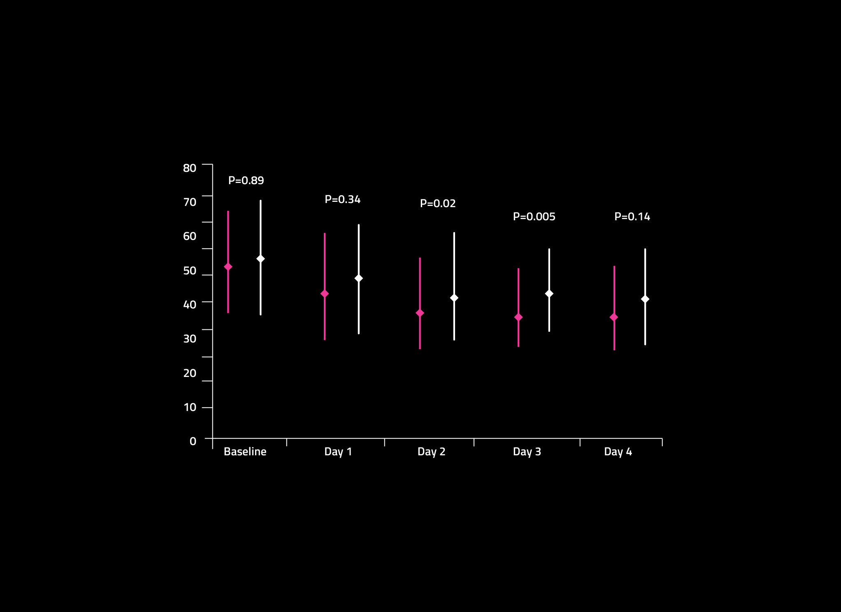
No Reduction of Disease Severity with IABP Compared to Medical Therapy
IABP SHOCK I
Randomized Controlled Trial¹
(N=40)
IABP-SHOCK II
Randomized Controlled Trial²
(N=600)
APACHE-Score
Simplified Acute Physiology Score-II
IABP (n=19)
Medical Therapy (n=21)
APACHE: Acute Physiologic and Chronic Health Evaluation—severity-of-disease classification system.³
Prondzinsky R, et al. Crit Care Med. 2010;38(1):152-160.
Thiele H, et al. N Engl J Med. 2012;367(14):1287-1296.
Knaus WA et at. Crit Care Med. 1985;13(10):818-29.
IM2-218-16
Notes:
44

Slide 45
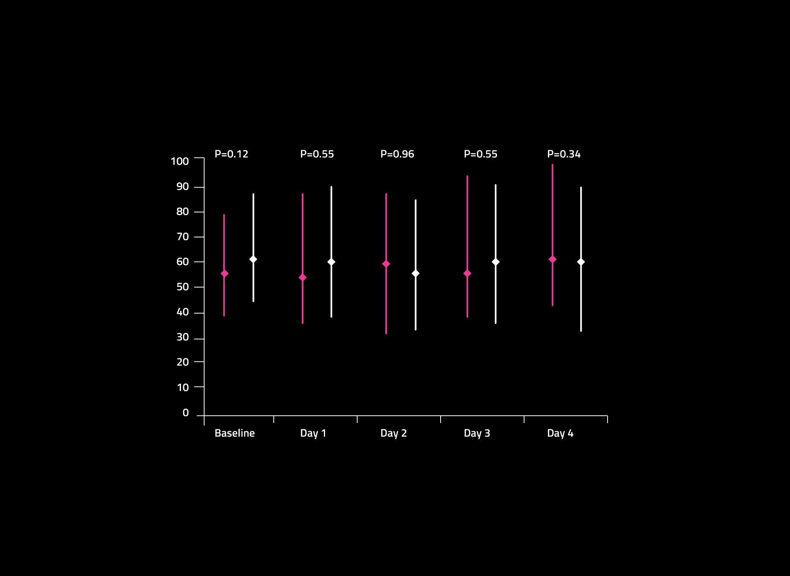
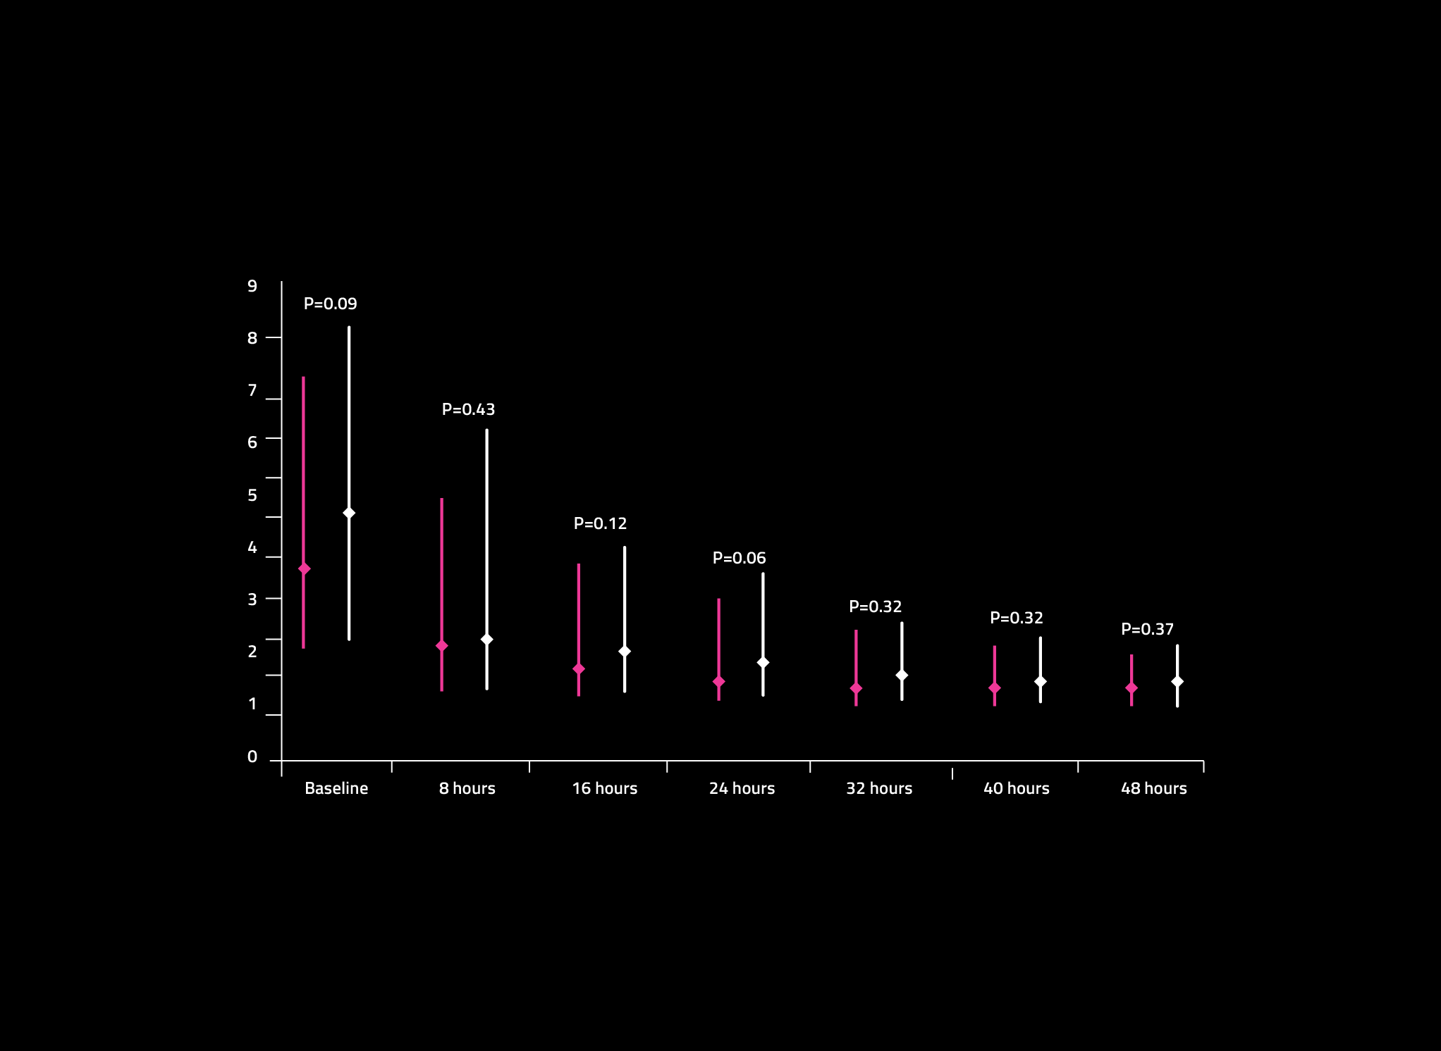
No Improvement of End Organ Perfusion Compared to Medical Therapy
IABP-SHOCK II Randomized Controlled Trial (N=600)
Serum Lactate
Renal Function (eGFR)
IABP (n=301)
Medical Therapy (n=299)
Serum Lactate (mmol/l)
Estimated Glomerular Filtration Rate
(ml/min)
IABP (n=301)
Medical Therapy (n=299)
Thiele H, et al. N Engl J Med. 2012;367(14):1287-1296.
IM2-218-16
Notes:
45

Slide 46
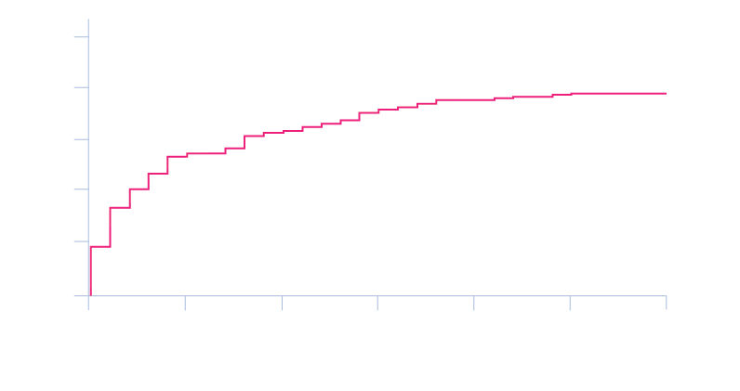

No Reduction in Mortality at 30 days And 1 year
IABP-SHOCK II Randomized Controlled Trial (N=600)^{1,2}
IABP (n=301)
Medical Therapy (n=299)
IABP (n=299)
Medical Therapy (n=296)
52%
41.3%
51%
39.7%
MORTALITY (%)
log-rank, p=0.92
Thiele H, et al. N Engl J Med. 2012;367(14):1287-1296.
Thiele H, et al. Lancet. 2013;382(9905):1638-1645.
IM2-218-16
Notes:
46

Slide 47
Randomized Trial Comparing Impella To IABP in Cardiogenic Shock
Improvement in Cardiac Index
ISAR SHOCK Randomized Controlled Trial
Impella 2.5
(L/min/m²)
IABP
2.20±0.64
N=26
P= 0.02
1.84±0.71
1.71±0.45
1.73±0.59
N.S.
Augmented CI
Ventricular Unloading
Native
Heart
Impella 2.5
Native CI
Pre-Support
On Impella
Pre-Support
On
IABP
Seyfarth et al., JACC, 2008
IMP-1220-16
Notes:
The same hemodynamic improvements can be seen in a randomized controlled trial called ISAR SHOCK with the Impella 2.5. Improvement in cardiac index while simultaneously unloading the left ventricle with statistical improvement over results observed with the IABP.
47

Slide 48
Outline
Impella pump use in Protected PCI
  “Proof of Concept”: First Patients
  Supporting Evidence: PROTECT II Trial
  Our Experience and Others: Real World Data
Impella pump use in Cardiogenic Shock
  What we knew : “Doing the same thing and expecting different results, is...”
  What we have learned: Timing is everything in life
  How we improved outcomes: Our secret sauce “Detroit CSI Protocol”
Notes:
15/09/2019
48

Slide 49
ECMO for acute heart failure

Slide 50
Definition
It refers to an innovative diagnostic-therapeutic pathway to treat refractory cardiac arrest patients by means of advanced technologies and therapies (ECMO)
ECMO (Extra Corporeal Membrane Oxygenation), associated to organ protection strategies, allows to support vital organs function, in order to come to a diagnosis and to remove pathologic causative factors

Slide 51
Cardiac Arrest Epidemiology
550000 cases/year in USA
750000 cases/year in Europe
60000 cases/year in Italy
5% survival rate for out-of-hospital cardiac arrest (OHCA)
18-20% survival rate for in-hospital cardiac arrest (ICHA)
Purple code can increase survival rate to 25-30%
Notes:
51

Slide 52
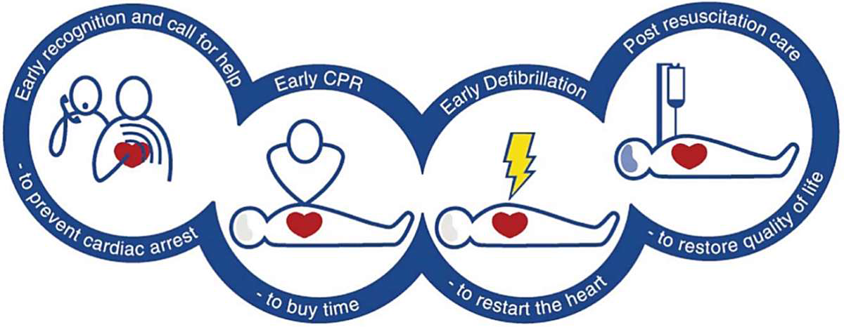
Early recognition and call for help
Early high quality CPR
Early Defibrillation
ALS and post resuscitation care
Notes:
52

Slide 53
NO FLOW TIME
From CARDIAC ARREST (CA)
To CPR
LOW FLOW TIME
From CARDIOPULMONARY RIANIMATION (CPR)
To START ECLS

Slide 54
No-flow Time
The cerebral blood flow (CBF) achieved by high quality cardio-pulmonary resuscitation (CPR) is inversely proportional to the time spent without blood flow (no-flow)
2 min CPR: CBF 50%
5 min CPR: CBF 28%
10 min CPR: CBF 0%
Notes:
54

Slide 55
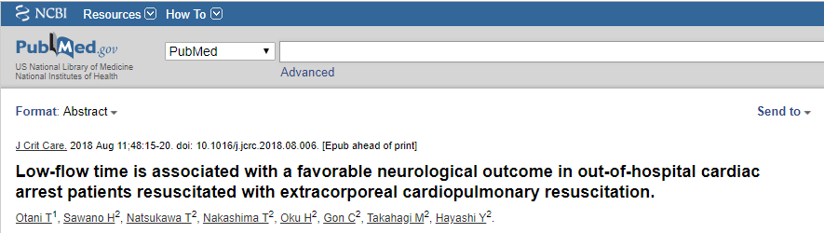
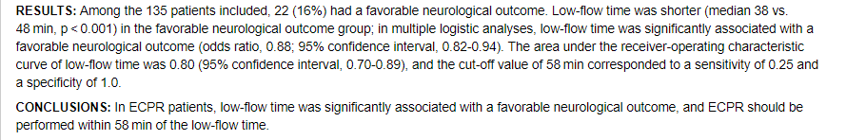
Low-flow time was significantly associated with a favorable outcome in ECPR.
No ECPR patients had a favorable outcome when low-flow time > 58 min.
To improve ECPR outcome, we need to shorten the low-flow time.

Slide 56
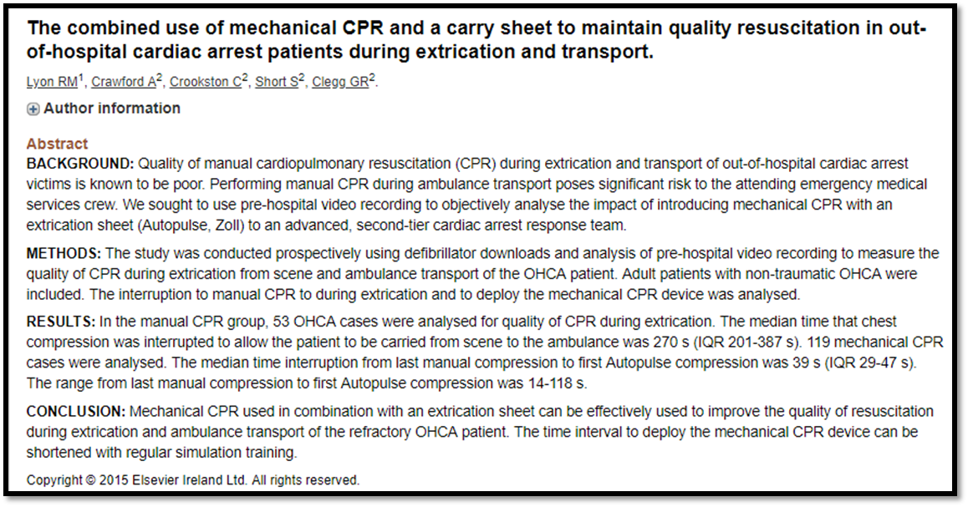
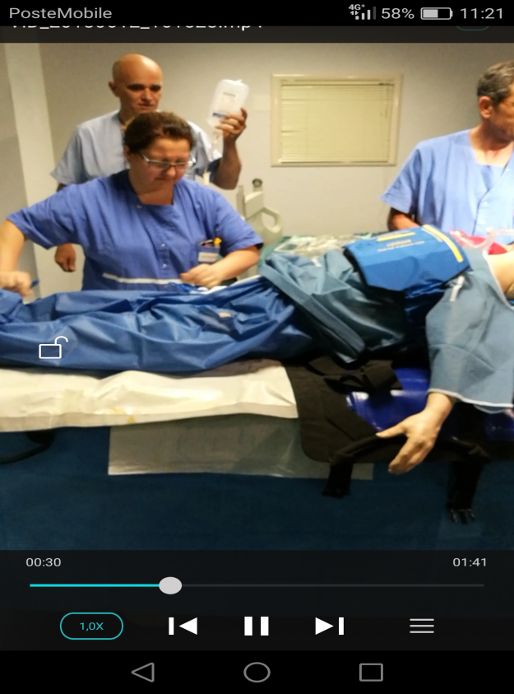
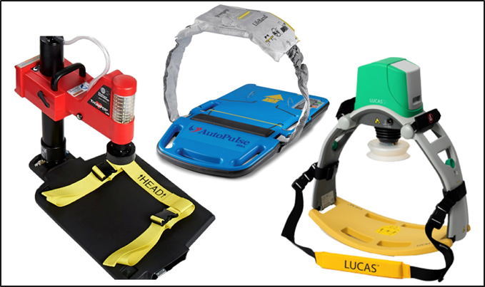
AutoPulse

Slide 57
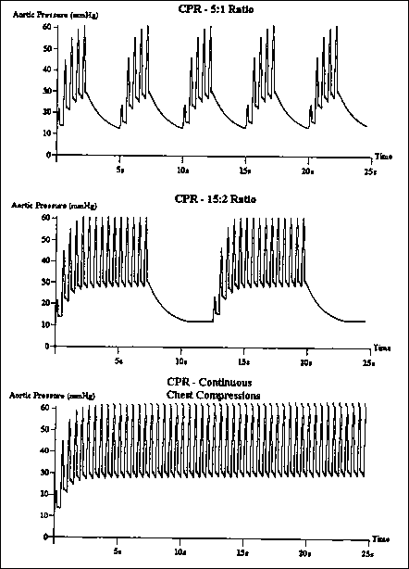
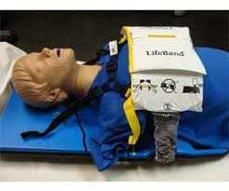
AutoPulse
Notes:
57

Slide 58
ECMO: Indications
Bridge to trasplant
Bridge to bridge
Bridge to decision
Bridge to explant
Bridge to recovery
Notes:
58

Slide 59
Refractory Cardiac Arrest
Refractory cardiac arrest due to VT/VF that doesn’t obtain ROSC after the treatment of so called ‘catena della sopravvivenza’, which is composed of 3 DC shocks and IV o IB 300mg of Amiodaron.

Slide 60
ECMO in Refractory Cardiac Arrest
Witnessed CCA
CCA with VF, VT or refractory PT
If no-flow < 6 min with VF, VT, PT, asystolia or PEA
Accidental hypothermia (T°<32)
Age between 12 and 75 yrs
Notes:
60

Slide 61
ECMO in Refractory Cardiac Arrest
Not witnessed CCA
Age <12 or > 75 yrs
Comorbidity:
  Suspected aortic dissection
  Severe peripheral artery disease
  Advanced heart failure without transplantation indication
  Severe aortic insufficiency
PEA or asystolia if age > 50 yrs
Notes:
61

Slide 62
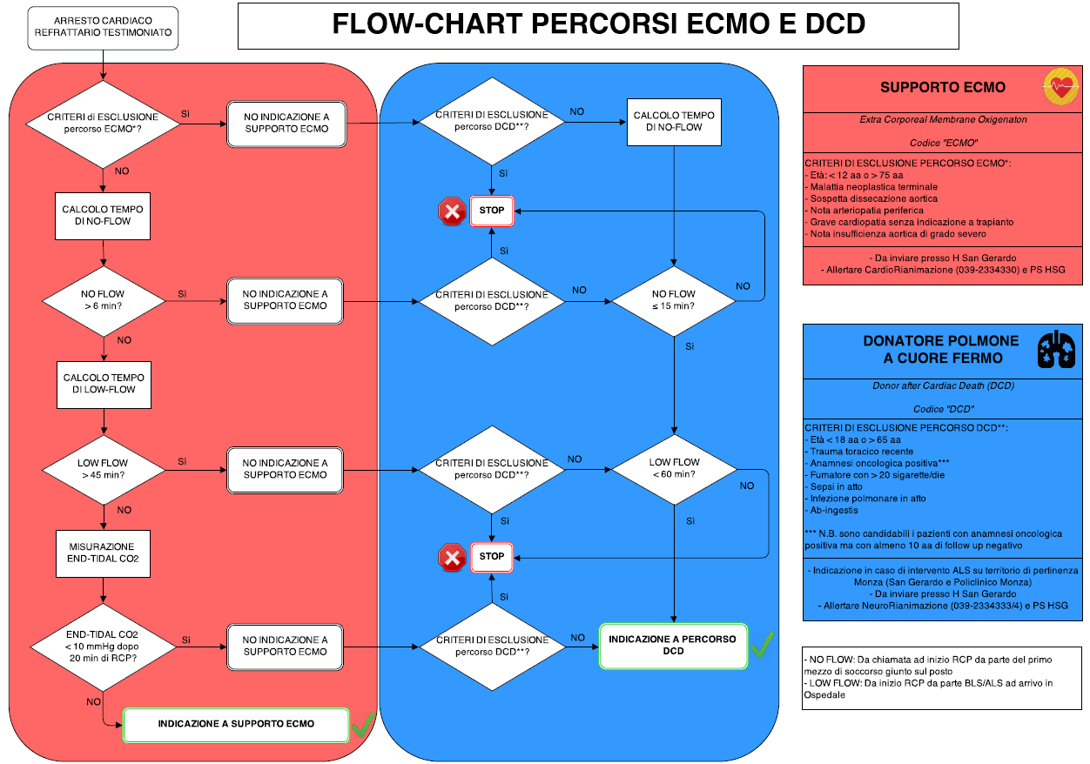
Notes:
62

Slide 63
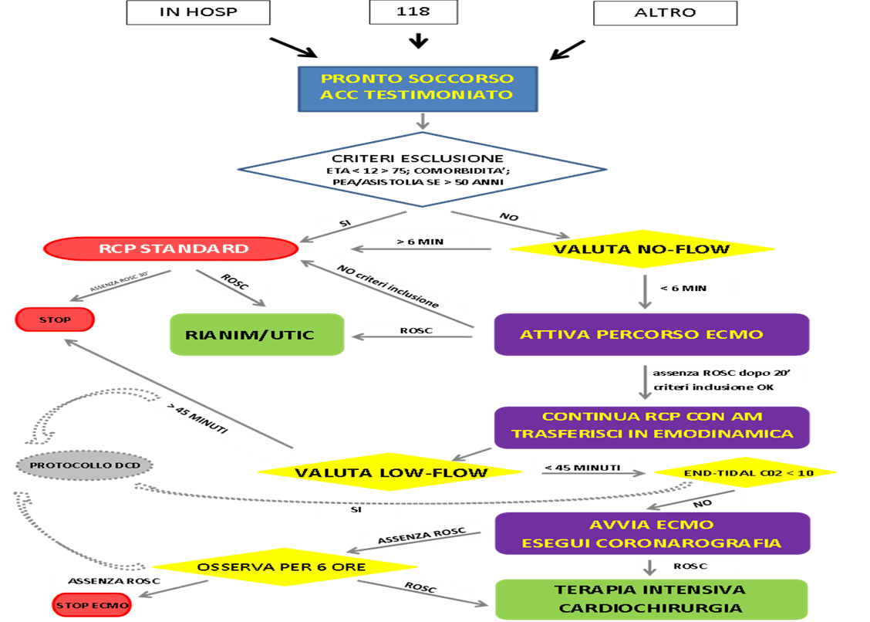
PDTA - University Hospital Policlinico Bari - Italy

Slide 64
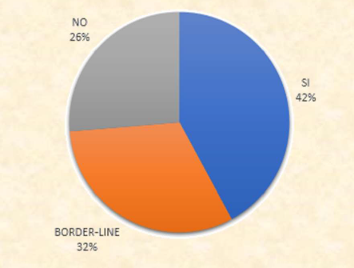
In-hospital Cardiac Arrest:
Policlinico 2016
19 Cases (14 M, 5 W)
Age between 19 and 68 yrs
8 Included cases
6 Border-line cases
5 Excluded cases
Notes:
64

Slide 65
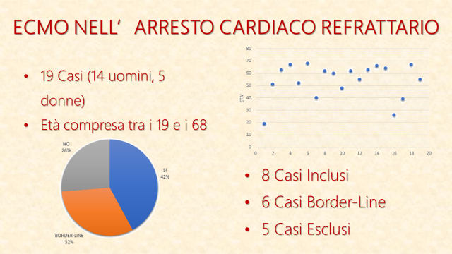

Slide 66
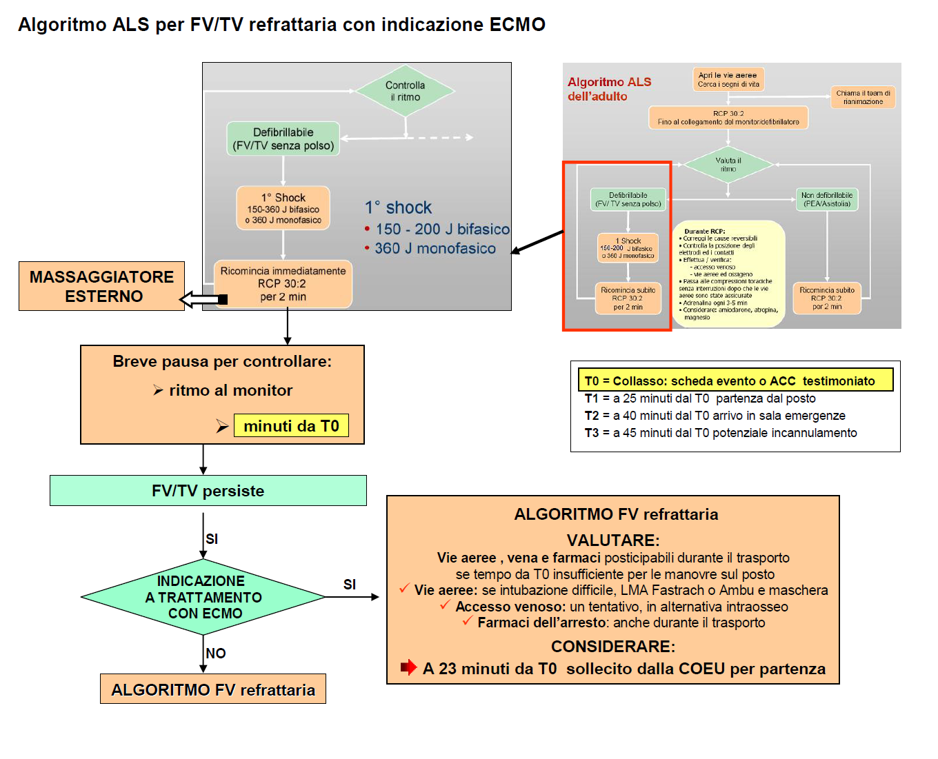
Notes:
66

Slide 67
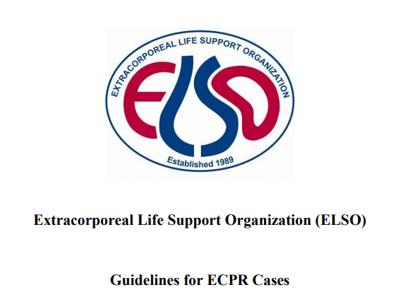


During Cannulation
Preassembled circuit without bubbles H24
Collaboration during cannulation
Reduction of the damage due to ischaemia- reperfusion

Slide 68


Myocardial Reperfusion Damage
Reversible
Arrhythmies
Myocardial stunning
Irreversible
3. Microvascular obstruction
Reperfusion damage

Slide 69

Kidney Reperfusion Damage
EAKI

Slide 70
Cerebral Reperfusion Damage
MODERATE HYPOTHERMIA
32/34 °C after cardiac arrest start ECMO
During the next 24h T≈33 °C
After 24h, progressive warm up of 1°C/h
Every °C > 37 in the first 48h after the cardiac arrest increase the risk of neurological damage.
100%
75%
NEGATIVE NEUROLOGICAL OUTCOME(%)
50%
25%
NORMOCAPNIA ONLY ONLY TOGHETHER
HYPERCAPNIA HYPOCAPNIA

Slide 71


Organ Donation After Death
HEART-BEATING DONATION – due to brain death
NON HEART-BEATING DONATION – due to cardiac death
NEW CLASSIFICATION
DBD – Donation after brain death
DCD – Donation after cardiac death
ECD – Extended criteria donation
CLASSIFICATION RELATED ON MODALITY PERFUSION BEFORE THE EXPLANT
DDNP – Deceased donor with natural perfusion (DBD)
DDAP – Deceased donor with absent or artificial perfusion (DCD)

Slide 72

In Situ Regional Perfusion
OBJECTIVE:
Prevent the ischaemic irreversible damage and recovery from ‘’ warm ischaemic damage’’
KEY POINTS:
Recovery of O2 flow
Metabolic support
Less time spending
Functional valutation
TECHNICAL ASPECTS:
Regional perfusion with cold solution at 4°C
Necmo -> Normothermic extracorporeal membrane oxygenation

Slide 73
Perfusionist
Interventional cardiologist
Nursing Team
Cath-Lab
Cardiac Surgeon
Anesthesiologist
Notes:
73

Slide 74
REFERENCES
Institute of Medicine. Guidelines for Clinical Practice. From Development to Use. Washington DC: National Academy Press, 1992
Delibera Giunta regionale Emilia Romagna n. 1173 del 25/07/2016 “Adozione del piano programma 2016-2018 dell'Agenzia sanitaria e sociale regionale e approvazione della relazione annuale 2015 e della relazione 2011-2015;
European Pathway Association: http://e-p-a.org/sito-internet-e-p-a/percorsi-diagnostici-terapeutici-e-assistenziali-pdta/
Aress – Piemonte: Raccomandazioni per la Costruzione di Percorsi Diagnostico terapeutici Assistenziali (PDTA) e Percorsi Integrati di Cura (PIC) nelle Aziende Sanitarie della Regione Piemonte
Philip H. Kay, Christopher M. Munsch: Tecniche di circolazione extracorporea
Robert H. Bartlett e coll.: ECMO Extracorporeal Cardiopulmonary Support in Critical Care
Billie Lou Short: ECMO Specialist Training Manual
Henry R. Halperin, MD, MA, Norman Paradis, MD, Joseph P. Ornato, MD, FACC,
Menekhem Zviman, PHD, Jennifer LaCorte, RN, Albert Lardo, PHD, Karl B. Kern, MD, FACC. Cardiopulmonary Resuscitation With a Novel Chest Compression Device in a Porcine Model of Cardiac Arrest Improved Hemodynamics and Mechanisms. (Journal of the American College of Cardiology © 2004
The American College of Cardiology Foundation. Published by Elsevier Inc.

