Slide 1
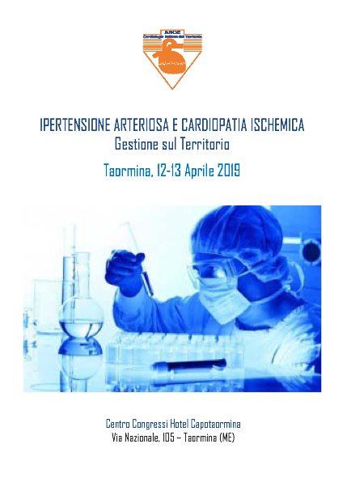

Slide 2
Calabrò P.
(Caserta)

Slide 3



ANCE 2019
IPERTENSIONE ARTERIOSA E CARDIOPATIA ISCHEMICA
Gestione sul Territorio
ATEROSCLEROSI E PLACCA VULNERABILE:
TERAPIA DI ASSOCIAZIONE PER IL RAGGIUNGIMENTO DEL TARGET LDL
Paolo Calabrò
Università della Campania «Luigi Vanvitelli»
AORN Sant’Anna e San Sebastiano, Caserta

Slide 4
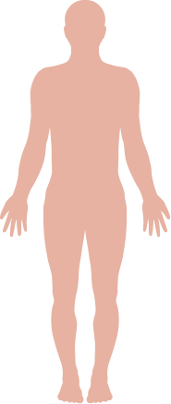
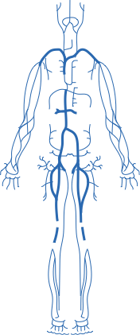

CV events are a manifestation of atherosclerotic disease
Ischaemic stroke
Transient ischaemic attack
Myocardial infarction (MI)
Unstable angina pectoris
Sudden death
Intermittent claudication
Critical limb ischaemia
Gangrene necrosis
  http://emedicine.medscape.com/article/153647-clinical. Accessed 22 Jan 16.
Notes:
Atherosclerosis of the arteries is a clinical effect of advanced atherosclerotic plaque. Blood flow is impaired when >50% of the lumen diameter is occluded. Increased metabolic activity and oxygen demand can lead to symptoms of inadequate blood supply to the target organ, seen clinically as stable angina pectoris, intermittent claudication, and mesenteric angina.
Rupture of the atherosclerotic plaque exposes the highly thrombogenic subendothelium and lipid core, which may cause thrombus formation, leading to partial or complete occlusion of flow in the involved artery. The effects will be seen clinically as unstable angina pectoris, MI, peripheral ischaemia and stroke.
Reference
http://emedicine.medscape.com/article/153647-clinical. Accessed 22 Jan 16.

Slide 5
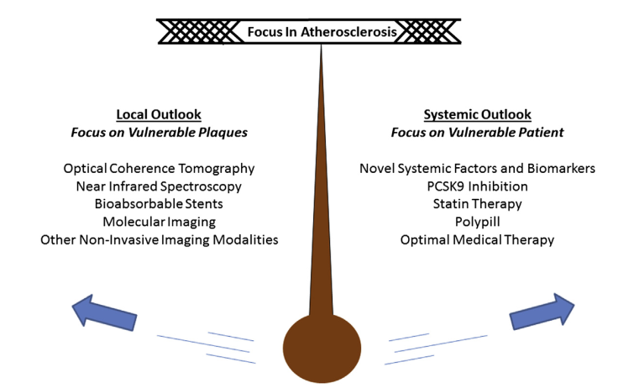
Swinging Focus of Interest in Atherosclerosis
Tomey et al. JACC, 63;16 2014
Notes:
Atherosclerosis is usually viewed as a chronic progressive disease characterized by continuous accumulation of atheroma within the arterial wall.

Slide 6
LDL-C is a major risk factor for atherosclerotic CVD
LDL-C: primary risk factor in coronary heart disease (CHD) and causative for development of coronary atherosclerosis⁵
Lipid disorders¹
(LDL↑, HDL↓, TG↑)
Hypertension¹
Smoking, physical inactivity¹
Metabolic syndrome²
Type 2 diabetes¹
Prior CV
event/manifest atherosclerosis³
Increased CV risk
Chronic kidney disease⁴
Age, ethnicity, gender, family history/genetic variations¹
Obesity¹
1. World Heart Federation. Cardiovascular disease risk factors.
2. Dekker et al. Circulation 2005;112:666–673. 3. Bhatt et al. JAMA 2010;304:1350–1357.
4. Go et al. N Engl J Med 2004;351:1296–1305. 5. Grundy et al. J Am Coll Cardiol 1999;34:1348–1359.
Notes:
Non-modifiable risk factors for atherosclerotic CVD include family history, ethnicity and age.
Preventable or treatable risk factors include smoking, hypertension, high cholesterol, obesity, physical inactivity, and type 2 diabetes.
Reference
World Heart Federation. Cardiovascular disease risk factors. www.world-heart-federation.org/cardiovascular-health/cardiovascular-disease-risk-factors. Accessed 13 Dec 2015.

Slide 7
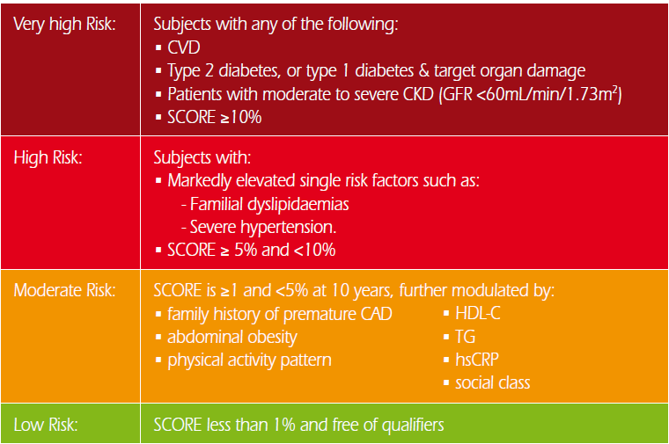
ESC: Goal-directed Prevention (2016)
<70 mg/dl
<100 mg/dl
<115 mg/dl
European Heart Journal (2016) 37, 2315–2381

Slide 8
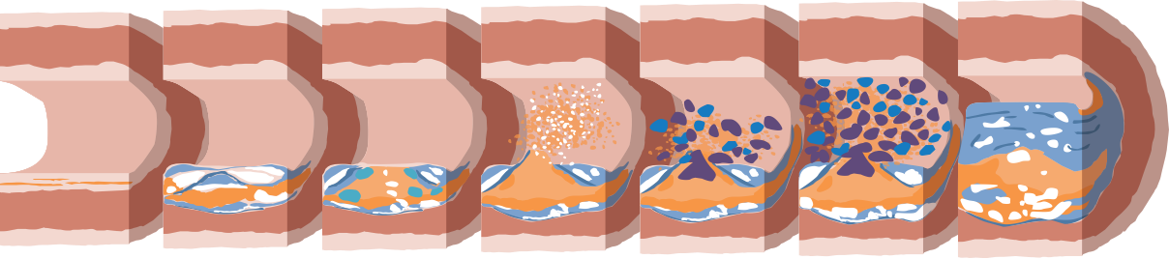
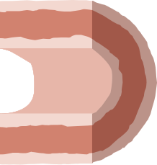

LDL-C is involved at every stage of atherosclerotic plaque formation
Acute event
Cardiac vessels − MI
Brain vessels − stroke
PAD − critical limb ischaemia
Progression…
Endothelial
dysfunction
Fatty acid streaks
Vulnerable
plaque
Obstructive atherosclerotic disease
Plaque
Rupture
Thrombus
LDL-C reduces eNOS activity¹
Increasing foam cell formation²
High concentration of lipid-filled macrophages,
thin fibrous cap, necrotic core²
Lesion enlarges, arterial lumen narrows, blood flow hampered³
Pro-coagulant pathways may dominate, leading to occlusive blood clot³
LDL and macrophages within the vessel wall form foam cells²
Foam cell necrosis²
Coagulation and platelet recruitment on exposure to tissue factor²
1. Davignon et al. Circulation 2004;109(23 Suppl 1):III27–III32.
2. Glass et al. Cell 2001;104:503–516. 3. Libby. Nature 2002;420:868–874.
Notes:
Elevated plasma LDL-C levels lead to infiltration of LDL-C into the arterial wall and the formation of an atherosclerotic plaque, resulting in overt ASCVD.
Early intimal endothelial lipidoses called 'fatty streaks' are found in childhood and adolescence.^{1–3} Modified LDL-C molecules in the arterial wall are susceptible to oxidation, which is thought to play a role in the progression of atherosclerosis in CVD.^{3–6} Macrophages recruited to the intima take up the excess cholesterol through the action of scavenger receptors to become foam cells;^{3–7} Intimal smooth muscle cells may also proliferate, contributing to foam cell formation and synthesising extracellular matrix proteins to form a fibrous cap.⁷
Necrosis of the foam cells leads to the formation of a necrotic core and accumulation of extracellular cholesterol. Macrophage secretion of matrix metalloproteinases and neovascularisation contribute to weakening of the fibrous plaque. Plaque rupture exposes blood components to tissue factor, initiating coagulation, the recruitment of platelets, and thrombus formation.⁷
The progression of the lesion eventually leads to plaque rupture.^{3,4,8} Following erosion or rupture of the atherosclerotic plaque, recruitment of circulating platelets and inflammatory cells and fibrin deposits lead to arterial thrombosis that may compromise the arterial lumen, leading to the development of acute ischaemic syndromes.⁹
Although a ruptured fibrous cap causes about 75% of acute MIs, most episodes probably cause no clinical symptoms. When fibrinolytic mechanisms prevail, a limited mural thrombus forms instead of an occlusive and sustained blood clot. However, the healing response leads to fibrous tissue formation.⁶
Abbreviations: ASCVD, atherosclerotic cardiovascular disease; eNOS, endothelial nitric oxide synthase, also known as NOS3 or constitutive NOS (cNOS).
References
1. Strong et al. J Atheroscler Res 1969;9:251–265.
2. Sternby et al. Bull World Health Organ 1999;77:250–257.
3. Hansson. N Engl J Med 2005;352:1685–1695.
4. Rader et al. Nature 2008;451:904–913.
5. Duewell et al. Nature 2010;464:1357–1361.
6. Libby. Nature 2002;420:868–874.
7. Glass et al. Cell 2001;104:503–516.
8. Francis et al. Exp Clin Cardiol 2011;16:77–86.
9. Badimon et al. J Intern Med 2014;276:618–632.

Slide 9
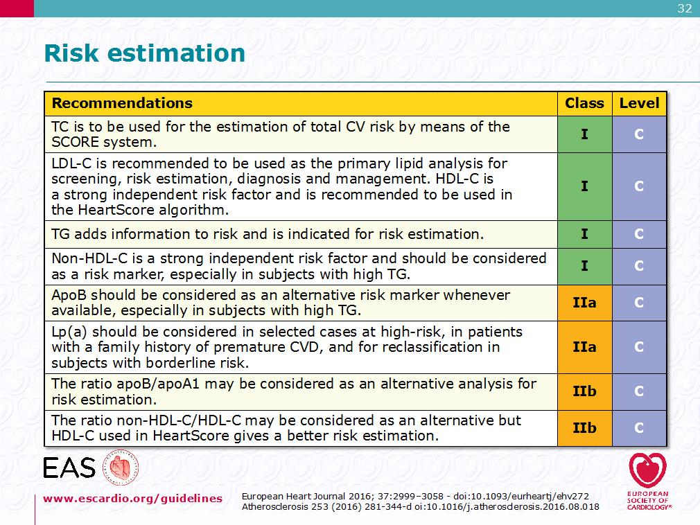
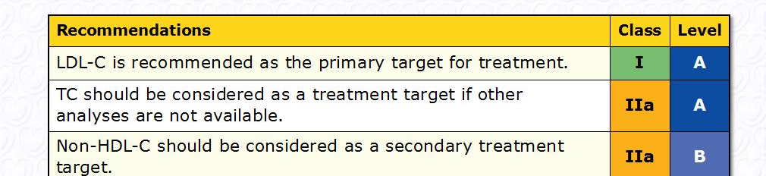

Slide 10


Plaque regression is the ideal goal of lipid-lowering therapy
Plaque regression…

Slide 11
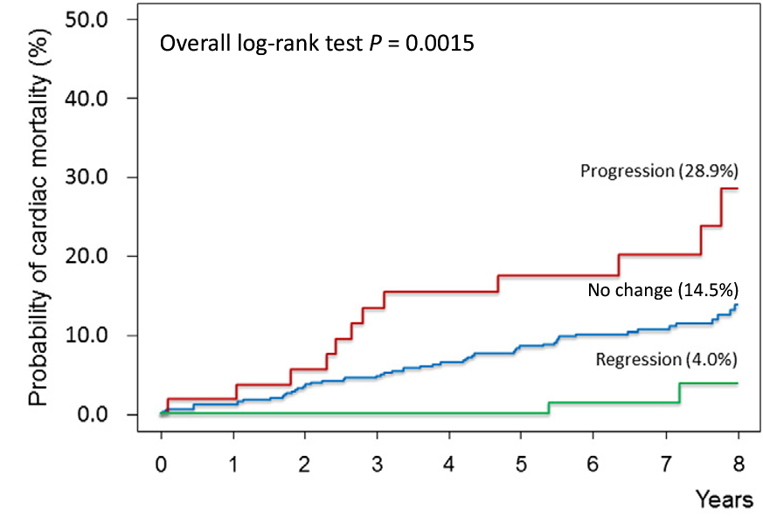
Atherosclerosis regression is associated with reduced coronary death
Ndrepepa G et al. Am Heart J 2016;177:9–16.
Notes:
Ndrepepa et al. assessed the effect of atherosclerosis progression or regression on mortality in 605 patients with angiographically proven coronary artery disease.
The patients underwent angiography at baseline and two years later.
Atherosclerosis progression or regression was defined as a decrease or increase in the mean minimal lumen diameter (MLD) of ≥0.2 mm in non-stented segments on angiography at 2 years, compared to baseline.
The primary outcome was all-cause mortality.
Based on the angiographic results at 2 years, patients were divided into three groups: progression of atherosclerosis (n = 53; 8.8%), no progression or regression of atherosclerosis (n = 472; 78.0%) and regression of atherosclerosis (n = 80; 13.2%).
There were 126 deaths over 8-year follow-up: 17 among progressors, 103 among patients with no progression/regression and 6 deaths among the regressors.
Reference
Ndrepepa G et al., Am Heart J 2016;177:9-16.

Slide 12
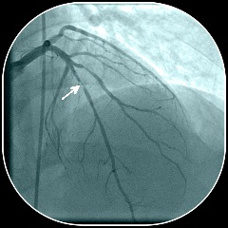
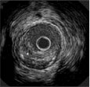
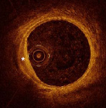
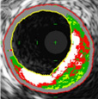
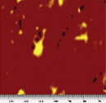
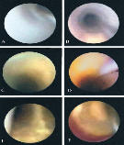
Invasive Imaging Techniques for
Coronary Arteries¹
Coronary Angiography¹
Intravascular Ultrasound (IVUS)^{1–3}
Two-dimensional silhouette of lumen only¹
0.4-mm resolution¹
Images vessel lumen and wall¹
0.08- to 0.1-mm resolution¹
Assesses changes in plaque burden, vascular remodeling¹
May be used to optimise stent placement³
Image courtesy of van Ditzhujzen NS, et al. Neth Heart J. 2011;19:442–446.
Optical Coherence Tomography (OCT)^{1,2}
Virtual Histology IVUS (VH-IVUS)^{4,5}
Images lumen and wall, plus other plaque characteristics¹
0.01-mm resolution¹
Measures near-infrared light reflected intensity from tissue¹
Analyses backscattered IVUS RF energy to create colour tissue map of wall and plaque⁴
Detects necrotic core, dense calcium, fibrous and fibrofatty tissue⁵
Image courtesy of van Ditzhuijzen NS, et al. Neth Heart J. 2011;19:442–446.
Image courtesy of Brown AJ, et al. Circ Cardiovasc Imaging. 2015;8:e003487.
Near-Infrared Spectroscopy (NIRS)^{1,6,7}
Angioscopy⁸
Creates chemogram of wall components⁷
1-mm resolution¹
Assesses lipid/protein content in atherosclerotic plaques⁷
Limited evaluation of lipid core depth¹
Images lumen and wall⁸
Atherosclerotic plaque categorised by colour⁸
Requires proximal occluding balloon for blood-free field⁸
Image courtesy of Choi B, et al. Eur Heart J. 2013;34:2047–2054.
. Image courtesy of MacNeill BD, et al. Arterioscler Thromb Vasc Biol. 2003;23:1333–1342.
RF = radiofrequency. 1. Tardif JC, et al. Circ Cardiovasc Imaging. 2011;4:319–333. 2. van Ditzhuijzen NS, et al. Neth Heart J. 2011;19:442–446 3. Hong SJ, et al. JAMA. 2015;314:2155–2163. 4. Brown AJ, et al. Circ Cardiovasc Imaging. 2015;8:e003487. 5. Vancraeynest D, et al. J Am Coll Cardiol. 2011;57:1961–1979. 6. Choi B, et al. Eur Heart J. 2013;34:2047–2054. 7. Jaguszewski M, et al. Curr Cardiovasc Imaging Rep. 2013;6:426–430. 8. MacNeill BD, et al. Arterioscler Thromb Vasc Biol. 2003;23:1333–1342.
Notes:
There are several techniques for imaging coronary arteries. Two-dimensional coronary angiography is the current standard technique for the diagnosis of atherosclerotic coronary disease. Using x-ray imaging, dye is injected into the coronary artery via a catheter inserted either into the femoral artery or the radial artery, and flow is imaged, creating a silhouette of the arterial lumen. Degrees of arterial stenosis are determined by comparing luminal narrowing with “normal” segments. This technique images only the lumen of the vessel. The limit of resolution is approximately 0.4 mm.¹⁻³
Optical coherence tomography (OCT) is an invasive, catheter-based technique that uses an infrared light source and measures reflected light intensity from tissue. It is capable of imaging the vessel wall with 0.01-mm resolution and a limited depth of 1.5 mm into the tissue. While OCT can be used in the context of percutaneous coronary interventions to assess stent apposition to the vessel wall, arterial dissections, and in-stent neointimal proliferation, its lack of ability to see through blood, requiring transient blood flow occlusion, and the limited penetration and depth of view are significant disadvantages. Thus, OCT can assess fibrous cap thickness and other plaque characteristics such as the lipid pool but cannot determine total plaque volume.^{1,4}
Near-infrared spectroscopy (NIRS) can be used to help determine the chemical components of the tissue. It relies on the phenomenon that organic molecules absorb and reflect light differently at specific wavelengths. Therefore, when near-infrared light is emitted into a tissue, the spectrum of absorbance reflects the tissue’s chemical composition. Thus, NIRS can detect and quantify lipids within an atherosclerotic plaque by creating a “chemogram”.³
Intravascular ultrasound (IVUS) is a catheter-based technique that uses an automatic catheter pullback system to acquire consecutive cross sections of the arterial wall.^{1,4}
The catheter imaging positioning is such that full thickness of the arterial wall can be visualised without a confounding effect of the projection angle. The cross-sectional plaque area for each section can be measured. IVUS can be used to assess changes in plaque burden and, in conjunction with angiography, may be used to optimise stent placement.^{1,5,6}
Virtual histology-IVUS (VH‑IVUS) is an invasive technique that uses spectral analysis of the ultrasound backscatter signal to categorise plaque into fibrous, fibrolipidic, calcific, and necrotic tissue in real time. While this technique lacks the resolution to image the thin fibrous cap, lesions with necrotic core in contact with the lumen can be identified, and have been shown to have moderate correlation with histology. However, it may overestimate these types of lesions.³
Coronary angioscopy is a catheter-based fibreoptic device that can characterise plaque composition and identify the presence of thrombus or endoluminal irregularities, such as ulcerations, fissures, or tears. Angioscopically, a normal artery appears glistening white, while atherosclerotic plaque can be categorised as yellow, indicating high concentrations of cholesterol-laden crystals seen through a thin fibrous cap. The most significant limitation of angioscopy is the need for a blood-free field, which can be achieved by inflating an occluding balloon proximally. However, this is not without risk. Since angioscopy images only the luminal surface, and while changes in the vessel wall may be reflected on the surface, this is inadequate to fully characterise alterations in plaque composition.⁷
References
Tardif JC, Lesage F, Harel F, et al. Imaging biomarkers in atherosclerosis trials. Circ Cardiovasc Imaging. 2011;4:319–333.
Balaji NR, Shah PB. Radial artery catherization. Circulation. 2011;124:e407–e408.
Dweck MR, Doris MK, Motwani M, et al. Imaging of coronary atherosclerosis – evolution towards new treatment strategies. Nat Rev Card. 2016;13:533–548.
van Ditzhuijzen NS, van den Heuvel M, Sorop O, et al. Invasive coronary imaging in animal models of atherosclerosis. Neth Heart J. 2011;19:442–446.
Nissen SE. Application of intravascular ultrasound to characterise coronary artery disease and assess the progression or regression of atherosclerosis. Am J Cardiol. 2002;89:24B–31B.
Hong SJ, Kim BK, Shin DH, et al. Effect of intravascular ultrasound-guided vs. angiography-guided everolimus-eluting stent implantation: the IVUS-XPL randomised clinical trial. JAMA. 2015;314:2155–2163.
MacNeill BD, Lowe HC, Takano M, et al. Intravascular modalities for detection of vulnerable plaque. Arterioscler Thromb Vasc Biol. 2003;23:1333–1342.

Slide 13
Aggressive LDL-C Reduction Leads to Progressively More Plaque Regression
Three recent trials utilising IVUS have confirmed regression of the coronary atherosclerotic plaque with intensive statin therapy
  REVERSAL: Reversal of Atherosclerosis with Aggressive Lipid Lowering
  ASTEROID: A Study to Evaluate the Effect of Rosuvastatin on Intravascular Ultrasound-Derived Coronary Atheroma Burden
  SATURN: Study of Coronary Atheroma by InTravascular Ultrasound: effect of Rosuvastatin versus Atorvastatin
Forbes C, et al. Curr Med Res Opin. 2016;32:1143–1150.

Slide 14
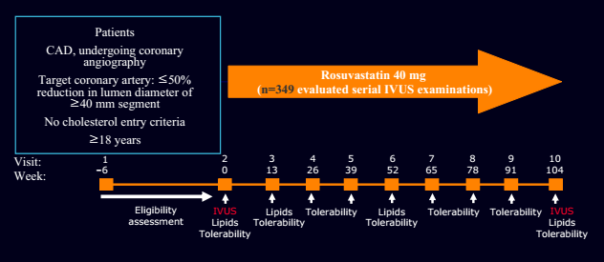
ASTEROID
To evaluate whether long-term treatment with rosuvastatin 40 mg in CAD pts resulted in coronary plaque regression (single arm study)
Nissen SE et al. JAMA. 2006;295:1556–1565.

Slide 15
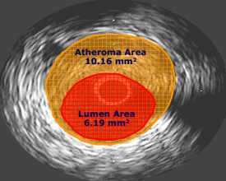
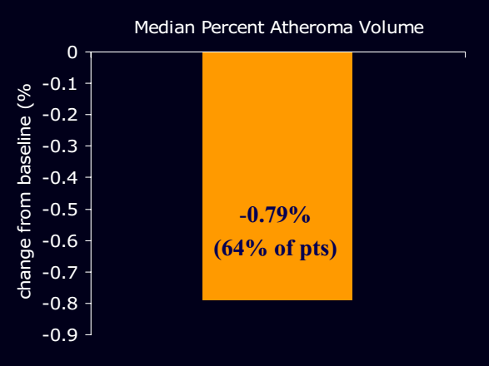
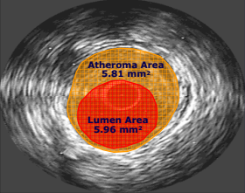
Primary Endpoint: ∆% Atheroma Volume
Very high-intensity statin therapy using rosuvastatin 40mg/d resulted in significant regression of atherosclerosis.
Nissen SE et al. JAMA. 2006;295:1556–1565.

Slide 16
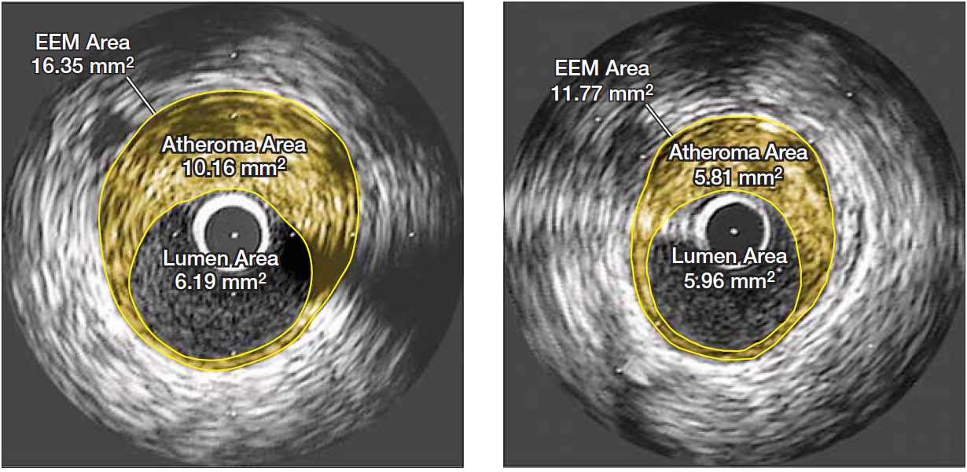
ASTEROID: Example of a patient showing marked regression of disease
Baseline
After 24 months of treatment
Median reduction in TAV = -12.5 mm³ (95% CI, -15.1 to -10.5 mm³)
Median change in PAV for entire vessel = -0.79% (97.5% CI, -1.21% to -0.53%)
EES = external elastic membrane
Nissen SE et al. JAMA. 2006;295:1556–1565.
Notes:
In the ASTEROID trial:
All patients received intensive statin therapy with rosuvastatin, 40 mg/d.
Two primary efficacy parameters were prespecified: the change in PAV and the change in nominal atheroma volume in the 10-mm subsegment with the greatest disease severity at baseline. A secondary efficacy variable, change in normalised total atheroma volume for the entire artery, was also prespecified.
The mean (SD) baseline LDL-C level of 130.4 (34.3) mg/dL declined to 60.8 (20.0) mg/dL, a mean reduction of 53.2% (P=0.001). The mean (SD) change in PAV for the entire vessel was −0.98% (3.15%), with a median of −0.79% (97.5% CI, −1.21% to −0.53%) (P=0.001 vs baseline). The mean (SD) change in atheroma volume in the most diseased 10-mm subsegment was −6.1 (10.1) mm³, with a median of −5.6 mm³ (97.5% CI, −6.8 to −4.0 mm³) (P<0.001 vs baseline). Change in total atheroma volume showed a 6.8% median reduction, with a mean (SD) reduction of −14.7 (25.7) mm³, and a median of −12.5 mm³ (95% CI, −15.1 to −10.5mm³) (P=0.001 vs baseline). Adverse events were infrequent and similar to other statin trials.
Very high-intensity statin therapy using rosuvastatin 40 mg/d achieved an average LDL-C of 60.8 mg/dL, resulting in significant regression of atherosclerosis for all three prespecified IVUS measures of disease burden. Treatment to LDL-C levels below currently accepted guidelines, when accompanied by significant HDL-C increases, can regress atherosclerosis in coronary disease patients. Further studies are needed to determine the effect of the observed changes on clinical outcome.
Reference
Nissen SE, Nicholls SJ, Sipahi I, et al. Effect of very high-intensity statin therapy on regression of coronary atherosclerosis: the ASTEROID trial. JAMA. 2006;295:1556–1565.

Slide 17
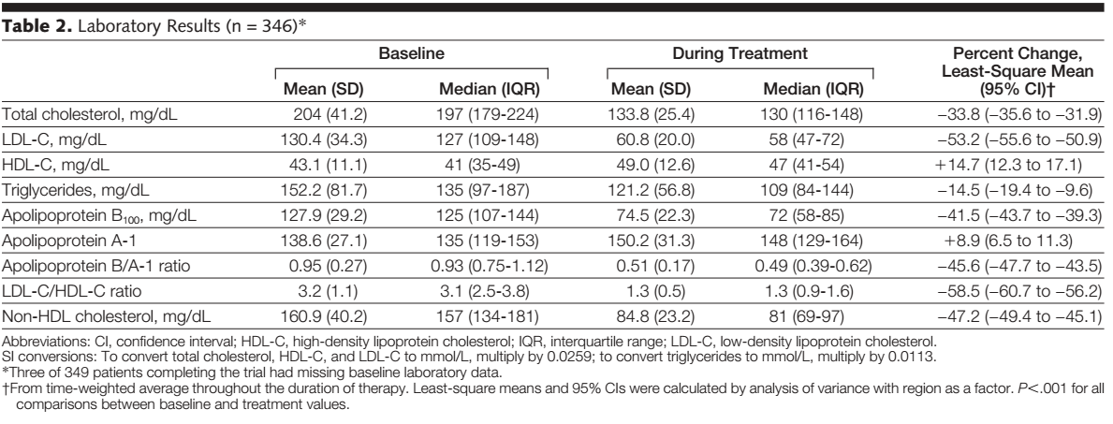
LDL-C: baseline vs statin therapy
Nissen SE et al. JAMA. 2006

Slide 18
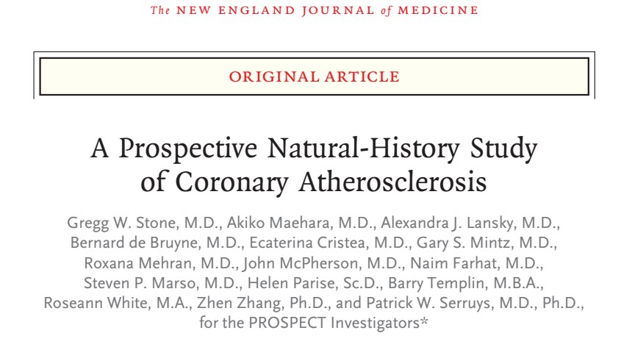
PROSPECT Study
Stone GW et al. NEJM 2011
Notes:
In a prospective study, 697 patients with acute coronary syndromes underwent three-vessel coronary angiography and gray-scale and radiofrequency intravascular ultrasonographic imaging after percutaneous coronary intervention. Subsequent major adverse cardiovascular events (death from cardiac causes, cardiac arrest, myocardial infarction, or rehospitalization due to unstable or progressive angina) were adjudicated to be related to either originally treated (culprit) lesions or untreated (nonculprit) lesions. The median follow-up period was 3.4 years.

Slide 19
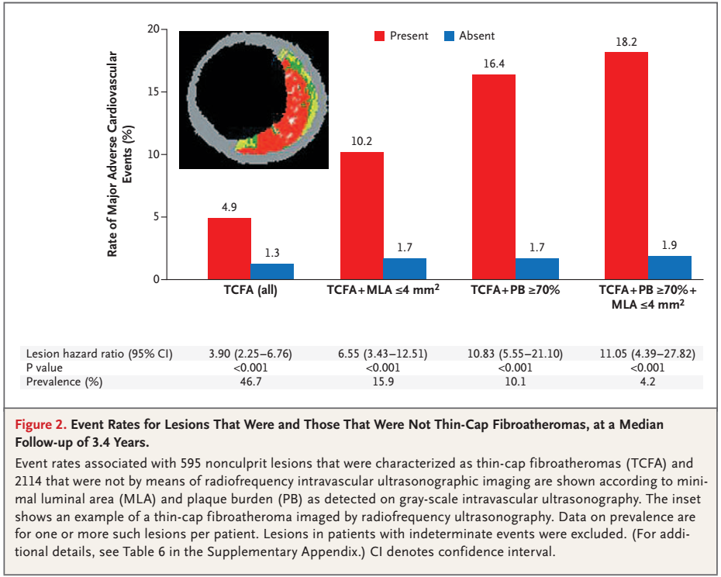
Stone GW et al. NEJM 2011
Notes:
Event rates associated with 595 nonculprit lesions that were characterized as thin-cap fibroatheromas (TCFA) and 2114 that were not by means of radiofrequency intravascular ultrasonographic imaging are shown according to minimal luminal area (MLA) and plaque burden (PB) as detected on gray-scale intravascular ultrasonography. The inset shows an example of a thin-cap fibroatheroma imaged by radiofrequency ultrasonography. Data on prevalence are for one or more such lesions per patient. Lesions in patients with indeterminate events were excluded.
Nonculprit-lesion–related major adverse cardiovascular events arose more frequently from thin-cap fibroatheromas with a large plaque burden, a small minimal luminal area, or both

Slide 20
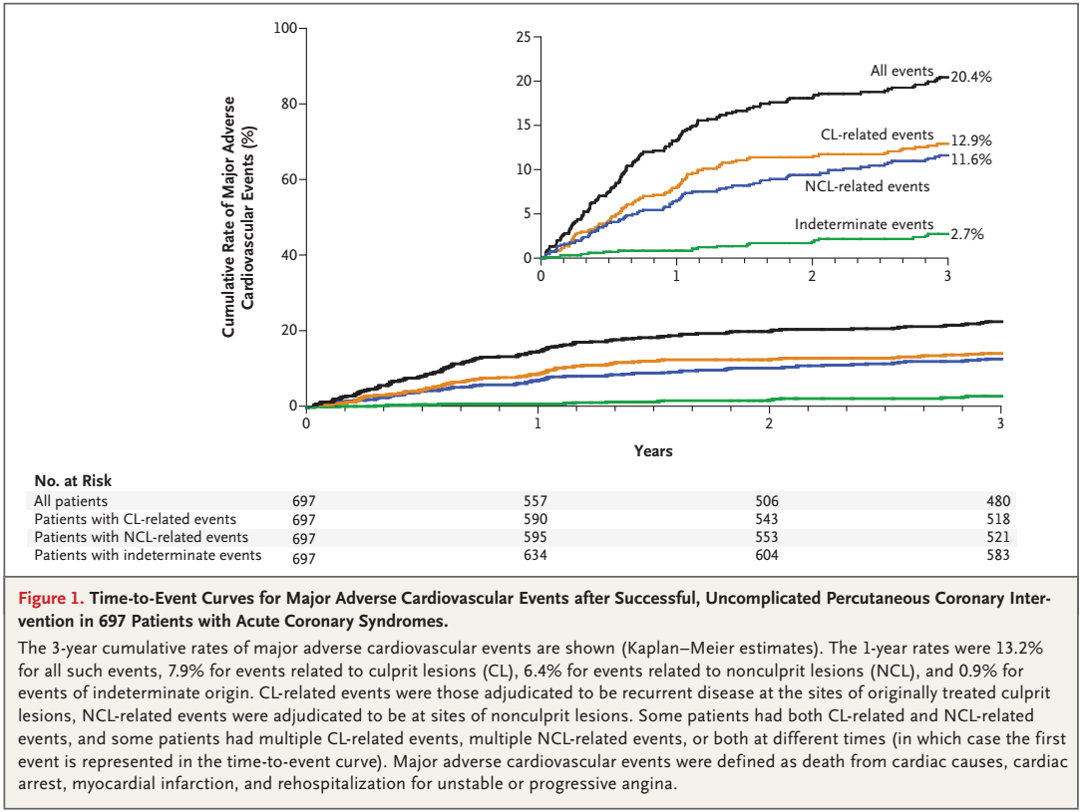
Stone GW et al. NEJM 2011
Notes:
The 3-year cumulative rates of major adverse cardiovascular events are shown (Kaplan–Meier estimates). The 1-year rates were 13.2% for all such events, 7.9% for events related to culprit lesions (CL), 6.4% for events related to nonculprit lesions (NCL), and 0.9% for events of indeterminate origin. CL-related events were those adjudicated to be recurrent disease at the sites of originally treated culprit lesions, NCL-related events were adjudicated to be at sites of nonculprit lesions. Some patients had both CL-related and NCL-related events, and some patients had multiple CL-related events, multiple NCL-related events, or both at different times (in which case the first event is represented in the time-to-event curve). Major adverse cardiovascular events were defined as death from cardiac causes, cardiac arrest, myocardial infarction, and rehospitalization for unstable or progressive angina.

Slide 21
Very low LDL-C levels are associated with more stable plaque features
 | LDL-C <50 mg/dL (<1.3 mmol/L) (87 plaques) | LDL-C 50–70 mg/dL (1.3–1.8 mmol/L) (81 plaques) | LDL-C 70–100 mg/dL (1.8–2.6 mmol/L) (117 plaques) | LDL-C >100 mg/dL (>2.6 mmol/L) (130 plaques) | P
Plaque microstructures in lipid plaques (n=293)
Fibrous cap thickness (μm) | 139.9 ± 93.9 | 103.1 ± 66.4 | 92.5 ± 48.5 | 92.1 ± 47.8 | 0.001
Plaque rupture, n (%) | 1/42 (2.3) | 2/46 (4.3) | 7/91 (7.6) | 12/114 (10.5) | 0.17
Thrombus, n (%) | 0/42 (0.0) | 1/46 (2.1) | 2/91 (2.1) | 3/114 (2.6) | 0.18
Plaque microstructure was more stable in statin-treated patients with lower LDL-C levels
Kataoka et al. Atherosclerosis 2015;242:490–495.
Notes:
Although lowering LDL-C with statins reduces CV events and slows plaque progression, the benefit of lowering LDL-C below current recommended targets is still under investigation.
In a recent study, 280 stable statin-treated CAD patients were stratified according to achieved LDL-C levels (<50, 50–70, 70–100, >100mg/dL) (<1.3, 1.3–1.8, 1.8–2.6, >2.6mmol/L). FD-OCT (frequency-domain optical coherence tomography), which enables visualisation of plaque microstructures associated with plaque instability, was used to evaluate 293 and 122 non-obstructive lipid and fibrous plaques.
LDL-C levels <50mg/dL (<1.3mmol/L) and <70mg/dL (<1.8mmol/L) were observed in 13.9% (39/280) and 29.2% (82/280) of patients, respectively. Patients with LDL-C <50mg/dL (<1.3mmol/L) were more likely to be older (P<0.001) and to receive a high-dose statin (P=0.01), compared with those with higher LDL-C levels.
Patients with LDL-C <50mg/dL (<1.3mmol/L) were also more likely to have fibrous plaques, and less likely to have lipid plaques, than those with higher levels. There were significant associations between LDL-C level and both lipid arc (P=0.01) and fibrous cap thickness (P=0.001). The smallest lipid arc and thickest fibrous cap were observed in patients who achieved LDL-C <50mg/dL (<1.3mmol/L).
To convert LDL-C, 100mg/dL=2.59mmol/L.
Reference
Kataoka et al. Atherosclerosis 2015;242:490–495.

Slide 22

Relationship Between Achieved LDL-C and Changes in Percent Atheroma Volume
2
CAMELOT
Placebo
REVERSAL
Pravastatin 40 mg
1
STRADIVARIUS
Placebo
REVERSAL
Atorvastatin 80 mg
Progression
Median Change in % PAV*
0
ILLUSTRATE
Atorvastatin + Placebo
Regression
ASTEROID
Rosuvastatin 40 mg
–1
SATURN Atorvastatin 80 mg
SATURN Rosuvastatin 40 mg
–2
40
60
80
100
120
Achieved LDL-C (mg/dL)
Summary of trials employing IVUS to measure changes in atheroma burden.
Adapted from Puri R, et al. Eur Heart J. 2013;34:1818–1825.
Notes:
IVUS can be used to evaluate the progression or regression of atherosclerosis by analysing sequential images of the same area in a diseased vessel over time.¹
By evaluating the change in atheroma volume, the magnitude and consistency of plaque regression–progression can be evaluated.¹
IVUS provides precise and reproducible determination of the change in atheroma burden.¹
Trials using IVUS have investigated the effects of a variety therapies.¹
Atheroma volume correlates with LDL-C levels. ¹
A graph of atheroma volume and LDL-C levels in seven studies using IVUS indicates that LDL-C levels and atheroma volume were correlated, with the ASTEROID study actually showing a decrease in atherosclerosis progression at lower LDL-C levels.²
References
Nissen SE, Nicholls SJ, Sipahi I, et al; for the ASTEROID Investigators. Effect of very high-intensity statin therapy on regression of coronary atherosclerosis: the ASTEROID trial. JAMA. 2006;295:1556–1565.
Puri R, Nissen SE, Ballantyne C, et al. Factors underlying regression of coronary atheroma with potent statin therapy. Eur Heart J. 2013;34:1818–1825.

Slide 23
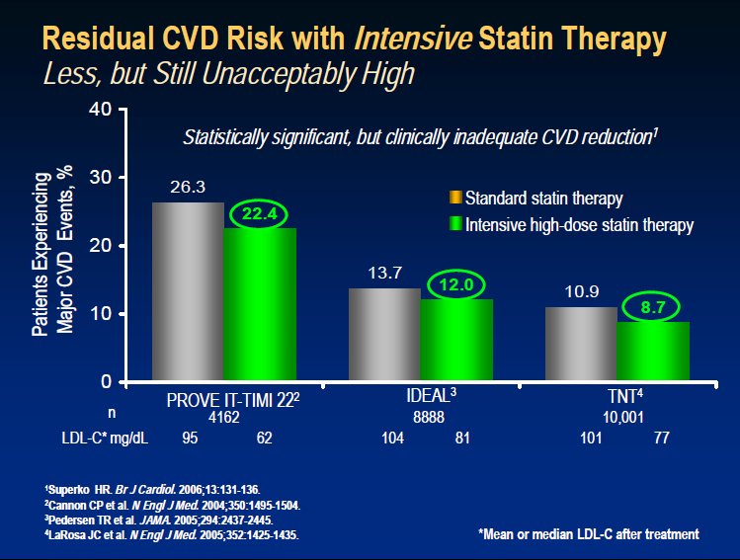

Slide 24
Doubling statin dose achieves ~6% additional LDL-C reduction
Change in LDL-C (%)
0
-5
-10
-15
-20
-25
-30
-35
-40
-45
-50
-55
-60
%
10mg
20mg
40mg
Rosuvastatin
10mg
20mg
40mg
80mg
Atorvastatin
1mg/d
2mg
4mg
Pitavastatin
10mg
20mg
40mg
80mg
Simvastatin
10mg
20mg
40mg
Pravastatin
www.fda.gov/drugs/drugsafety/ucm256581.htm#relative. Accessed 10 Jan 2016.

Slide 25
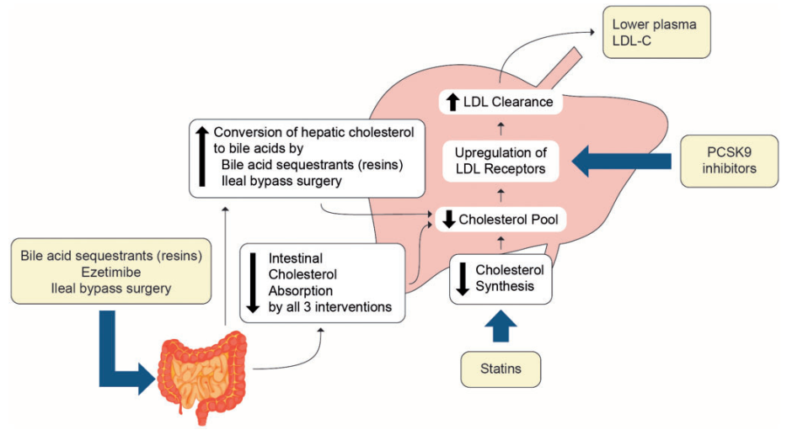
APPROCCIO “MULTI-TARGET” AL COLESTEROLO LDL…
Ference BA et al. European Heart Journal (2017) 0, 1–14
Titolo Relazione
High-intensity
High-dose

Slide 26
Razionale dell’associazione dell’Ezetimibe con statine
Dose iniziale di statina
X2
X4
X8
Dose raddoppiata per tre volte
Dose iniziale di statina
+ Ezetimibe
10 mg
Associazione come unico step
0
10
20
30
40
50
60
Riduzione % del C-LDL
L’associazione dell’Ezetimibe come unico step ha risultati simili alla titolazione della statina in tre fasi
Tratto da Stein E Eur Heart J Suppl 2001;3(suppl E):E11-E16
Notes:
26
L’associazione dell’Ezetimibe 10 mg/die con una dose iniziale di statina può far ottenere la stessa riduzione di C-LDL ottenuta con la dose di statina raddoppiata per tre volte.
Le curve dose-risposta per le statine stabilite dimostrano che ogni raddoppio della dose di statina riduce il C-LDL di un ulteriore 6%. L’associazione dell’Ezetimibe 10 mg/die con la dose iniziale di statina ha ridotto il C-LDL in maniera efficace quanto la titolazione della statina alla dose massima raccomandata. Pertanto, questa associazione dell’ Ezetimibe con una statina come primo step può fornire un controllo lipidico facile ed efficace rispetto alla monoterapia con la statina somministrata ad un dosaggio per tre volte raddoppiato.

Slide 27
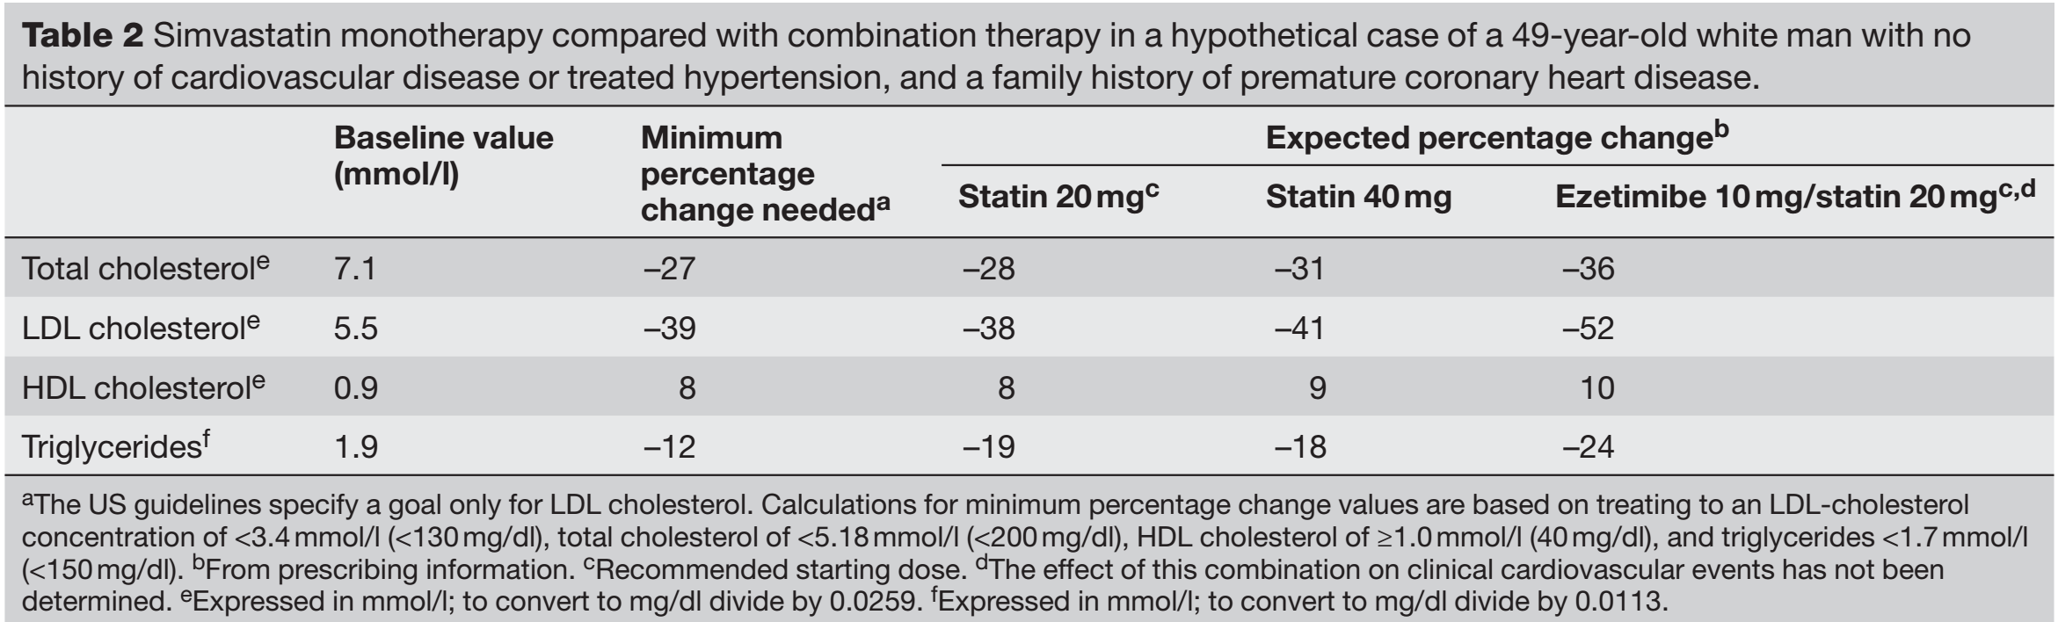
Statine vs statine + EZE: un esempio pratico…
Gotto and Farmer. Nat Clin Pract Cardiovasc Med. 2006;3(12):664-72.

Slide 28
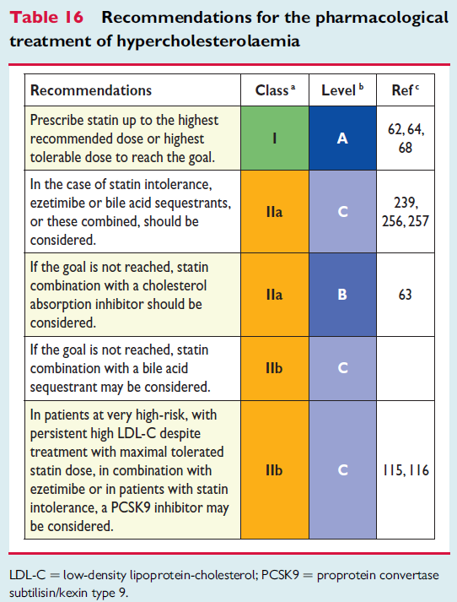
ESC/EAS guidelines 2016 the Management of dyslipidemias: recommendations for pharmacological treatment
A. Catapano al. Eur Heart J. 2016; doi:10.1093/eurheartj/ehw272

Slide 29
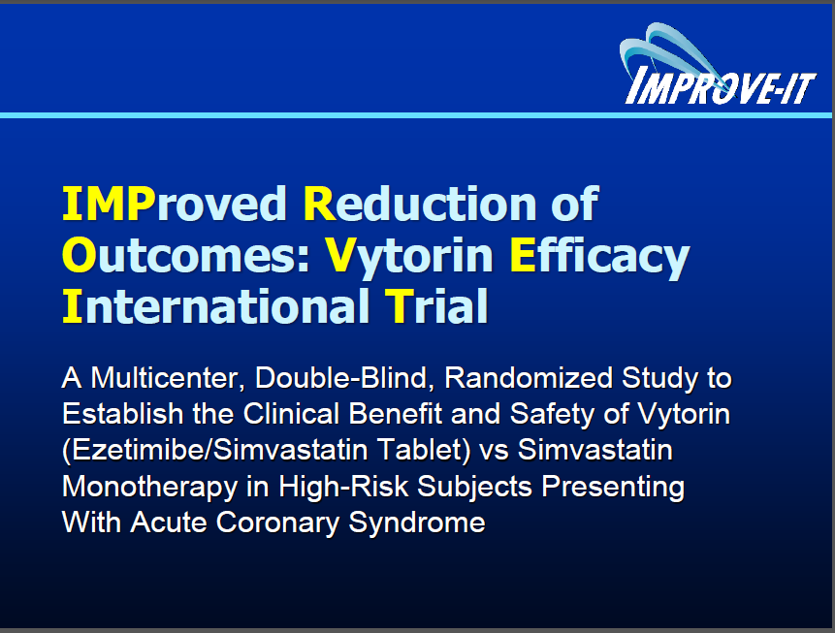
Notes:
IMPROVE-IT: 18,144 pts
Follow-up: mean 6 yrs
LDL-C baseline: 93
LDL-C follow-ul: EZE group 53 vs. Control 69 (-24%)
Primary endpoint reduction: RR -6% (HR 0.93; 32,7%[2572] vs 34,7% [2742])
HIJ-PROPER: 1734 pts
Follow-up: mean 3,86 yrs
LDL-C baseline: 135
LDL-C follow-ul: EZE group 65 vs. Control 84 (-23%)
Primary endpoint reduction: RR -11% (HR 0.89; 32.8% [283] vs. 36.9% [316])
Beneficio clinico (addirittura maggiore nel HIJ-PROPER) in termini di HR della terapia con EZE + statine in entrambi gli studi.
Simile riduzione LDL (con una differenza circa 20% tra i due gruppi di trattamento). Nel HIJ-PROPER, un dato positivo è che il risultato trascinato dalla riduzione della mortalità per tutte le cause (HR 0.70).
HIJ-PROPER: (1) Più piccolo come dimensioni; (2) follow-up più breve; (3) Minore numero di eventi.

Slide 30
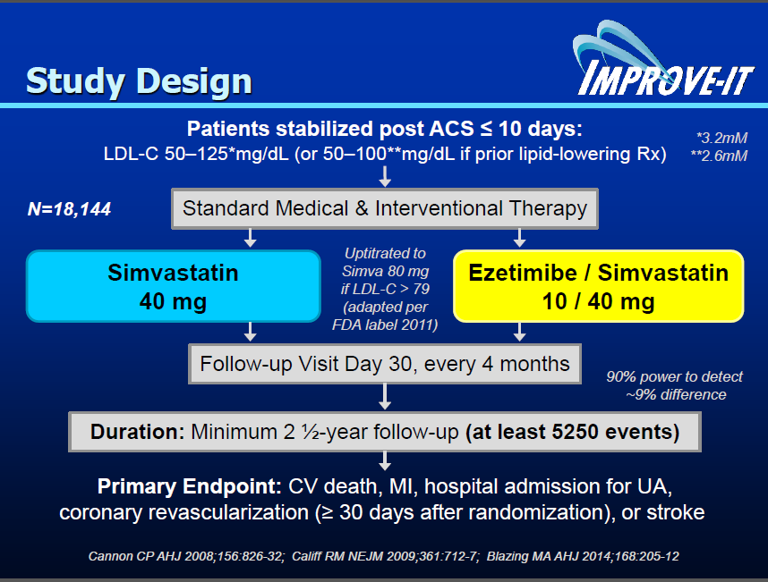
Pazienti in dimissione!
Notes:
BACKGROUND
Statin therapy reduces low-density lipoprotein (LDL) cholesterol levels and the risk
of cardiovascular events, but whether the addition of ezetimibe, a nonstatin drug
that reduces intestinal cholesterol absorption, can reduce the rate of cardiovascular events further is not known.
METHODS
We conducted a double-blind, randomized trial involving 18,144 patients who had
been hospitalized for an acute coronary syndrome within the preceding 10 days and
had LDL cholesterol levels of 50 to 100 mg per deciliter (1.3 to 2.6 mmol per liter)
if they were receiving lipid-lowering therapy or 50 to 125 mg per deciliter (1.3 to
3.2 mmol per liter) if they were not receiving lipid-lowering therapy. The combination
of simvastatin (40 mg) and ezetimibe (10 mg) (simvastatin–ezetimibe) was compared with simvastatin (40 mg) and placebo (simvastatin monotherapy). The primary end point was a composite of cardiovascular death, nonfatal myocardial
infarction, unstable angina requiring rehospitalization, coronary revascularization
(≥30 days after randomization), or nonfatal stroke. The median follow-up was 6 years.
RESULTS
The median time-weighted average LDL cholesterol level during the study was 53.7 mg
per deciliter (1.4 mmol per liter) in the simvastatin–ezetimibe group, as compared
with 69.5 mg per deciliter (1.8 mmol per liter) in the simvastatin-monotherapy
group (P<0.001). The Kaplan–Meier event rate for the primary end point at 7 years
was 32.7% in the simvastatin–ezetimibe group, as compared with 34.7% in the
simvastatin-monotherapy group (absolute risk difference, 2.0 percentage points;
hazard ratio, 0.936; 95% confidence interval, 0.89 to 0.99; P=0.016). Rates of prespecified muscle, gallbladder, and hepatic adverse effects and cancer were similar
in the two groups.
CONCLUSIONS
When added to statin therapy, ezetimibe resulted in incremental lowering of LDL
cholesterol levels and improved cardiovascular outcomes. Moreover, lowering LDL
cholesterol to levels below previous targets provided additional benefit. (Funded
by Merck; IMPROVE-IT ClinicalTrials.gov number, NCT00202878.)

Slide 31
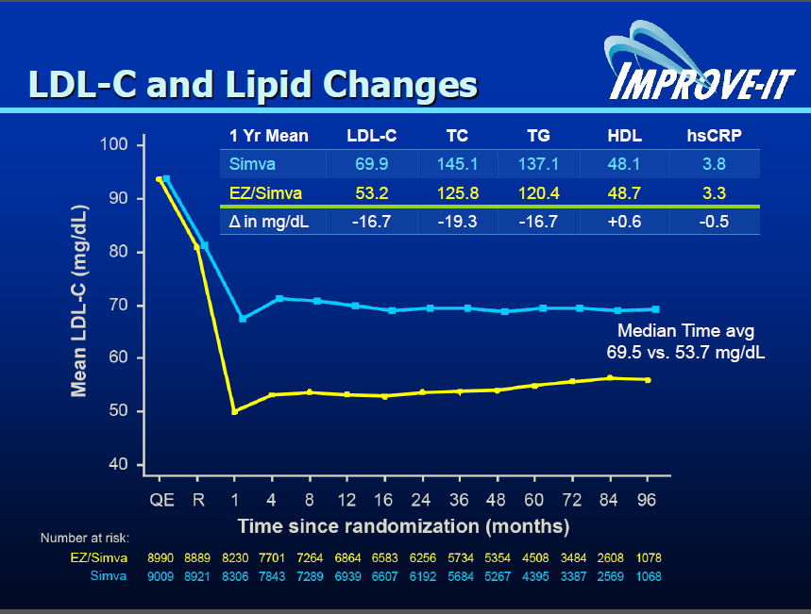

Slide 32
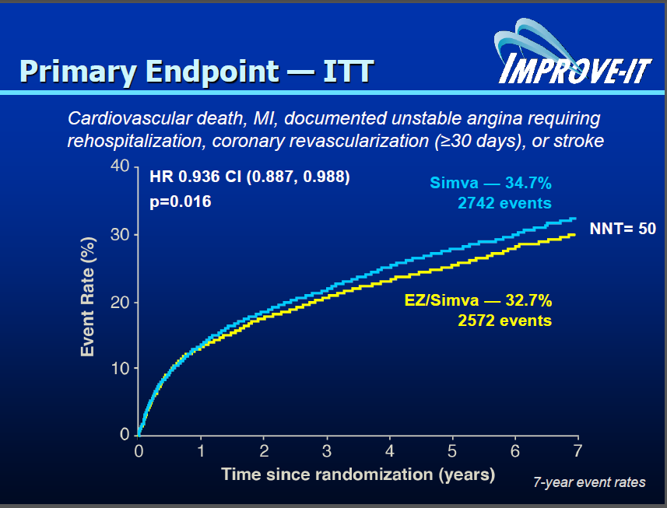
Absolute risk difference, -2.0%

Slide 33
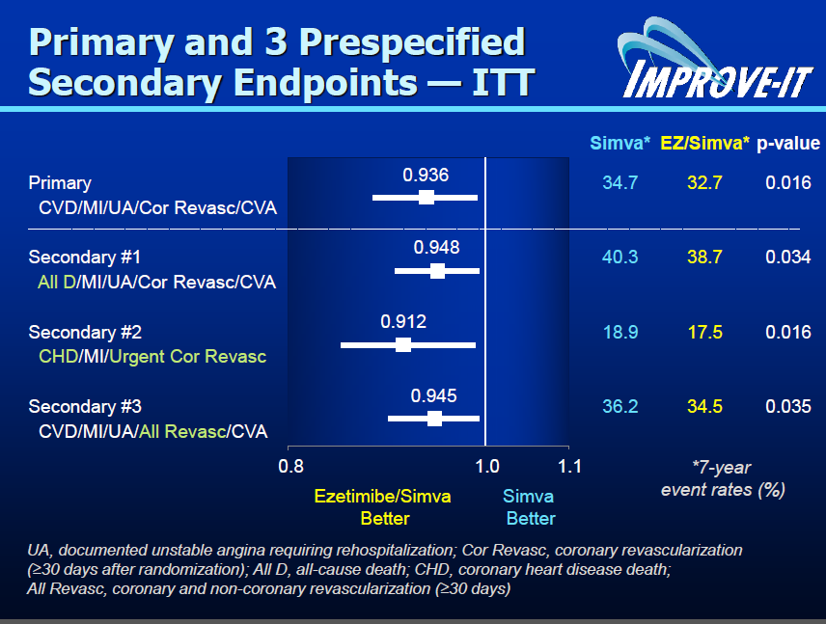

Slide 34
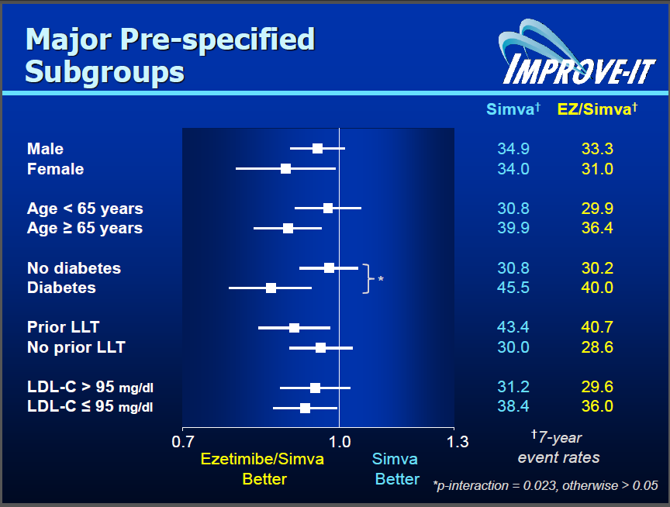

Slide 35
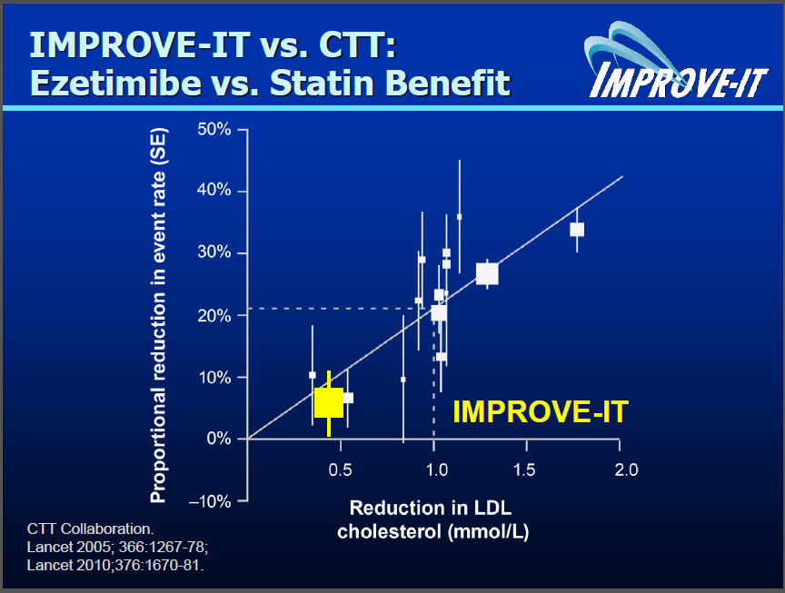

Slide 36
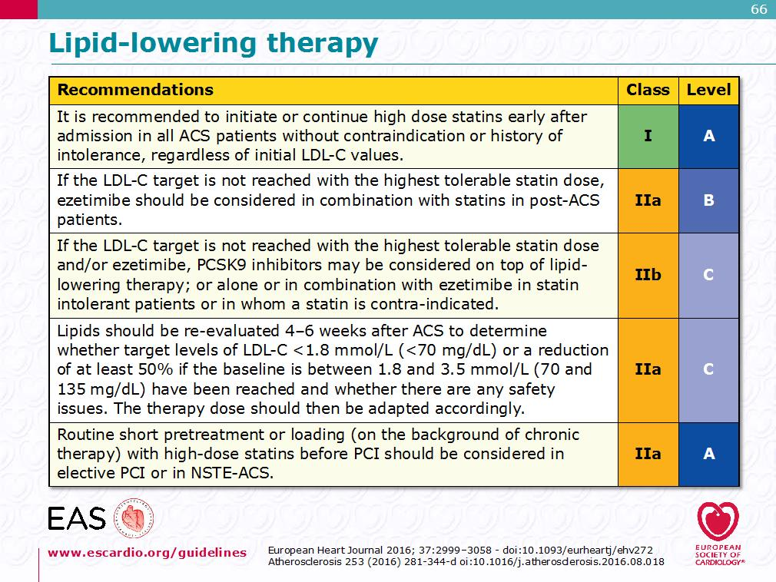

Slide 37
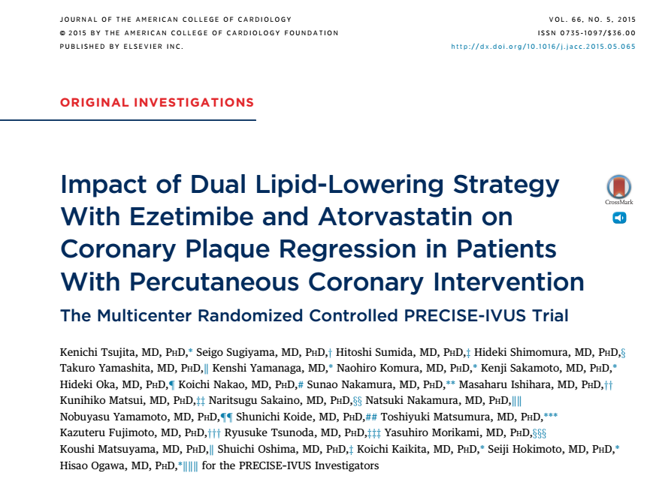
Notes:
METHODS This trial was a prospective, randomized, controlled, multicenter study. Eligible patients who underwent PCI were randomly assigned to atorvastatin alone or atorvastatin plus ezetimibe (10 mg) daily. Atorvastatin was uptitrated with a treatment goal of low-density lipoprotein cholesterol (LDL-C) <70 mg/dl. Serial volumetric intravascular ultrasound was performed at baseline and again at 9 to 12 months to quantify the coronary plaque response in 202 patients.
RESULTS The combination of atorvastatin/ezetimibe resulted in lower levels of LDL-C than atorvastatin monotherapy (63.2 16.3 mg/dl vs. 73.3 20.3 mg/dl; p < 0.001). For the absolute change in percent atheroma volume (PAV), the mean difference between the 2 groups (–1.538%; 95% confidence interval [CI]: –3.079% to 0.003%) did not exceed the pre-defined noninferiority margin of 3%, but the absolute change in PAV did show superiority for the dual lipid-lowering strategy (–1.4%; 95% CI: –3.4% to –0.1% vs. –0.3%; 95% CI: –1.9% to 0.9% with atorvastatin alone; p ¼ 0.001). For PAV, a significantly greater percentage of patients who received atorvastatin/ezetimibe showed coronary plaque regression (78% vs. 58%; p ¼ 0.004). Both strategies had acceptable side effect profiles, with a low incidence of laboratory abnormalities and cardiovascular events.
CONCLUSIONS Compared with standard statin monotherapy, the combination of statin plus ezetimibe showed greater coronary plaque regression, which might be attributed to cholesterol absorption inhibition–induced aggressive lipid lowering. (Plaque Regression With Cholesterol Absorption Inhibitor or Synthesis Inhibitor Evaluated by Intravascular Ultrasound [PRECISE-IVUS]; NCT01043380) (J Am Coll Cardiol 2015;66:495–507)

Slide 38
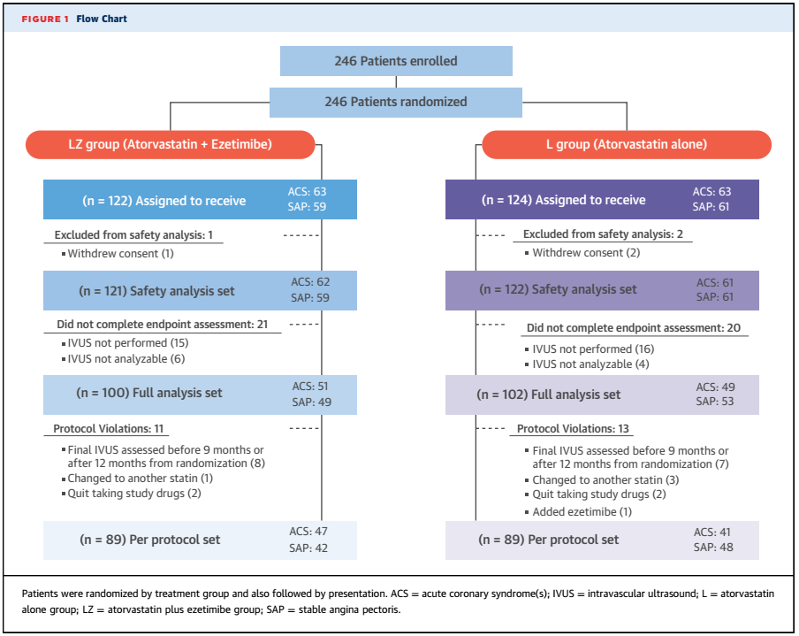

Slide 39
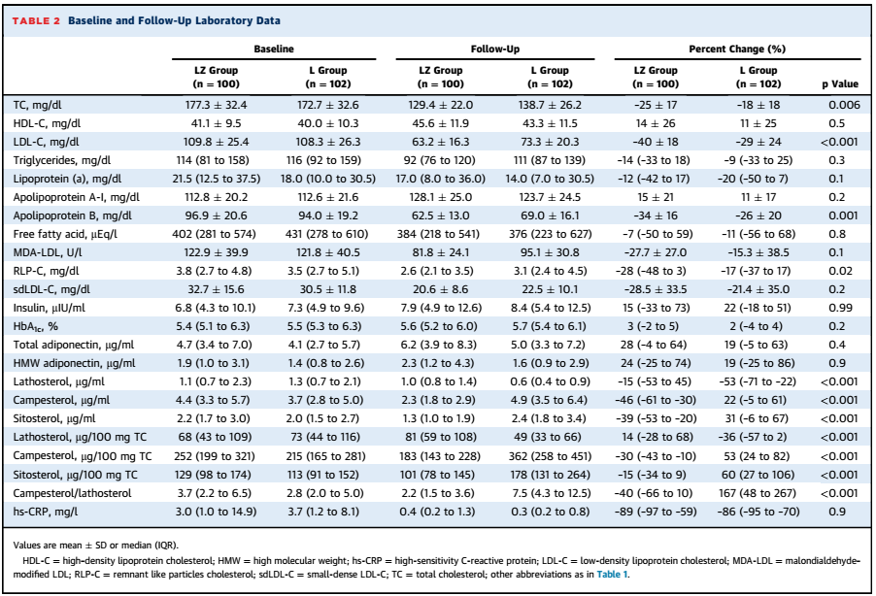

Slide 40
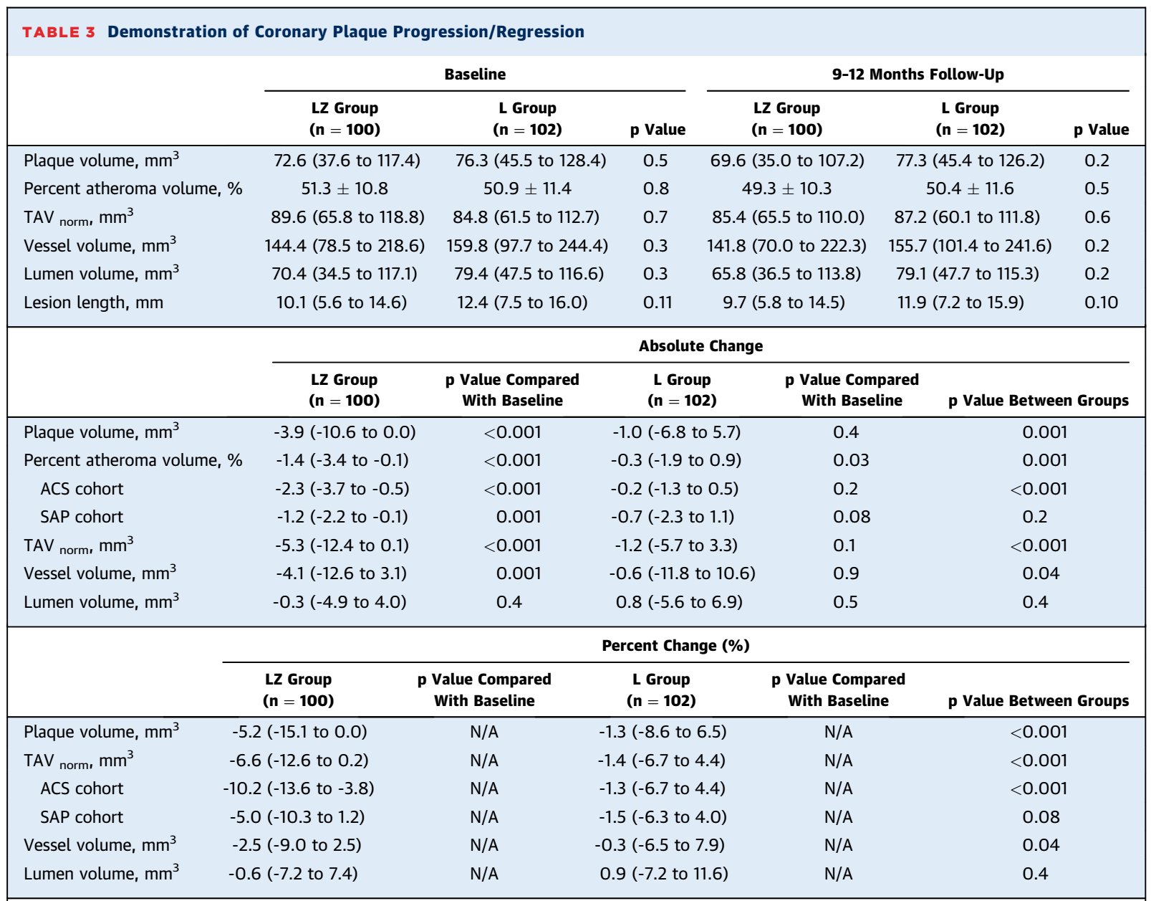

Slide 41
GLAGOV: Study Design
Screening and placebo run-in period
Clinically indicated coronary angiogram
IVUS based on coronary angiogram results
SC injection of 3 mL placebo
Up to
4-week lipid stabilization period
Assigned to background statin therapy
Placebo SC
every month
Randomization 1:1
to study drug
End Of Study
Evolocumab
420 mg SC
every month
2–4 weeks
Maximum 6 weeks
D1
W4
W12
W24
W36
W52
W64
W76
W78
W80
EOS
Study visits:
Study drug was administered monthly at home or in the clinic
Last
dose of study
drug
Last
IVUS procedure
*Nominal change refers to the actual number, as opposed to percent change
D = day; IVUS = intravascular ultrasound; SC = subcutaneously; W = week.
Puri R, et al. Am Heart J. 2016;176:83-92.
Notes:
Puri R, et al. American Heart Journal.2016: 88-A-1-Figure 2

Slide 42
GLAGOV: Study Endpoints
Endpoint | Description
Primary^{1,2} | Nominal change* in PAV from baseline to week 78, as determined by IVUS
Secondary^{1,2} | Nominal change* in TAV from baseline to week 78, as determined by IVUS Proportion of patients demonstrating any reduction of PAV from baseline† Proportion of patients demonstrating any reduction of TAV from baseline†
Exploratory² | Incidence of adjudicated events (all-cause mortality, cardiovascular death, myocardial infarction, hospitalization for unstable angina, coronary revascularization, stroke, transient ischemic attack, and hospitalization for heart failure) Change in lipid parameters
*Nominal change refers to the actual number, as opposed to percent change
†Proportion/percentage of subjects with regression is a group level summary statistics rather than a subject level endpoint
IVUS = intravascular ultrasound; PAV = percentage atheroma volume; TAV = total atheroma volume
1. Puri R, et al. Am Heart J. 2016;176:83-92. 2. Nicholls SJ, et al. JAMA. [published online ahead of print November 15, 2016]. doi: 10.1001/jama.2016.16951
Notes:
Puri R, et al. American Heart Journal.2016: 86-A-1
Nicholls SJ, et al. JAMA. 2016:
E4-B-2

Slide 43
Mean Absolute Change in LDL-C
Statin monotherapy
Statin + evolocumab
10
Mean LDL-C 93.0 mg/dL*
0
Change from baseline 3.9%
–10
–20
LDL-C Absolute Change From Baseline, mg/dL
–30
–40
–50
Mean LDL-C 36.6 mg/dL*
–60
Change from baseline -59.8%
–70
0
4
8
12
16
20
24
28
32
36
40
44
48
52
56
60
64
68
72
76
80
No. of patients
Study Week
Placebo
484
446
441
447
441
425
418
Evolocumab
484
456
452
444
449
426
434
Absolute change for evolocumab-statin group: -56.3 (-59.4 to -53.1); P < 0.001
Data shown are Mean (95% CI) *Time-weighted LDL-C; LDL-C = low-density lipoprotein cholesterol
Nicholls SJ, et al. JAMA. [published online ahead of print November 15, 2016]. doi: 10.1001/jama.2016.16951.
Nissen SE, et al. American Heart Association Scientific Sessions, Nov 12 - 16, 2016,
New Orleans, Louisiana. Oral Presentation.
Notes:
Nicholls SJ, et al. JAMA. 2016:
E6-A-1 (Fig 2)
Nicholls SJ, et al. JAMA. 2016:
E5-A-1 (Table 2)
Nissen AHA 2016-
Oral Presentation
LDL-C Change All Pts

Slide 44
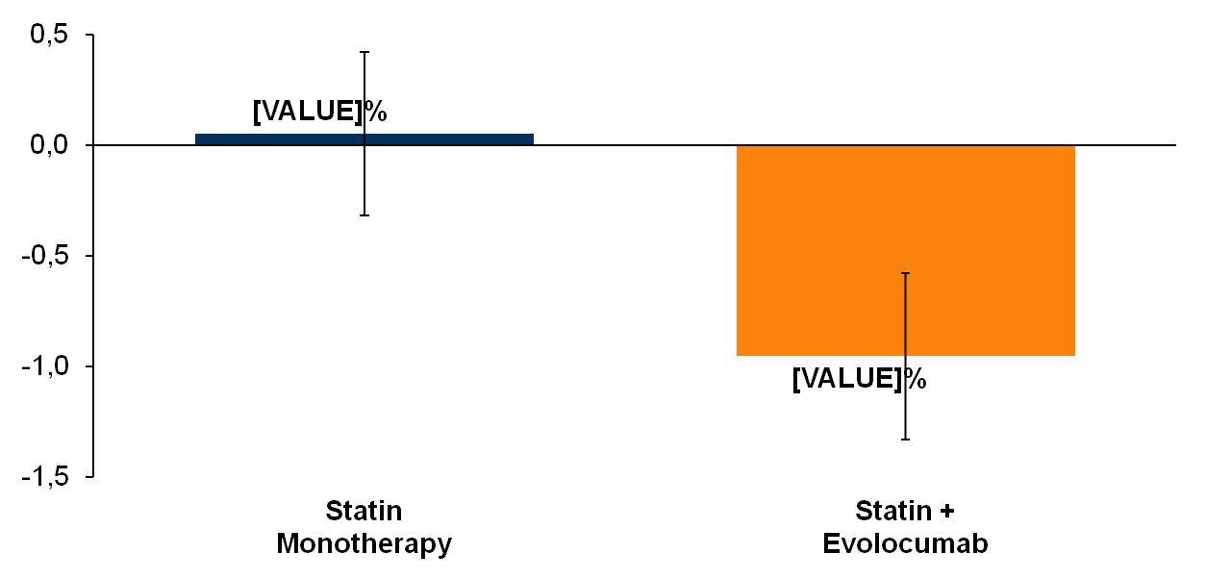
Primary Endpoint: Nominal Change in PAV From Baseline to Week 78
P = NS*
Change in % atheroma volume (%)
P < 0.001*
Difference between groups: -1.0% (-1.8 to -0.64); P < 0.001
Data shown are least-squares mean (95% CI). PAV = Percent Atheroma Volume
*Comparison versus baseline
Nicholls SJ, et al. JAMA. [published online ahead of print November 15, 2016]. doi: 10.1001/jama.2016.16951.
Notes:
Nicholls SJ, et al. JAMA. 2016:
E7-A-1 (Table 3)

Slide 45
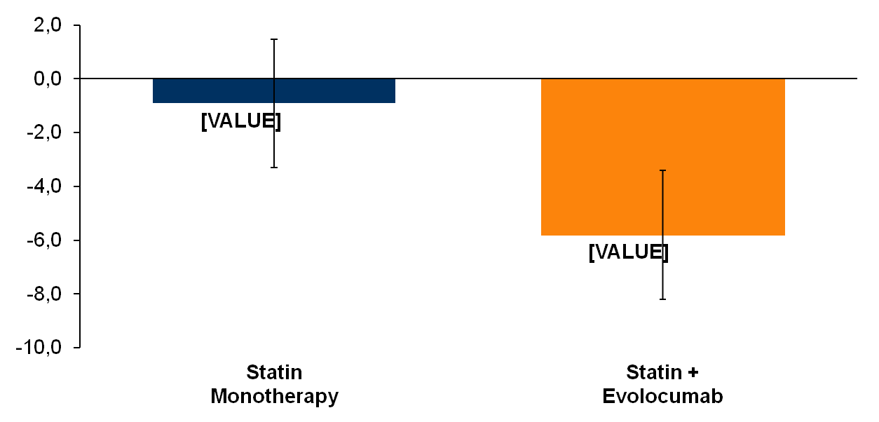
Secondary Endpoint: Nominal Change in TAV From Baseline to Week 78
P = NS*
Change in Total Atheroma
Volume (mm³)
P < 0.001*
Difference between groups: -4.9mm³ (-7.3 to -2.5); P < 0.001
Data shown are least-squares mean (95% CI). TAV = Total Atheroma Volume
*Comparison versus baseline
Nicholls SJ, et al. JAMA. [published online ahead of print November 15, 2016]. doi: 10.1001/jama.2016.16951.
Notes:
Nicholls SJ, et al. JAMA. 2016:
E7-A-1 (Table 3)

Slide 46
Exploratory Analysis: Achieved LDL-C and Change in PAV in All Patients
1.0
0.5
0
Change Percent Atheroma Volume (%)
-0.5
-1.0
-1.5
10
20
30
40
50
60
70
80
90
100
110
On-Treatment LDL-C (mg/dL)
Local regression (LOESS) curve illustrating the association (with 95% CI) between achieved LDL-C levels and change in PAV in all patients undergoing serial IVUS evaluation. PAV = percentage atheroma volume;
LDL-C = low-density lipoprotein cholesterol
Nicholls SJ, et al. JAMA. [published online ahead of print November 15, 2016]. doi: 10.1001/jama.2016.16951.
Notes:
Nicholls SJ, et al. JAMA. 2016:
E9-A-1 (Fig 4)

Slide 47
GLAGOV Summary
In statin-treated patients with symptomatic coronary disease, addition of evolocumab, 420 mg monthly for 18 months:
  Achieved LDL-C levels averaging 36.6 mg/dL compared with 93 mg/dL for a statin alone.
  Produced regression, mean change in PAV of -0.95% for evolocumab-statin treated group, compared with statin only patients, whose mean change in PAV was +0.05% (P < 0.001).
  Produced regression (change in PAV <0) in a greater percentage of patients; 64% for evolocumab-statin treated patients vs. 47% in statin only patients (P < 0.001).
No new safety signals were observed
Further studies assessing the effects of PCSK9 inhibition on clinical outcomes are pending.

Slide 48
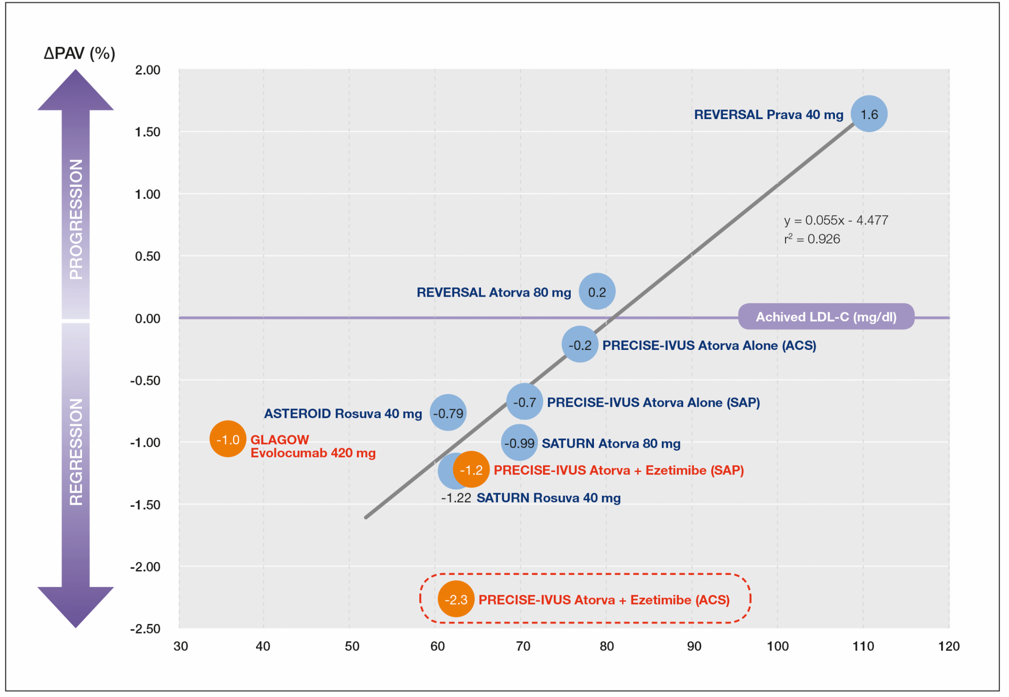
Coronary atherosclerosis regression
Gragnano F. and Calabrò P. Atherosclerosis 2018

Slide 49


Take Home Messages
Vulnerable plaque features are associated with increased risk of cardiovascular events.
When plaques are exposed to low levels of LDL-C, plaque regression occurs.
High-dose statin therapy is associated with plaque regression and beneficial histological changes in humans.
In statin-treated patients with symptomatic CAD, addition of EZETIMIBE FIRST and PCSK9 inhibitors induces plaque regression, with an effect on the natural history of the disease.

Slide 50


Take Home Messages
Lipid goals should be used for the management of high risk patients to prevent CVD. “The lower, the better” approach demonstrates to be effective in high risk patients.
Beyond the amount of LDL-C reduction the duration of exposure should also be considered in determining the appropriate target LDL-C level.
In addition to consolidate lipid-loweing therapy (statin), ezetimibe use should be implemented to further reduce CVD.
Durable strategies to address gaps in adherence to lipid lowering therapy are essential to maximize reduction in cardiovascular disease risk in real-world settings.
GRAZIE DELL’ATTENZIONE
paolo.calabro@unicampania.it

Slide 51
Calabrò P.
(Caserta)

