Slide 1


Slide 2
Nami R.
(Siena)

Slide 3


I SESSIONE - Moderatori: V. Aulitto (Napoli) – L.D. Giuncato (Lecce)
Trattamento del paziente iperteso alla luce delle nuove Linee Guida ESC/ESH
Renato Nami
Prof. di Cardiologia
Scuola di Specializzazione di Cardiologia-Univ Siena
Presidente Nazionale ANCE
Cardiologia Italiana del Territorio

Slide 4
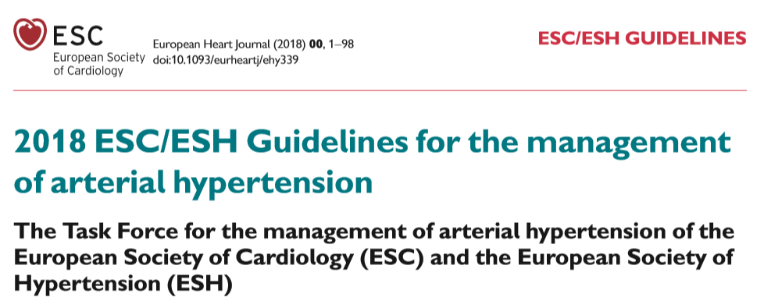

Slide 5
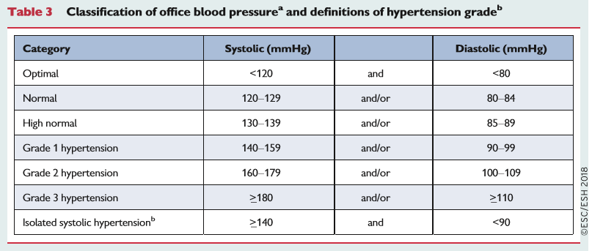

Slide 6
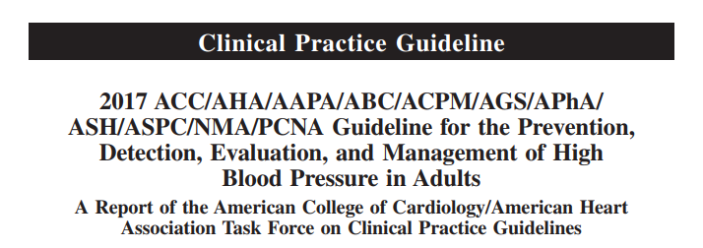
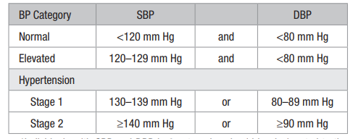

Slide 7

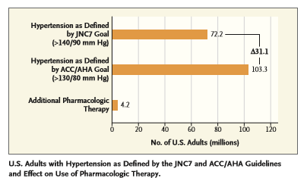
Copyright © 2018 Massachusetts Medical Society. All rights reserved

Slide 8
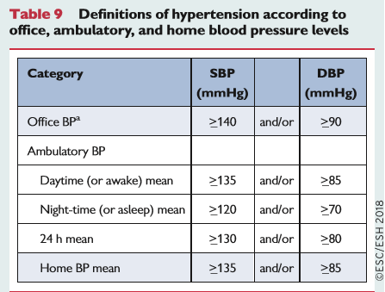

Slide 9
(11%)
(15%)

Slide 10
Masked
Uncontrolled
(30%)

Slide 11
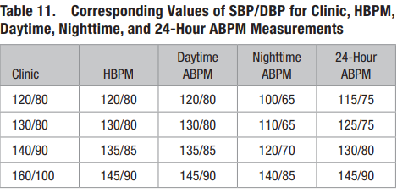

Slide 12
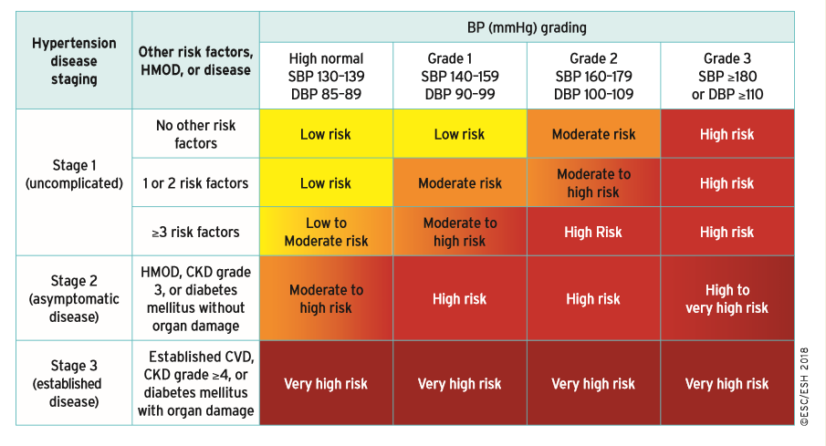
Classification of hypertension stages according to blood pressure levels, presence of cardiovascular risk factors, hypertension-mediated organ damage, or comorbidities.

Slide 13
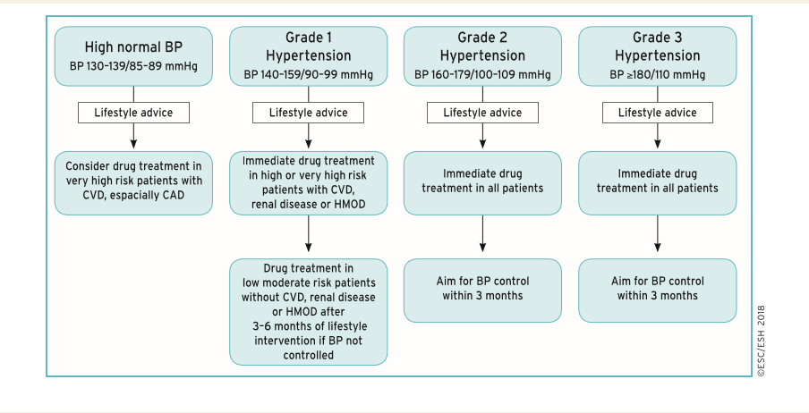
Initiation of blood pressure-lowering treatment (lifestyle changes and medication) at different initial office blood pressure levels

Slide 14
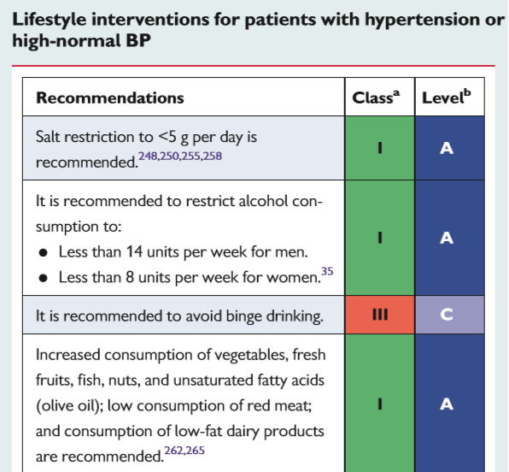
ESC/ESH Guidelines 2018

Slide 15
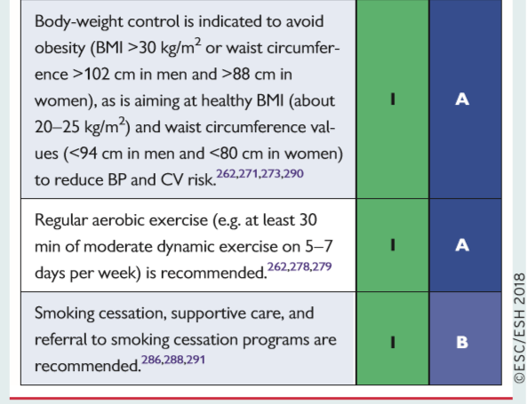

Slide 16
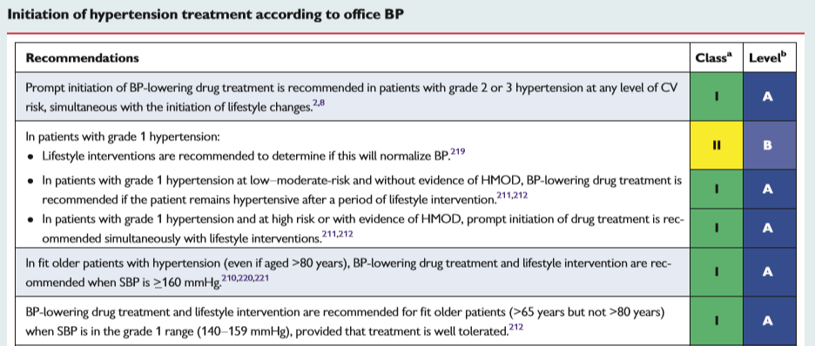

Slide 17
Initiation of blood pressure-lowering treatment (lifestyle changes and medication) at different initial office blood pressure levels

Slide 18
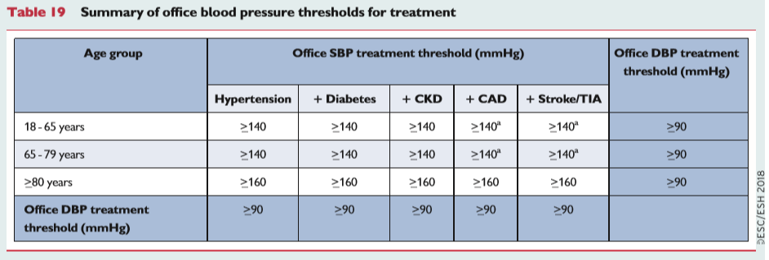

Slide 19
Should guidelines also indicate a BP value
not to go below
in order to avoid harm?
Notes:
19

Slide 20
INVEST
(CAD pts)
ONTARGET
(high risk pts, mainly with CAD)
CV events (%)
CV events (%)
Adjusted HR
110
>110
to 120
>120
to 130
>130
to 140
>140
to 150
>150
to 160
>160
On-treatment SBP (mmHg)
On-treatment SBP (mmHg)
VALUE
(High risk pts)
TNT
(CAD pts)
Cardiac events (%)
CV events (%)
Adjusted HR
< 120
>120
to 130
>130
to 140
>140
to 150
>150
to 160
>160
to 170
>170
to 180
≥ 180
≤ 60
61-70
71-80
81-90
91-100
> 100
On-treatment SBP (mmHg)
On-treatment DBP (mmHg)
Notes:
20

Slide 21
The idea «the lower, the better» has been discarded
ESC/ESH Guidelines 2013

Slide 22
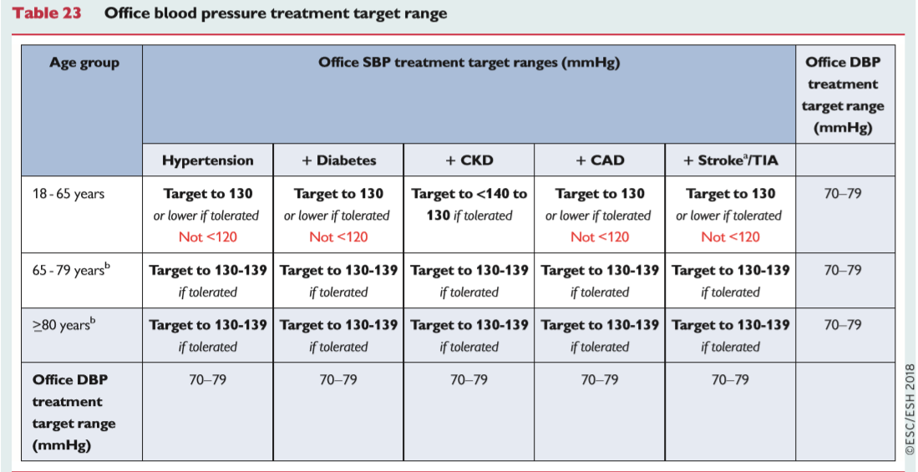

Slide 23
Qualche incongruenza dalle Linee Guida ESC/ESH Guidelines 2018
Paziente >18 <65 anni con valori limite di PA > 140/90 mm Hg
Trattamento: SI fino al target di PA 130/70-79 mm Hg
Paziente >18 <65 anni con valori limite di PA sistolica >131 < 139 mm Hg e PA diastolica > 81 < 89 mm Hg
Trattamento: NO!
Valori pressori target 130/70-79 mm Hg: mai raggiunti!

Slide 24
Qualche incongruenza dalle Linee Guida ESC/ESH Guidelines 2018
Paziente > 80 anni con valori limite di PA sistolica > 160 mm Hg
Trattamento: SI fino al target di PA sistolica 130-139 mm Hg
Paziente > 80 anni con valori limite di PA sistolica >140 e < 159 mm Hg
Trattamento: NO!
Valori pressori target 130-139 mm Hg: mai raggiunti!

Slide 25
Fonte di confusione dalle Linee Guida ESC/ESH Guidelines 2018
Distingue i valori limite della PA
dai target pressori!
Valori limite PA = Target pressori!

Slide 27
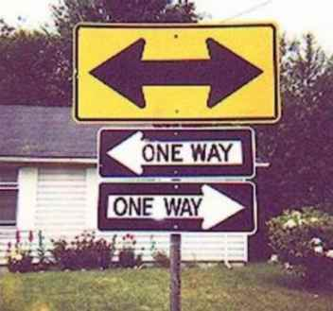
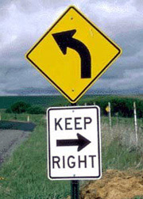
Therapeutic Approach in Hypertension

Slide 28
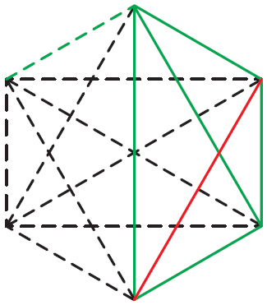
Diuretici Tiazidici
Beta-Bloccanti
Sartani
Altri Agenti Antiipertensivi
CA-Antagonisti
ACE-Inibitori
ESH/ESC Guidelines 2013

Slide 29
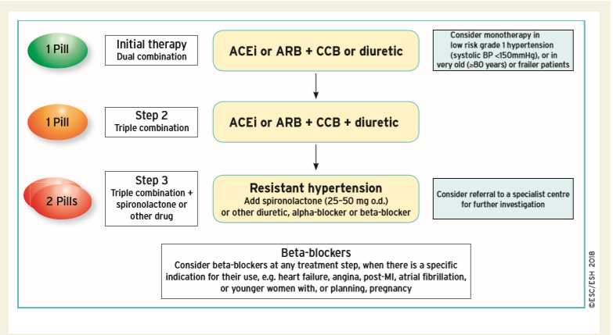
Core drug treatment strategy for uncomplicated hypertension

Slide 30
Prevalence of primary aldosteronism in patients with resistant hypertension

Slide 31
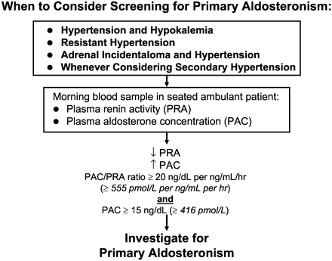

Slide 32
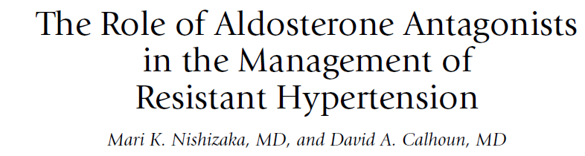
Spironolactone-induced BP reduction in resistant hypertension
Current Hypertension Reports, 2007

Slide 33
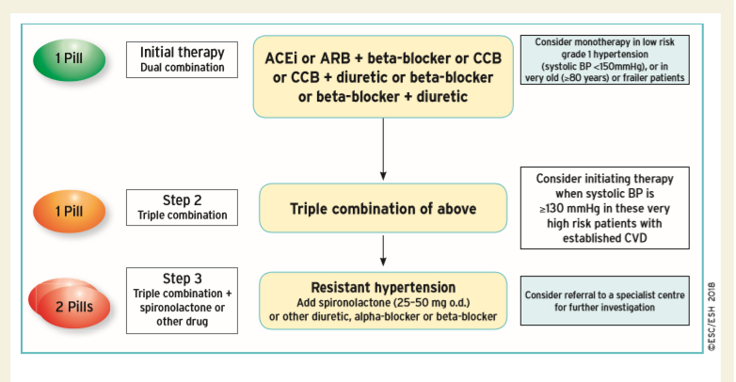
Drug treatment strategy for hypertension and coronary artery disease.
?
?

Slide 35
Individualized Blood Pressure Target !
ESH-ESC 2007

Slide 36
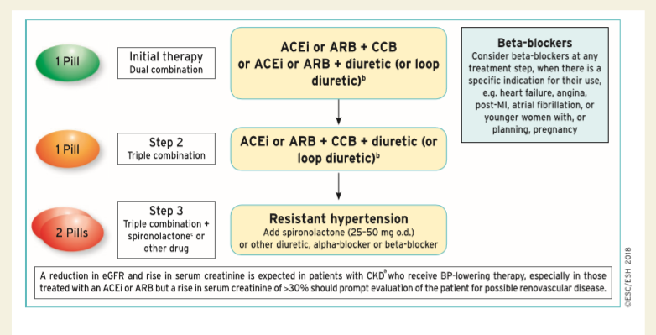
Drug treatment strategy for hypertension and chronic kidney disease

Slide 37
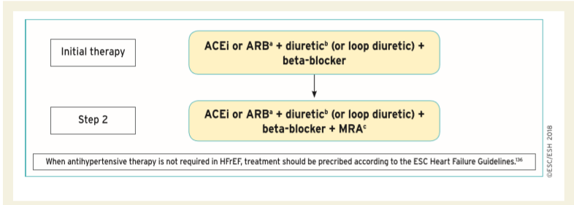
Drug treatment strategy for hypertension and heart failure with reduced ejection fraction

Slide 38
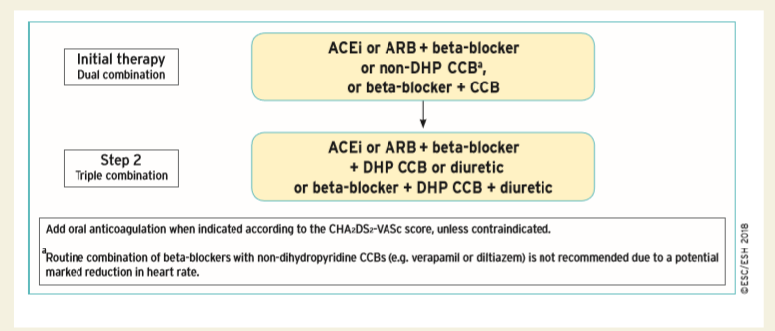
Drug treatment strategy for hypertension and atrial fibrillation

Slide 39
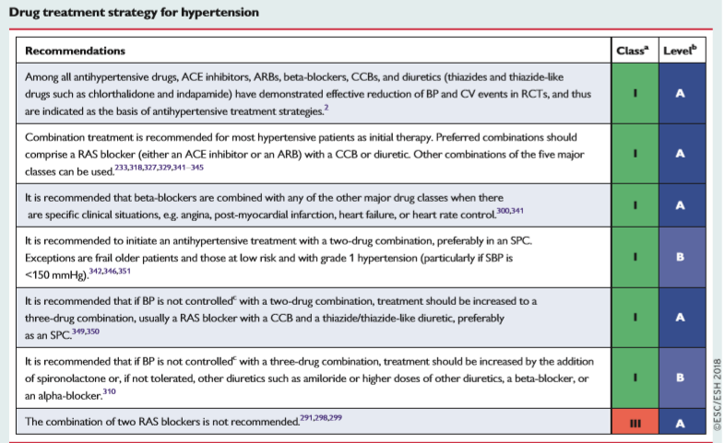

Slide 40
Improvement in blood pressure control in hypertension: drug adherence
There is growing evidence that poor adherence to treatment—in addition to physician inertia (i.e. lack of therapeutic action when the patient’s BP is uncontrolled)—is the most important cause of poor BP control.
Non-adherence to antihypertensive therapy correlates with higher risk of CV events.
Early discontinuation of treatment and suboptimal daily use of the prescribed regimens are the most common facets of poor adherence.
Poor adherence is strongly and inversely correlated with the number of pills prescribed.
A major emphasis of these Guidelines has been to simplify the treatment strategy to try and improve adherence to treatment and BP control, by prescribing a single pill to most patients with hypertension.
ESC/ESH Guidelines 2018

Slide 41

Can a single pill prevent CVD in hypertension?

Slide 42

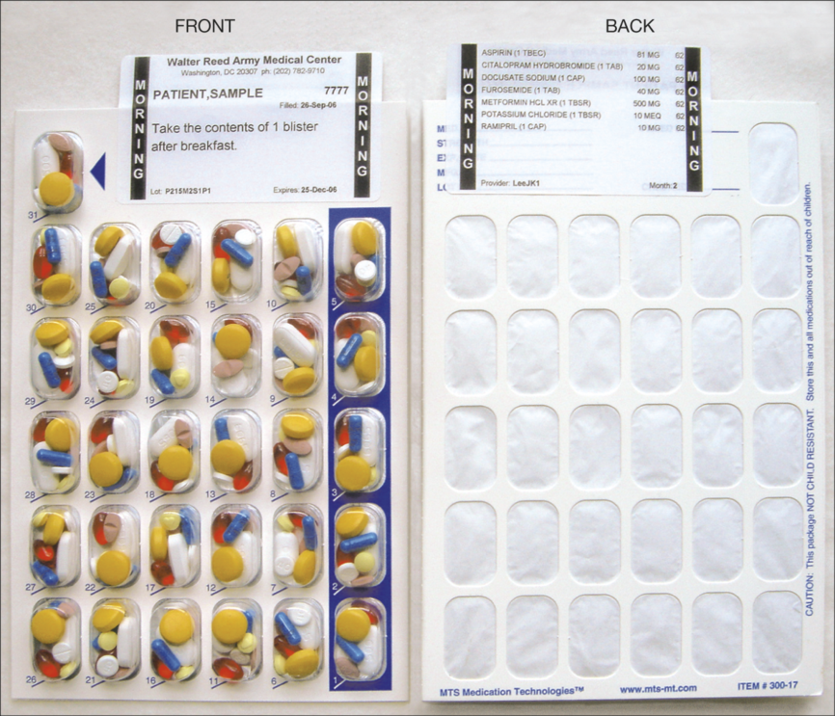
From: Effect of a Pharmacy Care Program on Medication Adherence and Persistence, Blood Pressure, and Low-Density Lipoprotein Cholesterol: A Randomized Controlled Trial
JAMA. 2014;296(21):2563-2571. doi:10.1001/jama.296.21.joc60162
Figure Legend:
The multidose adherence package enables clear packaging and labeling of multiple medications in a disposable, punch card format. The translucent blister facilitates visual verification of the card content. This medication packaging organizes the patients' pills according to the daily dosing time and prevents them from working with multiple medication bottles. Patients received combinations of morning, noon, evening, or bedtime blister packs according to their regimen. Patients took the numbered blister that matched the day of the month.
Copyright © 2015 American Medical Association. All rights reserved.

Slide 43

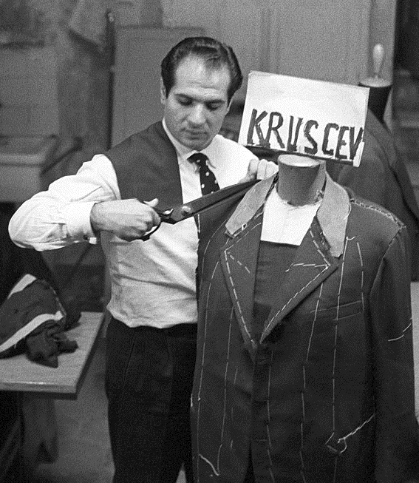
Tailored therapy ed ipertensione arteriosa: ogni paziente è diverso...

Slide 44
Therapeutic management of
the «frail» hypertensive patient
Soft and gradually progressive
«Tailored»
Target BP not strict
Signs and symptoms-limited
Adverse events and side effects-conditioned
Assess comorbidities and any interference between drugs
Assess carefully the Risk –Benefit ratio
Evaluate the clinical effect of the treatment(s)
Nami R, It J Pract Cardiology, 2015

Slide 45
Conclusioni
La gestione clinico-terapeutica del paziente iperteso complicato,
al di là delle raccomandazioni generali e mai definitive
delle LG, deve basarsi su:
Caratteristiche cliniche individuali del paziente
Presenza di danno d’organo o patologie cliniche associate
Presenza di co-morbilità
3. Terapia antiipertensiva mirata (tailored)
4. Follow-up clinico con markers di danno d’organo
affidabili ed a basso costo
5. Esperienza, prudenza e soprattutto buon senso clinico-pratico
del medico curante

Slide 46
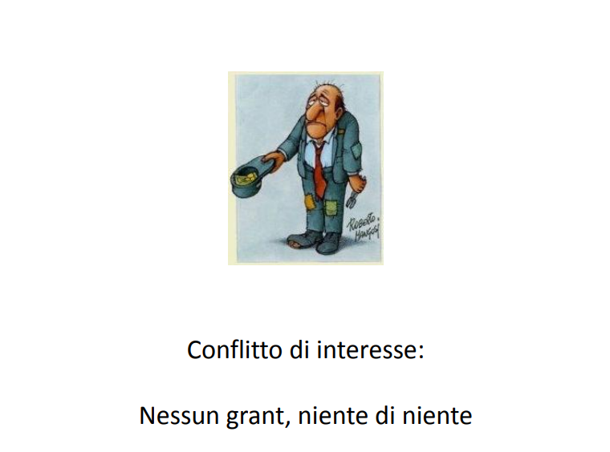
Grazie per l’attenzione

Slide 47
FINE

Slide 48
Nami R.
(Siena)

