Slide 1


Slide 2
Prof. Salvatore NOVO
Conflitto di Interessi
Progetti di Ricerche cliniche contrattualizzati
con l’A.O.U.P. “Paolo Giaccone”:
AMGEN – Behring - Boehringer Ingelheim –
Menarini - Pfizer – Sanofi -

Slide 3



A.O.U.P.
«Paolo Giaccone»
«Scuola di Medicina
Università di Palermo
Dipartimento di Scienze per la Promozione della Salute (PROSAMI)
Cattedra e Scuola di Specializzazione di Malattie dell’Apparato Cardiovascolare
Dipartimento di Emergenza e Urgenza
U.O.C. di Cardiologia con UTIC, Emodinamica, Elettrofisiologia,
Cardiologia Interventistica e Riabilitazione Cardiovascolare
Centro per la Diagnosi Precoce di Aterosclerosi Preclinica e Pluridistrettuale e
per la Prevenzione Secondaria delle Malattie Cardiovascolari
Centro di Riferimento Regionale per la Diagnosi e Cura dell’Insufficienza Cardiaca e per il Trattamento dell’Ipertensione Pulmonare - A.O.U. Policlinico “Paolo Giaccone” di Palermo
Direttore: Prof. Salvatore Novo
LETTURA DI SALVATORE NOVO
SINDROME METABOLICA, ResistENZA INSULINICA, E
ALTERAZIONI DELL’APPARATO CARDIOVASCOLARE
Presentata da M. Di Franco (Palermo)
Hilton Giardini Naxos (ME) – 4 Ottobre 2018 – ore 15.30 - 16.00

Slide 4
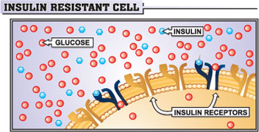
INSULIN-RESISTANCE

Slide 5
ATS AND CAD
Glucose intolerance
Abdominal obesity
Low HDL, hyperTG
Hypertension
Hyperinsulinemia
Insulin Resistance Syndrome
generate Metabolic Syndrome

Slide 6

ALTERATIONS OF COAGULATION
MACRO- AND MICRO- VASCULAR DISEASE
ENDOTHELIAL
DYSFUNCTION
SYSTEMIC
INFLIAMMATION
POLYCISTIC OYSTER
INSULIN-RESISTANCE
AND
METABOLIC SYNDROME
IMPAIRED GLUCOSE TOLERANCE
DYSLIPIDEMIA
HYPERTENSION
OBESITY
HYPERGLYCEMIA

Slide 7
Adipose Tissue Is an Endocrine Organ:
Its Function in Health and Disease
Hypertension
 Lipoprotein lipase
 Angiotensinogen
Inflammation
 IL-6
Atherogenic Dyslipidemia
 Insulin
 CRP
 Free Fatty Acids
 TNF 
 Resistin
 Leptin
 Adipsin
(Complement D)
Type 2 Diabetes
 Lactate
Atherosclerosis
 Plasminogen activator inhibitor-1
(PA-1)
 Adiponectin
Thrombosis
CRP = C-reactive protein; IL-6 = interleukin-6; TNFα = tumor necrosis factor-alpha
Trayhurn P, Wood IS. Br J Nutr. 2004;92:347–355
Eckel RH, et al. Lancet. 2005;365:1415–1428
Lyon CJ, et al. Endocrinology. 2003;144:2195–2200.
Notes:
7
Adipose Tissue Is an Endocrine Organ: Its Function in Health and Disease
Adipose tissue is the largest endocrine organ in the body and secretes hormones and cytokines, which are largely proinflammatory. Adiponectin — the antiinflammatory, proinsulin-sensitizing hormone from fat — is decreased with excess visceral adiposity, which further contributes to the proinflammatory state. Secretion of hormones and cytokines from adipocytes is primarily regulated by adipose tissue macrophages in a paracrine fashion. Inflammatory adipokines and free fatty acids lead to every component of the metabolic syndrome.
References:
Lyon CJ, Law RE, Hsueh WA. Minireview: adiposity, inflammation, and atherogenesis. Endocrinology. 2003;144:2195-2200.
Trayhurn P, Wood IS. Adipokines: inflammation and the pleiotropic role of white adipose tissue. Br J Nutr. 2004;92:347-355.
Eckel RH, Grundy SM, Zimmet PZ. The metabolic syndrome. Lancet. 2005;365:1415-1428.

Slide 8
Prevalence of the Metabolic Syndrome Among U.S. Adults IN THE NHANES 1988-94
45
Men
40
Women
35
30
25
Prevalence (%)
20
15
10
5
0
20-29
30-39
40-49
50-59
60-69
> 70
Age (years)
Ford E et al. JAMA 2002; 287 : 356-60
Notes:
Age-Specific Prevalence of the Metabolic Syndrome Among 8814 US Adults aged at least 20 years, by Sex, National Health and Nutrition Examination Survey III, 1988-1994

Slide 9
IN QUESTO è statA valutaTA la prevalenza della SM usando tre definizioni diverse (ATPIII, l’IDF e AHA) e l’associazione CON l’atS coronarica e periferica IN 947 PTS (52% M e 48% F).

Slide 10
Escludendo i pazienti diabetici (n = 259, 27%), la prevalenza della SM variava dal 32% usando la definizione ATPIII (n=220) e AHA/NHLBI (n=225) al 40% (n=274) secondo la definizione IDF (p <.0001)
Corrado E, Novo S et al. – Intern. Angiol. 2012; 31: 572-8

Slide 11
Prevalenza dell’atS carotidea (IMT e/o PLACCA) nei pazienti con SM vs controlli (0-2 FDR) secondo le tre definizioni usate
<.0004
<.0006
<.04
Prevalenza ATS carotidea
Corrado E, Novo S et al. – Intern. Angiol. 2012; 31: 572-8

Slide 12
Prevalenza di IHD (pregresso IM e/o0 anginA stabile) nei pazienti con SM vs controlli (0-2 FDR) secondo le tre definizioni usate
<.05
<.06
<.02
Prevalenza di IHD
Corrado E, Novo S et al. – Intern. Angiol. 2012; 31: 572-8

Slide 13
livelli di hs-PCR PIU’ ELEVATI NEI PAZIENTI CON SM vs controlli CON TUTTE LE definizionI USATe
<.03
<.03
<.01
% h-PCR > 3 mg%
Corrado E, Novo S et al. – Intern. Angiol. 2012; 31: 572-8

Slide 14
in 339 patients, At the end of 5-yearS follow-up, we registered cardio- and cerebro-vascular FATAL AND NON FATAL EVENTS in
29% of patients with the MS and in 20% of those without it (p < 0.01)
Transient ischemic attack
Stroke
Effort or unstable angina
Acute myocardial infarction
Peripheral artery disease
Cerebro- and Cardio-vascular death
Corrado E, Novo S et Al. – Intern. Angiol. 2012; 31: 572-8

Slide 15
Alberti KG et al. Harmonizing the metabolic syndrome. A joint interim statement of the IDF Task Force on Epidemiology and Prevention; NHLBI; AHA; WHF; IAS; and International Association for the Study of Obesity. Circulation 2009; 120: 1640-5

Slide 16
DEFINITION OF Metabolic Syndrome
Risk Factor (≥ 3) | Defining Level
Abdominal obesity | Waist circumference*
Triglycerides | ≥ 150 mg/dl
HDL-C | < 40 mg/dl in men; < 50 mg/dl in women
Blood pressure | ≥ 130/≥85 mm Hg
Fasting glucose | ≥ 100 mg/dl
*In Europe: Men > 102 cm - Women > 88 cm
Albert KG et al. Circulation 2009; 120: 1640-5
Notes:
Metabolic syndrome as a secondary goal after LDL-C
This slide shows the features of the metabolic syndrome. To achieve this diagnosis, a patient should have 3 or more of these characteristics.
Reference:
Expert Panel on Detection, Evaluation, and Treatment of High Blood Cholesterol in Adults. Executive summary of the third report of the National Cholesterol Education Program (NCEP) Expert Panel on Detection, Evaluation, and Treatment of High Blood Cholesterol in Adults (Adult Treatment Panel III). JAMA 2001;285:2486-2497.

Slide 17
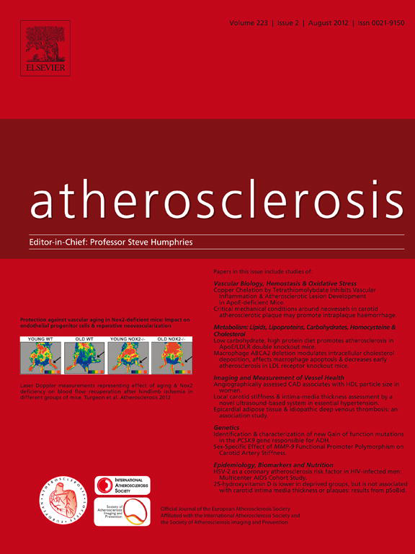
Metabolic syndrome (MetS) predicts cardio- and cerebrovascular events in a twenty years follow-up.
Novo S, Peritore A, Guarneri FP, Corrado E, Macaione F,
Evola S, Novo G. - Atherosclerosis 2012; 223: 468-72
From our registry of more than 9000 patients referred from 1985 to 1991 and in follow-up, we identified 529 asymptomatic subjects with Metabolic Syndrome at baseline, 257 male and 272 female, aged 25 to 85 years, with (n=251) or without (278) MetS according to the most recent definition by Albert KG et al. Circulation 2009; 120: 1640-5

Slide 18
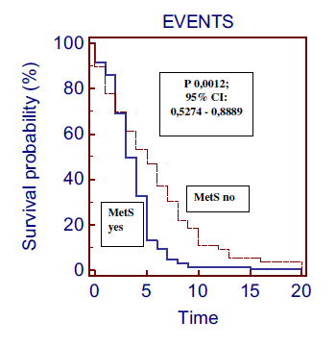
20 years follow-up
Free-events survival in patients suffering from MetS and not.
Novo S, Peritore A, Guarneri FP, Novo G, Atherosclerosis 2012; 223: 468-72
529 patients
251 patients suffering from MetS
278 healthy patients
242 Total
CV adverse events
120
Not fatal CV adverse events
120 Not Fatal CV adverse events – MetS
79 Not Fatal CV adverse No MetS
P < 0,0001
18

Slide 19

Preclinical aTS and meTS increase cardio- and cerebro-vascular events rate: a 20-year follow up
Novo S, Peritore A, Trovato RL, Guarneri FP, Di Lisi D, Muratori I, Novo G
Cardiovascular Diabetology 2013; 12: 155

Slide 20
Preclinical atherosclerosis and MetS increase cardio- and cerebrovascular events rate: a 20-year follow up. Novo S et al. Cardiovasc Diabetol. 2013; 23: 155-62
251 patients suffering from MetS
278 healthy patients
Results
144 total CV adverse events
98 total CV adverse events
P < 0,0001
108 in pts with Carotid
ATS
36 in pts without Carotid ATS
71 in pts with Carotid
ATS
27 in pts without Carotid ATS
P < 0,0099 – RR 3.0
P < 0,0003 – RR 2.6

Slide 21
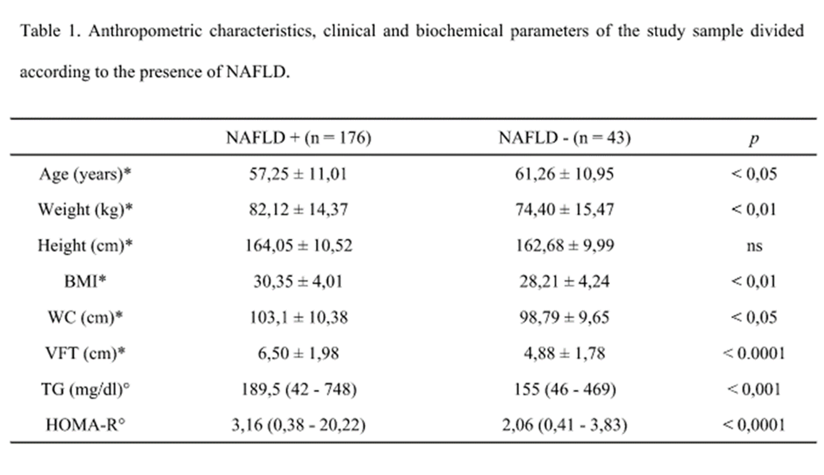
Relationship between NAFLD and preclical carotid ATS in a population with MetS.
Novo S, Montalto MA, Cefalù AB, Giannitrapani L, Muratori I, Noto D,
Soresi M, Novo G, Barbagallo CM, Averna MR, submitted

Slide 22
Results
The prevalence of Carotid ATS (IMT/PLAQUE) in patients without NAFLD was 8/43 subjects (19%), while in patients with NAFLD was 114/176 subjects (65 %); the chi-square tests showed statistical significant difference ( χ2= 4,39; p< 0,05).

Slide 23
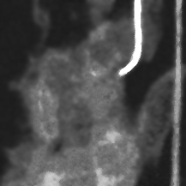
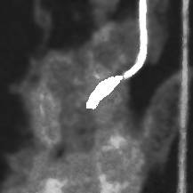
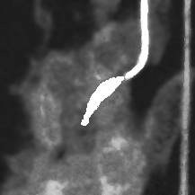
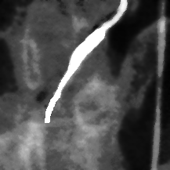
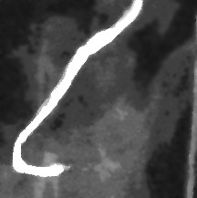
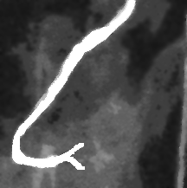
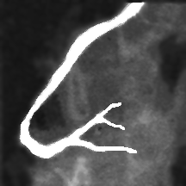
Study methods
Coronary angiography: Timi Frame Count (TFC)
0
1
2
3
4
5
TFC ≥ 40 → PATHOLOGICAL
6
Gibson CM et al. TIMI frame count: a quantitative method of assessing coronary artery flow.
Circulation 1996; 93: 879-88

Slide 24
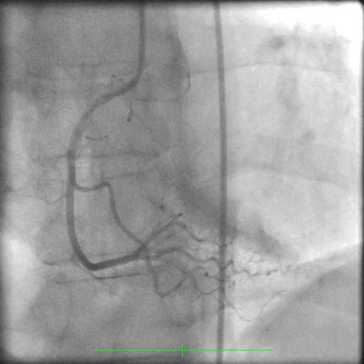
ANGIOGRAPHIC ANALYSIS OF CORONARY MICROCIRCULTION IN BASAL CONDITIONS (2)
Miocardial Blush Grade: Evaluate the passage of the contrast medium in the microcirculation, as a radiopaque "nubecola" on downstream of subepicardial vessels, in relation to the number of cardiac cycles in which it is determined and where vanishes.
< 3 cycle → MBG = 3
> 3 cycle → MBG = 2
Gibson CM et al. TIMI frame count: a quantitative method of assessing coronary artery flow.
Circulation 1996; 93: 879-88

Slide 25

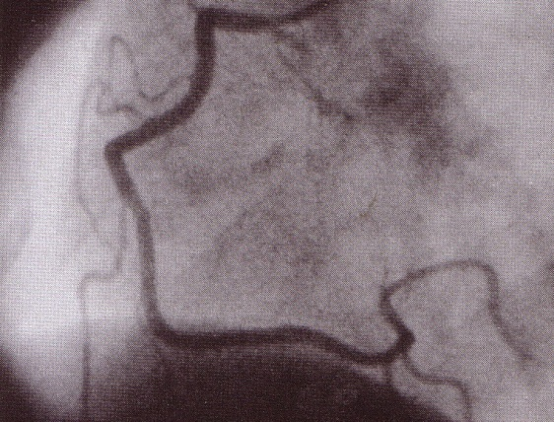

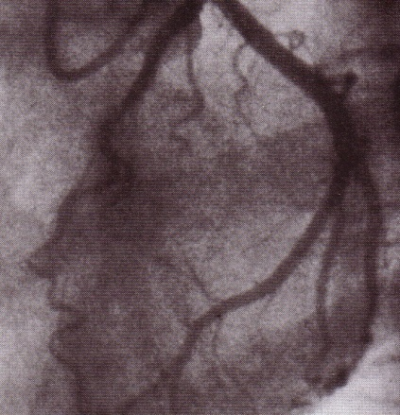
Study methods
Total Myocardial Blush Score (TMBS)
Total TIMI Frame Count (TTFC)
TMBS
TTFC
Atmaca Y. et al. Angiographic evaluation of myocardial perfusion in patients with syndrome X. Am J Cardiol 2005; 96: 803-5.
Notes:
Nel creare questo nuovo indicatore, il Total TIMI (Thrombolysis in Myocardial Infarction) Frame Count, ci siamo basati sullo stesso principio sfruttato da Yusuf e colleghi nel creare il Total Myocardial Blush Score. Cioè una SOMMATORIA dei TIMI Frame Count.

Slide 26
Comparison of TIMI FRAME COUNT (TFC) and MYOCARDIAL BLUSH GRADE (MBG) IN SUBJECTS WITH metabolic syndrome and IN control subjects
 | Metabolic Syndrome N=128 | Controls Subjests N=155 | P value
TFC IVA | 28 +/- 6.6 | 18.8 +/- 4.7 | P < 0.0001
TFC CX | 24.5 +/- 6.4 | 20.8 +/- 4.6 | P = 0.0027
TFC RCA | 18.7 +/- 6.3 | 14.6 +/- 4.5 | P = 0.0009
TTFC | 71.2 +/- 6,4 | 54.2+/-4.6 | P < 0.0001
MBG IVA | 2.31 +/- 0.46 | 2.94 +/- 0.23 | P < 0.0001
MBG CX | 2.28 +/- 0.45 | 2.91 +/- 0.28 | P < 0.0001
MBG RCA | 2.31 +/- 0.46 | 2.66 +/- 0.47 | P = 0.0005
TMBG | 6.90+/- 0.45 | 8.51 +/-0.32 | P < 0.0001
Sucato V, Evola S, Alibani A, Novo G, Novo S. Int J Cardiol Int. 2015; 186: 96-97

Slide 27
METS INCREASE Cardiovascular Mortality in the Kuopio IHD AND RF Study
Cardiovascular Disease Mortality
RR (95% CI), 3.55 (1.98–6.43)
Metabolic
Syndrome
YES
Cumulative Hazard, %
NO
0
2
4
6
8
10
12
Follow-up, year
Lakka HM et al. JAMA 2002; 288: 2709-16
Notes:
Cardiovascular disease mortality increased in the metabolic syndrome: Kuopio Ischemic Heart Disease Risk Factor Study
In a study of slightly more than 1,000 males from Kuopio, Finland, followed up for 10 years, Lakka et al. showed a 3.5-fold increase in risk for cardiovascular disease mortality. This increased risk is as high as or higher than the risk of type 2 diabetes for cardiovascular disease in males described in many other studies such as the Framingham Study. Other studies such as the NHANES analysis suggest a much lower risk of the metabolic syndrome for cardiovascular disease in nondiabetic subjects.
References:
Lakka HM, Laaksonen DE, Lakka TA, Niskanen LK, Kumpusalo E, Tuomilehto J, Salonen JT. The metabolic syndrome and total and cardiovascular disease mortality in middle-aged men. JAMA 2002;288:2709-2716.
Alexander CM, Landsman PB, Teutsch SM, Haffner SM. NCEP-defined metabolic syndrome, diabetes, and prevalence of coronary heart disease among NHANES III participants age 50 years and older. Diabetes 2003;52:1210-1214.

Slide 28
Effect of the Metabolic Syndrome on Outcomes in Patients Aged < 50 Years Versus THOSE > 50 Years With PRIMARY PCI AND RE-AMI
Data are lacking on the association of MS with clinical outcomes in young adults with AMI.
In a retrospective analysis of 2,082 patients with AMI who underwent PCI < 50 years, recurrent AMI (re-AMI) was the highest in young AMI patients with MS (4.8% vs 1.4%, p = 0.03, respectively).
In Kaplan-Meier curve, young AMI patients with MS tend to have highest incidence of re-AMI (p = 0.05).
MetS was an independent predictor of 6-year major cardiac and cerebral events (hazard ratio 3.3, 95% confidence interval 1.073 to 10.283, p = 0.03) and re-AMI (hazard ratio 7.7, 95% confidence interval 1.290 to 45.298, p = 0.02).
Kim I et al. Am J Cardiol. 2018; 122: 192-8

Slide 29
* La SM è presente in almeno 1/3 della popolazione mondiale, è in aumento (vedi EuroAspire IV) ed è preceduta dalla Sindrome da Insulino Resistenza
* L’Insulino-Resistenza e il tessuto adiposo in eccesso creano una serie di condizioni fisiopatologiche favorenti l’ATS preclinica e, successivamente, conclamata, con le sue classice complicanze (AMI, Ictus, PAD, etc)
* Anche il microcircolo coronarico è compromesso nella SM ancorquando i pazienti sono apparentemente asintomatici o pauci-sintomatici
* L’IMA e le complicanze cardiovascolari cerebrali sono significativamente più frequenti nei pazienti con SM
PRIME CONSIDERAZIONI

Slide 30
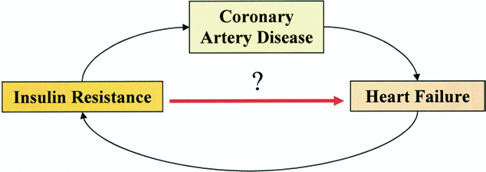
INSULIN RESISTANCE AND CARDIOVASCULAR RISK
“INSULIN-RESISTANT CARDIOMYOPATHY”
Witteles RM, Fowler MB. Insulin-Resistant Cardiomyopathy: Clinical Evidence, Mechanisms, and Treatment Options. JACC 2008; 51: 93-102
Notes:
insulin resistance can contribute to the development of coronary diseases and therefore to heart failure. Heart failure in turn will contriubiusce to worsen the insulin resistance.
it was coined the term of

Slide 31
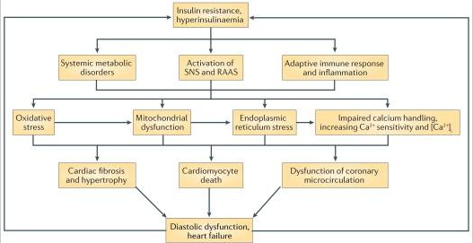
INSULIN RESISTANCE AND IMPARED CARDIAC FUNCTION: PATHOPHYSIOLOGY
Jia G, DeMarco VG, Sowers JR. Insulin resistance and hyperinsulinaemia in diabetic cardiomyopathy. Nature reviews Endocrinology. 2016; 12: 144-53
Notes:
In summary
Patients resistant to insulin there is a reduced availability of sarcolemmal transporters GLUT-4, resulting in decreased glucose absorption. This
leads to a kind of “metabolic switch” of the normal aerobic glycolysis, resulting in greater utilization of free fatty acid (FFA) to ensure an
adequate production of adenosine triphosphate (ATP), especially in conditions of stress. In this way there is higher oxygen consumption
and increased oxidative stress, which is associated to the alteration of Ca2+ homeostasis at the level of myocardial cells [19]. Recent studies
have validated the hypothesis that insulin resistance may also affect other mechanisms: the signal transduction pathways directly activated
by insulin, the altered cytokine pattern, particularly the adipokines (leptin and adiponectin included), generating a proinflammatory status
and the pathways of proliferator-activated receptor of peroxisomes

Slide 32
Diabetes mellitus and insulin resistance associate with lV shape and torsion by cMR imaging in asymptomatic individuals from the multi-ethnic study of aTS
METHODS: 1476 participants free of clinical CVD who underwent CMR in the Multi-Ethnic Study of Atherosclerosis (MESA). LV shape and longitudinal myocardial shortening and torsion were assessedas well as HOMA-IR for estimation of Insulin Resistance.
RESULTS: In multiple linear regression, longitudinal shortening was lower in impaired fasting glucose than normal fasting glucose (0.36% lower vs. NFG, p < 0.05).
Greater log-HOMA IR was associated with lower longitudinal shortening (- 0.26%/index, p < 0.05) and circumferential shortening (- 0.30%/index, p < 0.05). Torsion was positively correlated with log-HOMA-IR until 1.5 of log-HOMA-IR (0.16 °/cm/index, p = 0.030).
Yoneyama K et al. J Cardiovasc Magn Reson. 2018; 20: 53

Slide 33
Cardiac Autonomic Neuropathy in DIABETES AND METABOLIC SYNDROME:
A Predictor of Cardiometabolic Events.
Vinik AI et al. Front Neurosci. 2018;12: 591 – 6

Slide 34
Determining Factors of Arterial Stiffness in Subjects with Metabolic Syndrome
Cozma A et al. - Metab Syndr Relat Disord. 2018; Sept 5. doi:10.1089/met.2018 [Epub ahead of print]

Slide 35
NOSTRO INTERESSE A STUDIARE LE ALTERAZIONI PRECOCI DELLA FUNZIONE MIOCARDICA, VASCOLARE E DELLA REATTIVITA’ DEL SISTEMA NERVOSO AUTONOMICO SIMPATICO IN SOGGETTI APPARENTEMNENTE SANI MA CON INSULINA RESISTENZA

Slide 36
AIM OF OUR STUDY
To evaluate the impact of Insulin Resistance on: a) myocardial function; b) vascular damage; c) HR variability, in subjects with CV RFs but without diabetes mellitus or coronaropathy, so to identify subjects at risk, who need a more accurate evaluation and a more aggressive strategy of prevention.
MATERIALS AND METHODS
The experimental study has been performed in the Division of Cardiology of the University Hospital «Paolo Giaccone» of Palermo. Enrolled patients had almost two CV RFs, and were admitted for suspected CHD, but coronary arteries were normal at the coronaro- angiography.

Slide 37
MATERIALI E METOI
150 pazienti con coronarie risultate indenni da lesioni significative all’esame CVG
CRITERI DI ESCLUSIONE (1)
- Diabete Mellito
- CAD evidenziata alla CVG o presenza di ponti intramiocardici
- Creatinina superiore a 1,5 mg/dl
- Ipertrofia ventricolare sinistra
Fibrillazione atriale oppure altre aritmie gravi
- Patologie valvolari più che lievi
Frazione di eiezione inferiore al 50%
Fibrillazione atriale permanente, Flutter atriale o altre aritmie per un tempo superiore al 10% della registrazione Holter nelle 24H
CRITERI DI ESCLUSIONE (2)
- BAV di Secondo o Terzo grado
- Pacemaker
-Miocarditi in fase attiva e alla
anamnesi
- Storia di Angina Instabile
- Malattia Polmonare Instabile
- Storia di Tossicodipendenza,
Malattie Psichiatriche con uso di
farmaci antipsicotici o
antidepressivi in atto
- Cirrosi
- Precedenti Ictus Cerebrali
65 soggetti asintomatici (M: F=40:25)

Slide 38
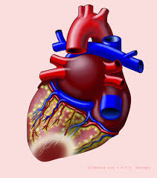
VALUTAZIONE DELLA FUNZIONE MIOCARDICA
- Ecocardiografia Standard
- Doppler tissutale a livello dell’anello mitralico
- Speckle Tracking Echocardiography
Lo Speckle Tracking Echocardiography (STE) è una nuova tecnica non invasiva, a ultrasuoni, che permette una valutazione obiettiva e quantitativa della funzione miocardica sia globale che regionale. Tra i parametri misurati in particolare abbiamo lo Strain (ε ) che rappresenta la percentuale di deformazione di una fibra miocardica rispetto alla sua lunghezza iniziale, espressa dalla formula:
(Strain) ε = (L – L0 )/ L0

Slide 39
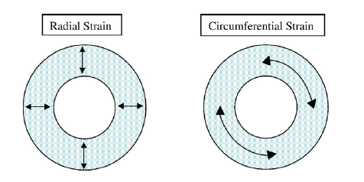
MECCANICA CARDIACA DEL CUORE
Longitudinal Function
TWIST
Movimento della base verso l’apice
Differenza tra la rotazione in senso orario della base e antiorario dell’apice
Radial function
Circumferential function
Ispessimento del miocardio
Variazione della lunghezza
lungo il perimetro circolare
Notes:
Durante la sistole il ventricolo subisce una complessa deformazione tridimensionale grazie alla disposizione spaziale delle fibre miocardiche che lo costituiscono: accorciamento longitudinale e movimento di twisting, accorciamento circonferenziale e radiale
La rotazione in senso antioario del loop apicale prevale

Slide 40
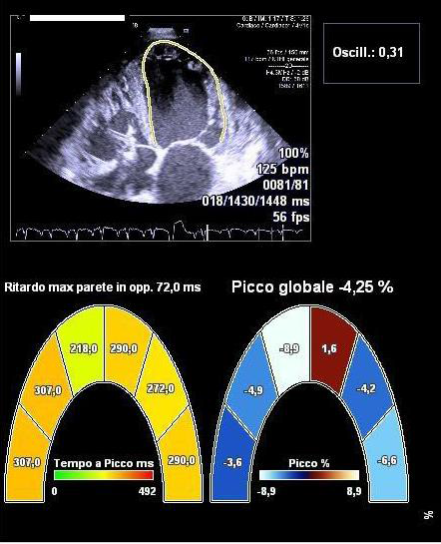
Nel nostro studio, in particolare, oltre i classici parametri ecocardiografici, abbiamo tenuto conto dello Strain longitudinale globale (GLS), valutato come media del valore di strain sistolico in 16 segmenti.

Slide 41
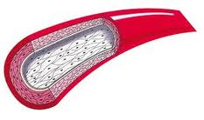
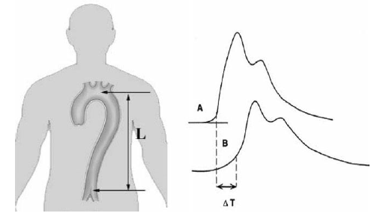

VALUTAZIONE DELLA FUNZIONE VASCOLARE
Eco-Doppler dei tronchi sovraortici:
- Valutazione e quantificazione dell’IMT
- Identificazione e quantificazione di eventuali placche ATS
- Misurazione della rigidità vasale (STIFFNESS)

Slide 42
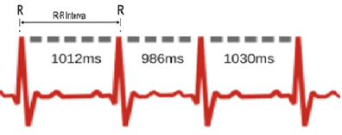
VARIABILITA’ DELLA FREQUENZA CARDIACA (HRV)
CALCOLO DELLA VARIABILITA’ DELLA FREQUENZA CARDIACA
Sono stati utilizzati metodi di analisi del dominio del tempo:
Abbiamo preferito l’utilizzo di valutazioni long-term della frequenza, piuttosto che short term. In questo modo è stato possibile fare uno studio complessivo della regolazione autonomica del cuore, anche di notte, inoltre i dati non sono inficiati da fattori confondenti come le emozioni, artefatti da movimento, come invece sarebbe accaduto con valutazioni short-term, con parametri di dominio della frequenza.
- SDANN
- SDNN-index
- RMSSD
Le valutazioni long-term della HRV sono state condotte tramite un esame ECG-holter nelle 24 h.

Slide 43
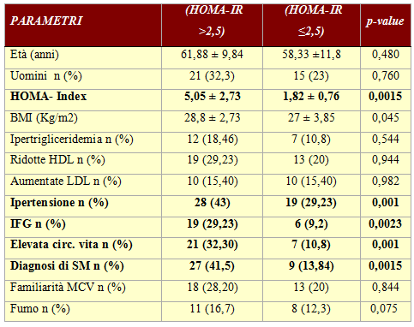
RISULTATI
Abbiamo suddiviso la popolazione dello studio in due gruppi, in base al valore di HOMA-IR pari a 2,5 [6]
Distinguiamo:
- Gruppo 0: HOMA-IR ≤2,5 (n=30)
- Gruppo 1: HOMA-IR >2,5 (n=35 )
6. Insulin resistance (HOMA-IR) cut-off values and the metabolic syndrome in a general adult population: effect of gender and age: EPIRCE cross-sectional study. Pilar Gayoso-DizBMC Endocrine Disorders 2013 13:47

Slide 44
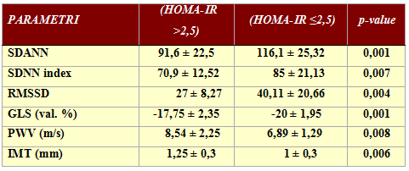
RISULTATI

Slide 45
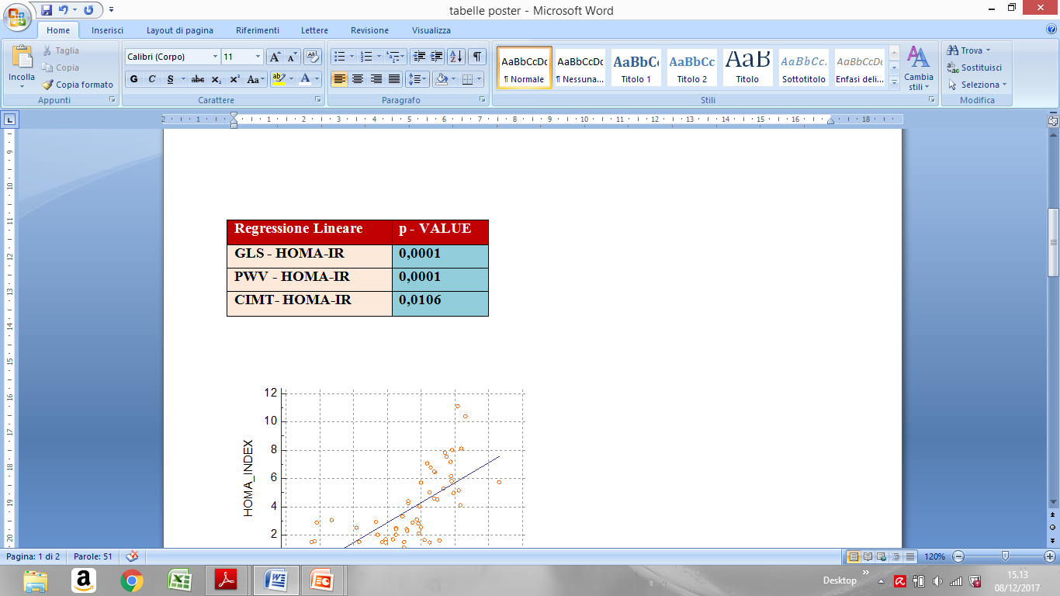

Slide 46
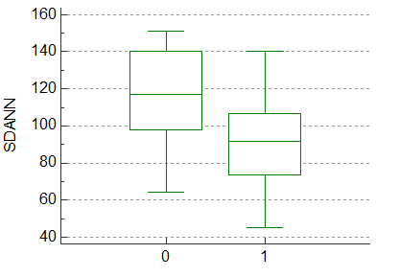
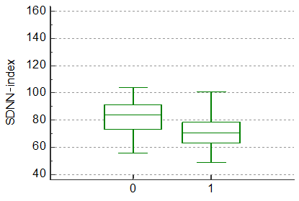
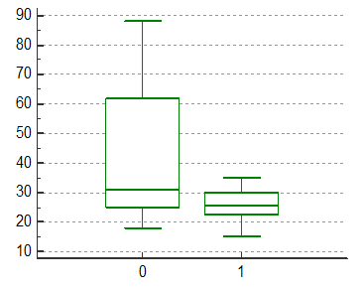
p=0,001
p=0,007
HOMA-IR ≤ 2,5
HOMA-IR > 2,5
HOMA-IR ≤ 2,5
HOMA-IR > 2,5
p=0,004
RMSSD
HOMA-IR ≤ 2,5
HOMA-IR > 2,5

Slide 47
P < 0,0209
P < 0,0053
Significativa correlazione negativa tra i valori di HOMA-IR SDNN-index
Significativa correlazione negativa tra i valori di HOMA-IR e SDANN
P < 0,0004
Significativa correlazione negativa tra i valori di HOMA-IR e RMSSD

Slide 48
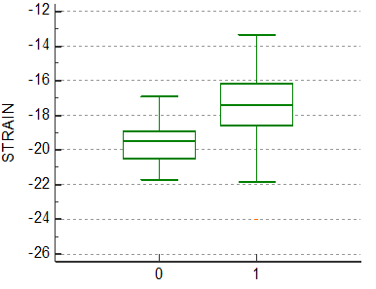
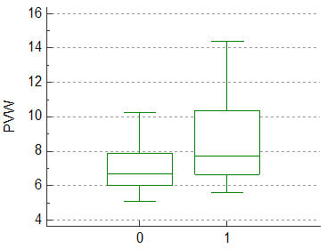
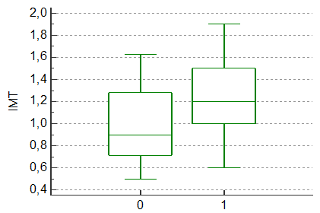
p=0,001
HOMA-IR ≤ 2,5
HOMA-IR > 2,5
p=0,006
p=0,008
HOMA-IR ≤ 2,5
HOMA-IR > 2,5
HOMA-IR ≤ 2,5
HOMA-IR > 2,5

Slide 49
P < 0,0001
P < 0,0001
Significativa correlazione positiva tra maggiori valori di HOMA-IR e minori di GLS
Significativa correlazione positiva tra i valori di HOMA-IR e PWV
P < 0,00106
Significativa correlazione positiva tra i valori di HOMA-IR e IMT

Slide 50
CONCLUSIONI
La resistenza all’insulina e quindi l’iperinsulinismo, sono associati ad alterazioni subcliniche a livello miocardico e vascolare.
Lo Speckle-tracking echocardiography, e lo studio della variabilità della frequenza cardiaca si sono rivelati efficaci nell’individuazione precoce di alterazioni strutturali e funzionali a livello del cuore (HFpEF, ridotto GLS, disregolazione autonomica, ridotta HRV). Lo stesso dicasi per l’Eco-tracking a livello dei vasi periferici in termini di aumento della stiffness.
Un loro utilizzo su larga scala, in questa categoria di pazienti, può essere utile al fine di attuare adeguati programmi di screening, opportuni cambiamenti dello stile di vita ed eventualmente interventi farmacologici mirati.

Slide 51

CONCLUSIONI
I nostri risultati, infine, rafforzano il concetto di “ventricular arterial coupling”, ovvero la stretta correlazione tra stiffness ventricolare e arteriosa. Il cuore, con le sue alterazioni sia strutturali che funzionali e i vasi non possono essere considerati elementi avulsi, bensì come un unicum, influenzandosi vicendevolmente nelle manifestazioni e complicanze delle malattie cardiovascolari. Pertanto devono essere indagati in pazienti a rischio, nella prospettiva di interventi preventivi e terapeutici, che possano agire con un sinergismo positivo su ambedue i fronti.
Variazioni del GLS
INSULINO-RESISTENZA E IPERINSULINSIMO
Aumento della Stiffness e IMT
Ridotta HRV

Slide 52
COLLABORATORI
Alibani Andrea, AIF - Bonomo Vito, AIF - Caccamo Giuseppina, DM - Cangemi Stefano, L - Coppola Giuseppe, DM - Corrado Egle, RC - Dell’Oglio Sonia, DM - Di Lisi Daniela, DM - Evola Giovanna, DM – Evola Vincenzo, AIF - Evola Salvatore, DM - Guarneri Francesco Paolo, AIF - Levantino Piero, AIF - Macaione Francesca, DM - Manno Girolamo, AIF - Mignano Antonino, DR - Montalto Maria Alessandra, AIF - Muratori Ida, DM - Novo Giuseppina, PA - Nugara Cinzia, DM e DR - Pace Giuliana, DR - Peritore Angelica, DM, Rizzo Manfredi, PA - Russo Rosario, DM - Sucato Vincenzo, DR - Tantillo Rosalba, DM - Trovato Rosalinda, DM

Slide 53

GRAZIE PER L’ATTENZIONE!

