Slide 1
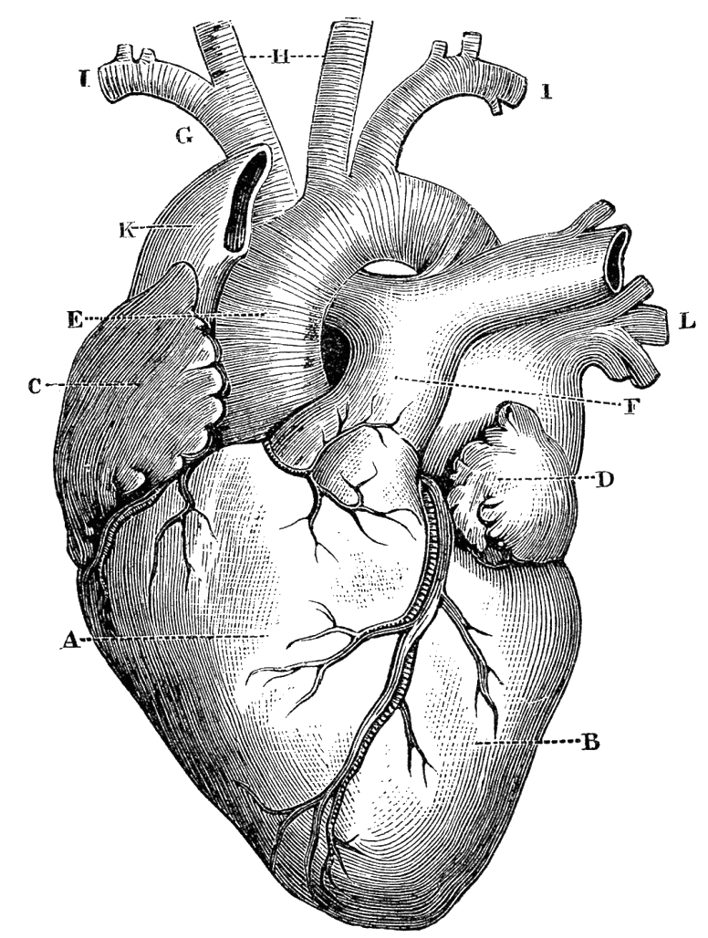


Impact of Non-Ischemic Fibrosis on
Echo-evidenced Right Ventricular Function among Patients with Ischemic Mitral Regurgitation
Di Franco Antonino, MD
Postdoctoral Associate in Medicine - Dept. of Cardiology
Advanced Cardiovascular Imaging Program
Weill Cornell Medicine | New York-Presbyterian Hospital
DISCLOSURES: NONE
525 East 68th Street
New York, NY 10021
Phone: (646) 962-4733,
Fax: (212) 746-8561
and2052@med.cornell.edu

Slide 2
Background
Ischemic mitral regurgitation (iMR) predisposes to RV Pressure and Volume overload, providing a nidus for RV dysfunction (RV_{DYS}) and Non-Ischemic Fibrosis (NIF)
Cardiac Magnetic Resonance (CMR) provides accurate volumetric quantification of RV function and tissue properties, including NIF
Notes:
To begin this talk we want to keep in mind that ischemic MR is known to predispose…

Slide 3
HOW MUCH ATTENTION
DO WE ACTUALLY PAY ON
RV FUNCTION AND NIF?

Slide 4

A BRIEF TEST
∼100% of men did not notice a gorilla is in the picture
IT IS ALL ABOUT YOUR FOCUS

Slide 5
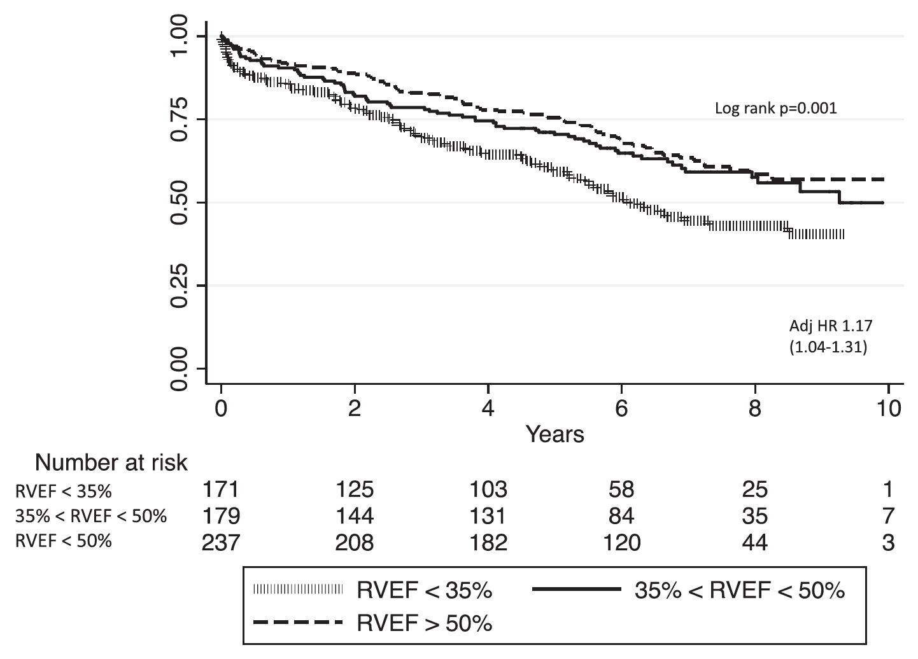
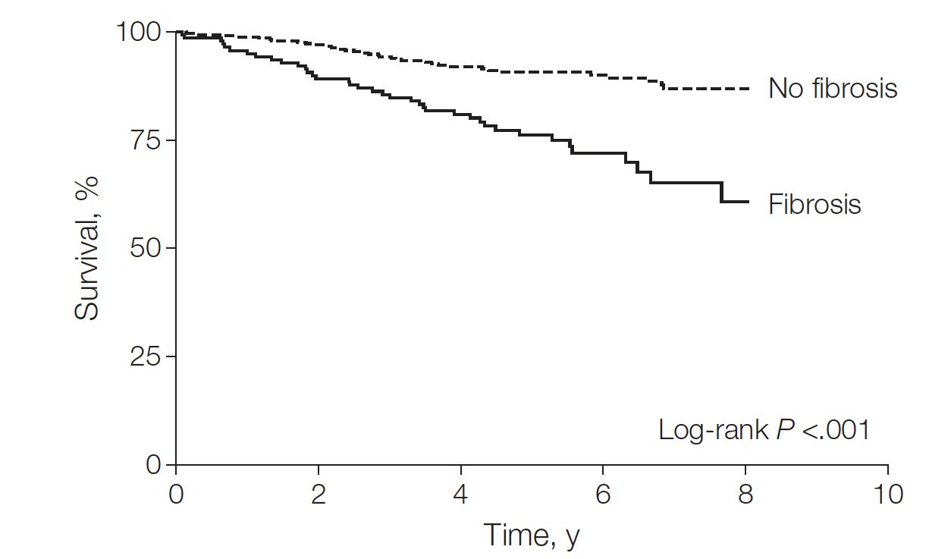
Background
Ischemic Cardiomyopathy
Sabe MA et al. Circulation. 2016;134:656-665.
Ischemic mitral regurgitation (iMR) predisposes to RV Pressure and Volume overload, providing a nidus for RV dysfunction (RV_{DYS}) and Non-Ischemic Fibrosis (NIF)
Cardiac Magnetic Resonance (CMR) provides accurate volumetric quantification of RV function and tissue properties, including NIF
Both RV_{dys} and NIF on CMR have been associated with adverse prognosis
Gulati A et al. JAMA. 2013;309:896-908.
Notes:
To begin this talk we want to keep in mind that ischemic MR is known to predispose…

Slide 6
Background
Conventional echo RV indices → limited agreement with CMR-RVEF
Possible reasons for CMR/echo discordances in prior literature:
-Mixed cohorts
Focardi et al. EHJ CV IMG 2015 → myocarditis, IDCM, HCM, ARVD, infiltrative diseases
-Broad interval between modalities
Park JH et al. J CV US 2014 → 10±15 days
-State of the art echo approaches variably included
Kim J et al. JASE 2016 → no strain assessment
Impact of altered RV myocardial tissue properties on agreement between CMR-RVEF and echo indices has not been studied
Given that RV_{DYS} and NIF impact prognosis, validation of
conventional and emerging echo indices vs. CMR is important

Slide 7
STUDY AIMS
To assess prevalence of CMR-evidenced RV_{DYS} (RVEF< 50%) among patients with iMR and compare the ability of conventional and strain echo indices to act as markers of CMR-evidenced RV_{DYS}
To assess prevalence of Non-Ischemic Fibrosis (NIF) among patients with iMR and compare the ability of conventional and strain echo indices to act as markers of NIF

Slide 8
STUDY DESIGN
Prospective protocol examining iMR patients
History of CAD and/or previous PCI
and/or ECG/imaging-evidenced
infero-lateral MI
Primary MR (e.g. prolapse)
INCLUSION CRITERIA
Mitral Valve replacement
EXCLUSION CRITERIA
≥MILD MR (via echo)
Contraindication to CMR
TRANSTHORACIC ECHO
Max interval: 72h
CARDIAC MRI
TAPSE
RV-S’
FAC
RV-GLS & REGIONAL RV-LS
Cine-CMR
(cardiac structure/function)
DE-CMR
(myocardial tissue characterization)

Slide 9
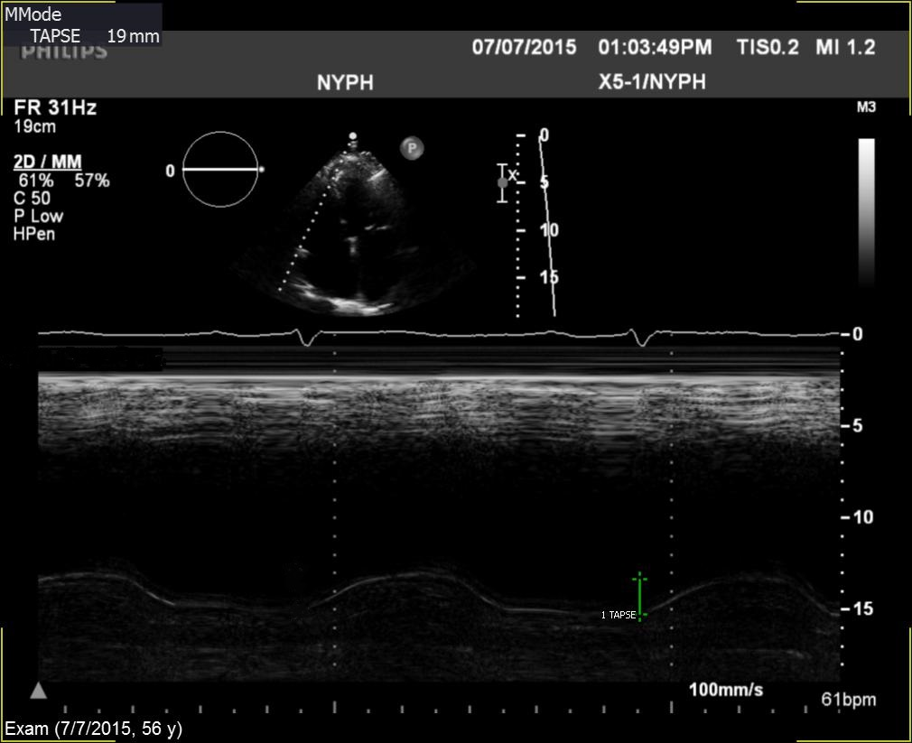
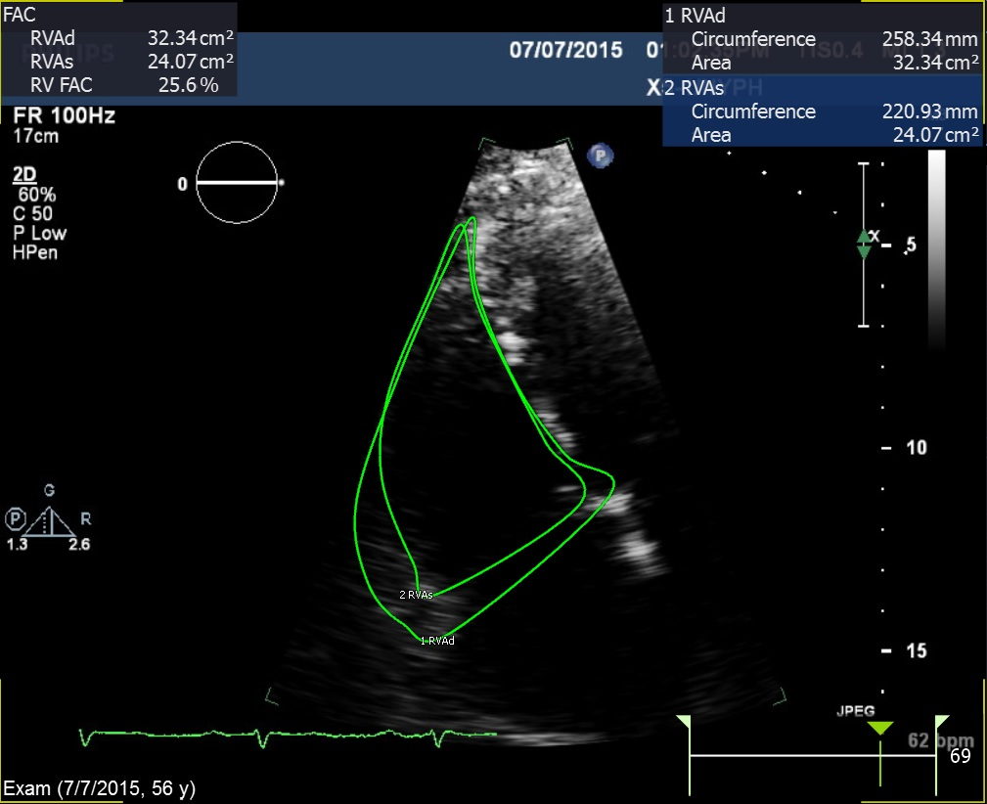
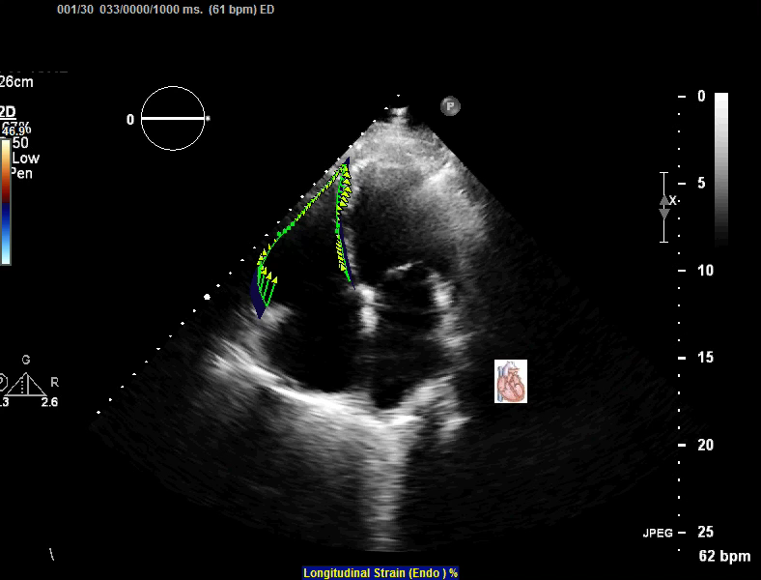
METHODS
Tricuspid Annular Plane
Systolic Excursion
RV Peak Tricuspid Annular
Systolic Velocity
RV-S’: 11.2 mm/s
TAPSE: 1.9 cm
RV Fractional Area Change
RV Global Longitudinal Strain
FAC: 21%
RV-GLS: 15.0%
Notes:
This a representative case of a patient enrolled in our study…
CMR showed RVEF of 41% so this patient had RVDYS.
But if we assess RV function by means of conventional linear indices like TAPSE, results are in the normal range (TAPSE was 1.9 cm).
Nevertheless, when area-based and strain evaluations were performed, results were consistent with CMR-RVEF (FAC 21%, RV-GLS 15%), as opposed to conventiale linear indices.
MWF: yes, prior MI and prior PCI

Slide 10
METHODS
RV-GLS: 15.0%

Slide 11
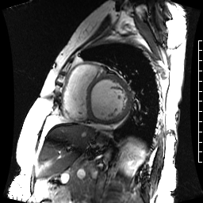
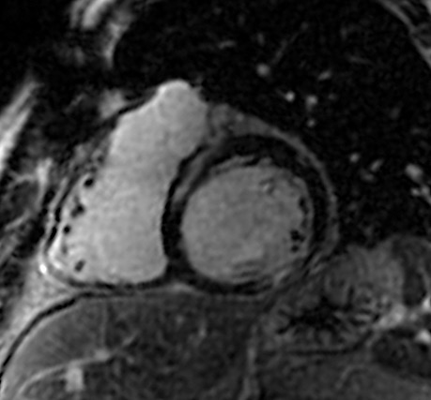
METHODS
CMR was used as the reference standard for
RV_{DYS} and tissue remodeling
RVdys assessed both as a continuous variable (RVEF) as well as using a binary cutoff of EF< 50%
NIF defined as localized hyperenhancement in the mid myocardial or epicardial aspect of the basal to mid inter-ventricular septum
Kim et al. PloS One 2016, Swift et al. JACC CV Img 2014
Marker of response
to increased
RV afterload
Notes:
Note that this pattern spares the subendocardium and is localized in mid-myocardial aspect of the IV septum only

Slide 12
STUDY AIMS
To assess prevalence of CMR-evidenced RV_{DYS} (RVEF< 50%) among patients with iMR and compare the ability of conventional and strain echo indices to act as markers of CMR-evidenced RV_{DYS}
To assess prevalence of Non-Ischemic Fibrosis (NIF) among patients with iMR and compare the ability of conventional and strain echo indices to act as markers of NIF

Slide 13
RESULTS
73 patients with iMR undergoing Echo and CMR within 3 days
- 96% same day
mean interval: 0.2±0.6 days
CMR-DEFINED RV_{DYS} (RVEF< 50%) was present in 36% of the population
CMR-DEFINED RV_{DYS} → 3-FOLD MORE COMMON
IN PATIENTS WITH ADVANCED MR [73% vs 27%, P>0.001]
Notes:
Nearly all people

Slide 14
RESULTS
ADVANCED MR → 2.5-FOLD MORE COMMON AMONG PATIENTS WITH CMR-EVIDENCED RV_{DYS} [73% vs. 30%, p= 0.001]
RV_{DYS} on CMR independently associated with advanced MR (OR 6.1 [95% CI 1.7-21.4]; p=0.005) after controlling for magnitude of CMR-defined LV_{DYS}
(OR 2.0 per 10-point decrement in LVEF [CI 1.4-2.6]
p< 0.001) (model χ²=32.95, p<0.001)
Substitution of echo derived LVEF in the model yielded similar results, again showing RV_{DYS} to be associated with advanced MR (OR 5.5 [95% CI 1.6-19.3]; p=0.008) independent of global LV dysfunction (OR 2.0 per 10-point decrement in LVEF [95% CI 1.5-2.6]; p< 0.001) (model χ²=32.98, p< 0.001)
Notes:
Strong, NOT EXTREMELY STRONG

Slide 15
 | Overall (n=73) | RV_{DYS} - (n=47) | RV_{DYS} + (n=26) | p
Clinical
Age (years) | 68.3±9.9 | 68±9 | 70±11 | 0.38
Male gender | 61 (84%) | 37 (79%) | 24 (92%) | 0.19
Cardiovascular risk factors
Hypertension | 58 (80%) | 39 (83%) | 19 (73%) | 0.32
Hypercholesterolemia | 55 (75%) | 37 (79%) | 18 (69%) | 0.37
Diabetes Mellitus | 39 (53%) | 24 (51%) | 15 (58%) | 0.59
Tobacco Use | 43 (59%) | 26 (55%) | 17 (65%) | 0.40
Family History | 17 (23%) | 11 (23%) | 6 (23%) | 0.98
Prior events/procedures
Prior myocardial infarction | 42 (58%) | 26 (55%) | 16 (62%) | 0.61
Prior PCI or CABG | 58 (80%) | 36 (77%) | 22 (85%) | 0.42
Medications
Beta-blocker | 60 (82%) | 38 (81%) | 22 (85%) | 0.76
ACE-Inhibitor or ARBs | 42 (58%) | 22 (47%) | 20 (77%) | 0.013
Loop diuretic | 26 (36%) | 11 (23%) | 15 (58%) | 0.003
HMG CoA-Reductase Inhibitor | 59 (81%) | 38 (81%) | 21 (81%) | 0.99
Aspirin | 62 (85%) | 41 (87%) | 21 (81%) | 0.51
Thienopyridine | 32 (44%) | 20 (43%) | 12 (46%) | 0.81

Slide 16
 | Overall (n=73) | RV_{DYS} - (n=47) | RV_{DYS} + (n=26) | p
CARDIAC MAGNETIC RESONANCE
LV Ejection fraction (%) | 42.4±16.0 | 48.7±14.4 | 31.1±12.2 | <0.001
LV End-diastolic volume (ml) | 202.7±61.9 | 186.3±60.1 | 232.4±54.6 | 0.002
RV Ejection fraction (%) | 51.7±11.9 | 58.8±6.6 | 38.9±7.9 | <0.001
RV End-diastolic volume (ml) | 151.5±51.1 | 138.7±43.0 | 174.7±56.9 | 0.003
ECHOCARDIOGRAPHY
LV Ejection fraction (%) | 41.9±15.9 | 48.1±14.8 | 30.6±10.8 | <0.001
LV End-diastolic diameter (cm) | 5.9±0.6 | 5.7±0.6 | 6.2±0.6 | 0.004
Pulmonary Arterial Pressure* (mmHg) | 38.0±16.1 | 34.3±14.5 | 44.4±16.9 | 0.02
Pulmonary Hypertension* | 30 (41%) | 15 (32%) | 15 (58%) | 0.032
Advanced mitral regurgitation (≥moderate) | 33 (45%) | 14 (30%) | 19 (73%) | 0.001
Regurgitant Fraction (%) | 39.2±14.6 | 35.9±14.8 | 43.9±13.3 | 0.03
Vena Contracta | 0.3±0.1 | 0.3±0.1 | 0.4±0.1 | 0.02
*Available in 78% of the study population

Slide 17
RESULTS
CONVENTIONAL ECHO INDICES OF RV FUNCTION
p< 0.001
p< 0.001
p< 0.001
 | Overall (n=73) | RV_{DYS} - (n=47) | RV_{DYS} + (n=26)
TAPSE (cm) | 1.8±0.4 | 1.9±0.4 | 1.5±0.3
RV-S’ (cm/sec) | 11.0±2.9 | 12.0±2.8 | 9.3±2.3
FAC (%) | 38.2±8.8 | 42.2±6.1 | 31.1±8.4

Slide 18
RESULTS
STRAIN ECHO INDICES OF RV FUNCTION
p< 0.001
p< 0.001
p= 0.001
 | Overall (n=73) | RV_{DYS} - (n=47) | RV_{DYS} + (n=26)
RV global longitudinal strain (%) | 18.3±5.3 | 21.2±3.4 | 13.3±4.2
RV free wall longitudinal strain (%) | 18.1±6.6 | 21.5±4.3 | 12.3±5.8
RV septal longitudinal strain (%) | 11.1±6.8 | 13.2±6.5 | 7.6±5.9

Slide 19
r= 0.46
r= 0.44
p< 0.001
p< 0.001
r= 0.61
r= 0.73
p< 0.001
p< 0.001

Slide 20
STUDY AIMS
To assess prevalence of CMR-evidenced RV_{DYS} (RVEF< 50%) among patients with iMR and compare the ability of conventional and strain echo indices to act as markers of CMR-evidenced RV_{DYS}
To assess prevalence of Non-Ischemic Fibrosis (NIF) among patients with iMR and compare the ability of conventional and strain echo indices to act as markers of NIF

Slide 21
RESULTS
NIF was present in 24% of the population, and was 8-fold more common in patients with RV_{DYS} (54% vs. 7%; p<0.001)
Patients with NIF had more advanced RV_{DYS} and adverse remodeling on CMR:
- lower RVEF (41±10 vs. 54±11%, p< 0.001)
larger chamber size (RVEDV: 182±60 vs. 144±45 ml, p= 0.01)
higher PA pressure (53±23 vs. 35±11 mmHg, p< 0.001)
Notes:
Please take a look at this picture. The arrow indicates the presence of NIF. Note that this pattern spares the subendocardium and is localized in mid-myocardial aspect of the IV septum only, as opposed to post-infarction ischemic fibrosis which is tipically subendocardial, as shown by the red arrow.

Slide 22
all echo RV indices differed between patients w/ and w/o NIF (all p< 0.001)
magnitude of difference
was larger for strain compared to
conventional indices
 | Overall (n=72) | NIF - (n=56) | NIF + (n=16) | p
TAPSE (cm) | 1.8±0.4 | 1.9±0.4 | 1.4±0.1 | <0.001
RV-S’ (cm/sec) | 10.9±2.9 | 11.6±2.9 | 8.8±1.9 | <0.001
FAC (%) | 38.2±8.8 | 40.6±7.7 | 29.8±7.3 | <0.001
RV-GLS (%) | 18.3±5.3 | 19.8±4.8 | 13.5±3.9 | <0.001

Slide 23
LET’S GET PRACTICAL

Slide 24
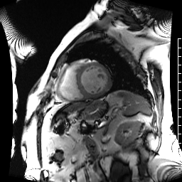
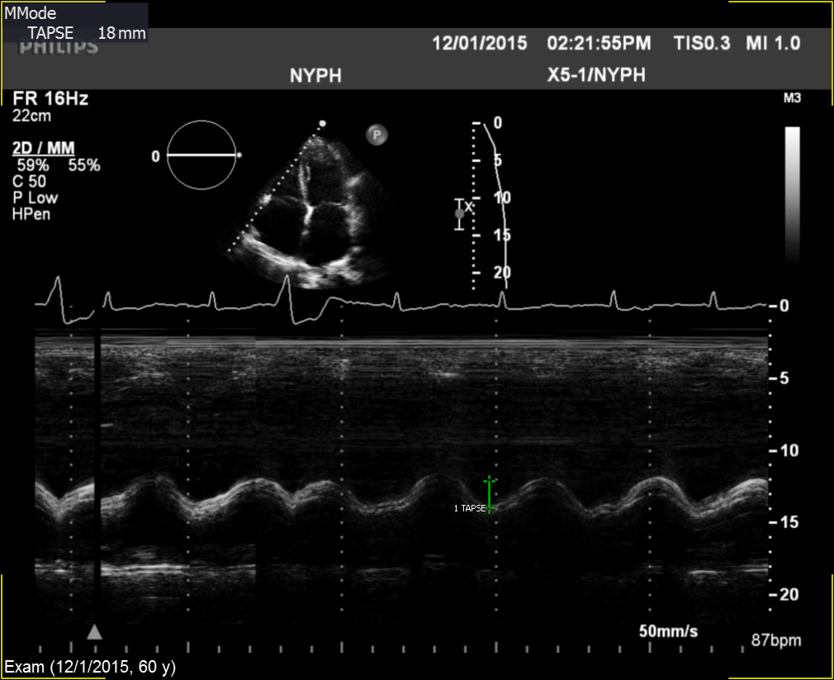
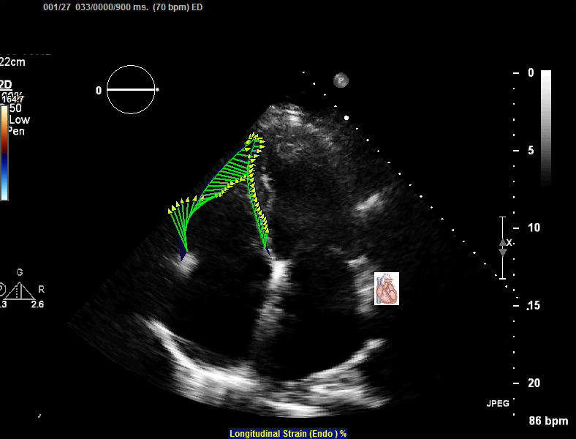
60 years old man, ischemic cardiomyopathy, iMR, NIF+
RV_{DYS}+
NORMAL RV FUNCTION
RV_{DYS}+
CMR-RVEF: 43%
TAPSE: 1.8 cm
RV-GLS: 13.8%
Notes:
This a representative case of a patient enrolled in our study…
CMR showed RVEF of 43% so this patient had RVDYS.
But if we assess RV function by means of conventional linear indices like TAPSE, results are in the normal range (TAPSE was 1.8 cm).
Nevertheless, when RVGLS was performed, results were consistent with CMR-RVEF (RV-GLS 13.8%), as opposed to conventiale linear indices.
MWF: yes, prior MI and prior PCI

Slide 25

ALL
YOU NEED TO
KNOW ABOUT
1
THE PRESENT STUDY
IN
MINUTE
OR LESS

Slide 26
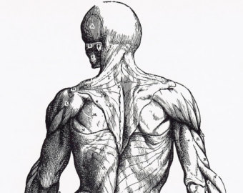
TO THE BEST OF OUR KNOWLEDGE
STUDY TO
FIRST
INVESTIGATE THE LINK BETWEEN
A
A
PER
ISCHEMIC
N
RV
N
N
FOR
MR
I F
D
D
MANCE

Slide 27
1
TAKE-HOME
MESSAGES

Slide 28
RV DYSFUNCTION
ISCHEMIC
M R
IN PATIENTS WITH
IS COMMONLY ACCOMPANIED
BY
I F
N
AND
BEST
CORRELATED
WITH
ECHO STRAIN

Slide 29
2
TAKE-HOME
MESSAGES

Slide 30
NIF
IS PARALLELED BY REDUCED
RV SEPTAL & FREE WALL
STRAIN
SUGGESTING THAT
LOCALIZED
MARKER
PER
TISSUE
RV
OF GLOBAL IMPAIRMENT
FOR
CHANGES
OF
ON CMR
MANCE

Slide 31
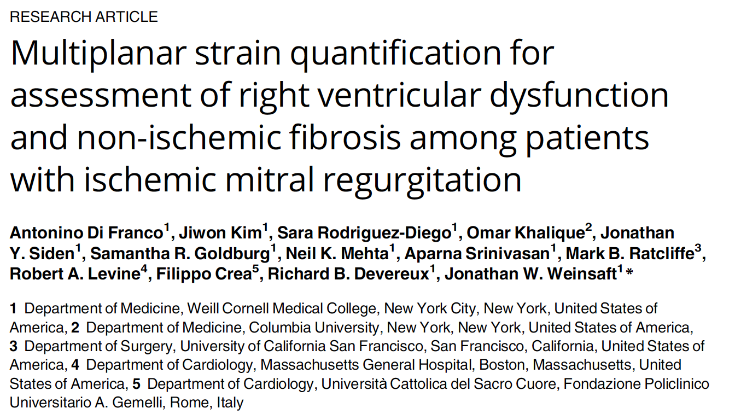
Di Franco A, et al. PLoS ONE. 2017;12:e0185657.

Slide 32




Slide 33

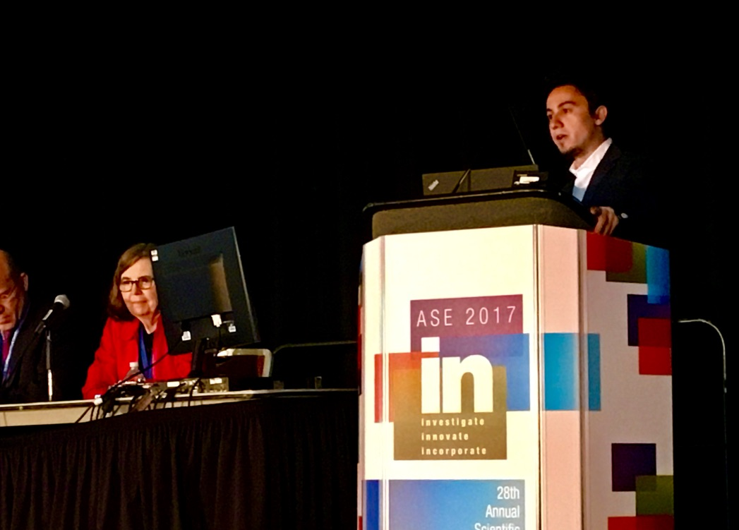

Slide 34
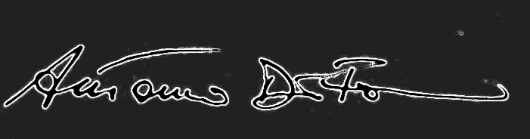
THANK YOU FOR YOUR ATTENTION

Slide 35

Pebble Beach
Lat: 40.70349
Brooklyn, NYC
Long: -73.9894
NY 11201, USA
Height: 4m

Slide 37
Impact of Non-Ischemic Fibrosis on
Echo-evidenced Right Ventricular Function among Patients with Ischemic Mitral Regurgitation
di franco antonino, md
postdoctoral associate in medicine - dept. of cardiology
advanced cardiovascular imaging program
weill cornell medicine|new york-presbyterian hospital
DISCLOSURES: NONE
525 East 68th Street
New York, NY 10021
Phone: (646) 962-4733,
Fax: (212) 746-8561
and2052@med.cornell.edu

Slide 38
RESULTS
CORRELATIONS BETWEEN RV REGIONAL STRAIN INIDICES AND CMR-RVEF
r= 0.70
r= 0.51
p< 0.001
p< 0.001
BACK-UP SLIDES

Slide 39
RESULTS
In multivariate analysis, RV-Free Wall LS was associated with NIF (regression coefficient 1.22 per % strain point [CI 1.09-1.36]; p<0.001) after controlling for MR severity (p= 0.49)
Substitution of RV-Septum LS in the model yielded similar magnitude of association (regression coefficient 1.12 [CI 1.02-1.22]; p=0.01)

Slide 40
REGIONAL STRAIN ECHO INDICES OF RV FUNCTION
p< 0.001
p= 0.001
p< 0.001
p= 0.008
BACK-UP SLIDES

Slide 41
CONCLUSIONS
RV_{DYS} in patients with iMR is commonly accompanied by NIF and best correlated with echo strain
NIF is paralleled by reduced regional and global RV longitudinal strain suggesting that localized tissue changes on CMR are a marker of global impairments in RV performance

Slide 42
METHODS
3 tesla scanners employed (GE) using a standard dose of gadolinium (0.2 mmol/kg)
Exams consisted of two components:
- cine-CMR (SSFP) for geometry/function
- DE-CMR (IR-GRE) for tissue characterization
TRANSTHORACIC ECHO
CARDIAC MRI
Commercial ultrasound equipment employed
(Philips i33)
RV systolic function quantified via tapse, rv-s’, fac:
TAPSE< 1.6 cm, RV-S’< 10 mm/s, FAC< 35%
JASE 2010;23:685-713
Global and regional 2D RV longitudinal strain measured in apical 4 chamber
-RV-GLS calculated as mean of all RV seed points
-RV regional strain assessed in the Septum and Free wall
Mitral Regurgitation measured quantitatively:
Regurgitant Fraction: <30%; 30-50%; ≥50%
Vena Contracta: <0.3cm; 0.3-0.69cm; ≥0.7cm
JASE 2010;23:685-713

Slide 43



