Slide 1
Studio FOURIER: cosa abbiamo imparato per la pratica clinica
Prof. Paolo calabro’
UNIVERSITY OF CAMPANIA
«LUIGI VANVITELLI»
A.O.R.N. «SANT’ANNA E SAN SEBASTIANO» - CASERTA
Notes:
Buongiorno a tutti…
Ringrazio il Prof…
Il caso clinico che vado a presentare ha come tema centrale un argomento controverso, ovvero la gestione delle complicanze in corso di anticoagulazione

Slide 2
PCSK9i e rischio cardiovascolare: da dove nasce lo studio FOURIER?

Slide 3
Anche nei pazienti in terapia statinica massimale è presente un importante “rischio residuo”…

Slide 4
Doubling statin dose achieves ~6% additional LDL-C reduction
Change in LDL-C (%)
0
-5
-10
-15
-20
-25
-30
-35
-40
-45
-50
-55
-60
%
10mg
20mg
40mg
Rosuvastatin
10mg
20mg
40mg
80mg
Atorvastatin
1mg/d
2mg
4mg
Pitavastatin
10mg
20mg
40mg
80mg
Simvastatin
10mg
20mg
40mg
Pravastatin
www.fda.gov/drugs/drugsafety/ucm256581.htm#relative. Accessed 10 Jan 2016.

Slide 5
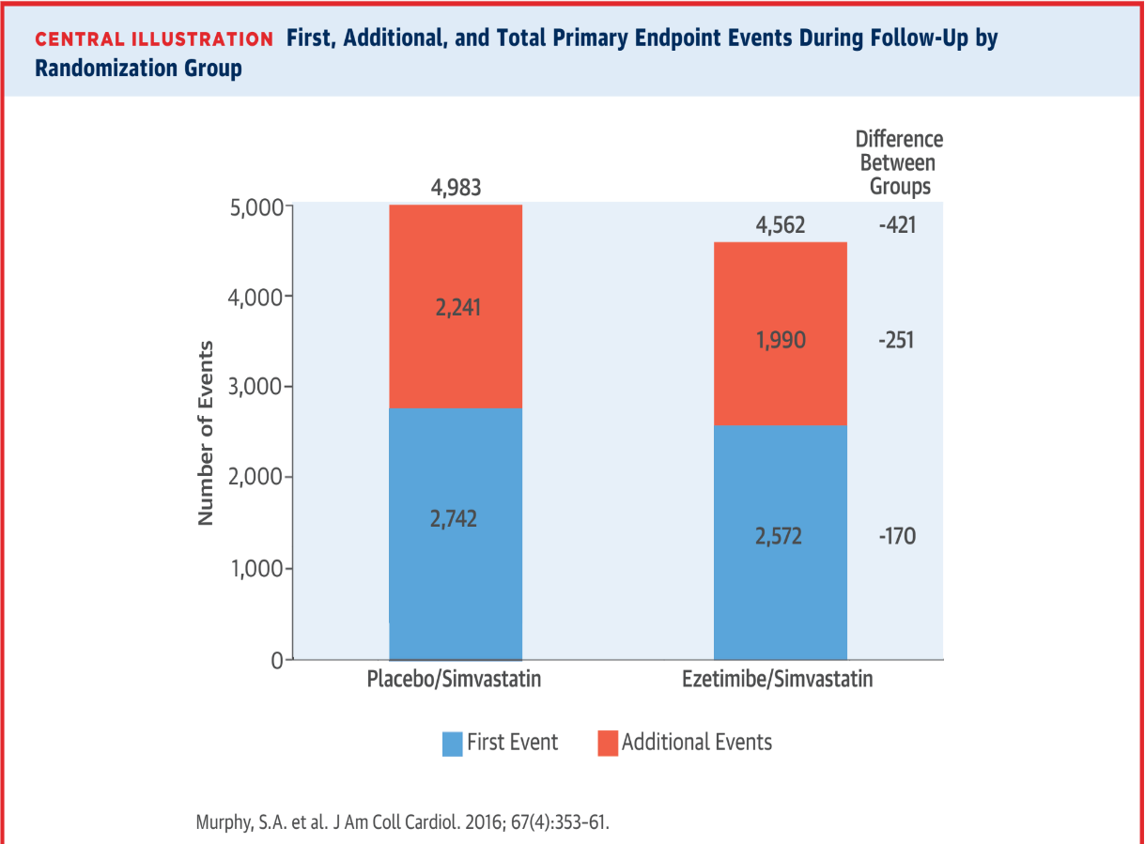
Rischio residuo nei pazienti in terapia con Ezetimibe + statine
IMPROVE-IT SUB-STUDY
Although there were 251 fewer subsequent events in the EZE/SIMVA group (1,990 in the EZE/SIMVA vs. 2,241 in the PLACEBO/SIMVA), a substantial number of cardiovascular events was reported also in the sperimental group.
Murphy et al. JACC, 2016
Notes:
Dagli studi in letteratura sappiamo che nei pazienti in terapia con statine abbiamo la persistenza di un elevato rischio residuo. Nello studio IMPROVE-IT una % importante di pz aveva eventi CV ricorrenti nel corso del FU, sia nel gruppo in trattamento con EZE/SIMVA che nel gruppo di controllo.
Nonostante il buon controllo del LDL-C (e valori medi al di sotto dei 70 mg/dl) nel gruppo EZE, una quota dei pazienti aveva ancora eventi cardiovascolari in terapia massimale. I risultati dell’analisi mostravano come la terapia EZE/SIMVA determinava una riduzione significativa del numero totale di eventi e degli eventi ricorrenti rispetto a SIMVA, sottolineando l’importanza di una terapia più aggressiva in questi pazienti.

Slide 6
FOURIER TRIAL: what’s new???

Slide 7
FOURIER: Further cardiovascular OUtcomes Research with PCSK9 Inhibition in subjects with Elevated Risk
Screening
Age 40–85 years
MI, stroke, or PAD
Additional risk factors (one major or two minor)
Optimal background lipid therapy (including effective dose of statin ± ezetimibe)
LDL-C ≥ 70 mg/dL or non–HDL-C ≥ 100 mg/dL
Evolocumab SC
140 mg Q2W or 420 mg QM
(per subject preference)
n ~ 13,750
Randomization 1:1
End of Study (EOS)
Placebo SC
Q2W or QM
(per subject preference)
n ~ 13,750
Maximum approximately 15 weeks
D1
W4
W12
W24
Q24W
Number of key 2⁰ endpoints achieved
D = day; HDL-C = high-density lipoprotein cholesterol; LDL-C = low-density lipoprotein cholesterol; MI = myocardial infarction; PAD = peripheral artery disease; Q2W = every 2 weeks; Q24W = every 24 weeks; QM = every month; SC = subcutaneous; W = week.
Sabatine MS, et al. Am Heart J. 2016;173:94-101.

Slide 8
FOURIER: Cosa abbiamo imparato?

Slide 9
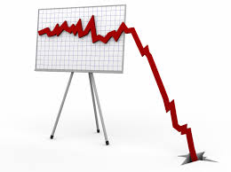
1. PRIMO INSEGNAMENTO
The lower, the better…
SENZA LIMITI!!!
LDL-C LEVELS

Slide 10
Median LDL-C Levels Over Time: All Patients
100
90
Placebo
Median 92 mg/dL
80
70
59% mean reduction (95%CI 58-60), P < 0.001
Absolute reduction: 56 mg/dL (95% CI 55-57)
60
LDL Cholesterol (mg/dL)
50
40
30
Evolocumab
Median 30 mg/dL
20
10
0
0
4
12
24
36
48
60
72
84
96
108
120
132
144
156
168
No. at risk
Weeks
Placebo
13,779
13,251
13,151
12,954
12,596
12,311
10,812
6,926
3,352
790
Evolocumab
13,784
13,288
13,144
12,964
12,645
12,359
10,902
6,958
3,323
768
LDL-C was significantly reduced in the evolocumab group (median: 30 mg/dL) including 42% who achieved levels ≤ 25 mg/dL vs < 0.1% in the placebo group
Data shown are median values with 95% confidence intervals in the two arms; ITT.
Sabatine MS, et al . NEJM. [published online ahead of print March 17, 2017]. doi: 10.1056/NEJMoa1615664
Notes:
Sabatine, et al. NEJM 2017: 4-A-1 (Figure 1)
Sabatine, et al. NEJM 2017: 3-B-3

Slide 11
Primary Endpoint: Composite of CV Death, MI, Stroke, Hospitalization for UA, or Coronary Revascularization
16
14.6
14
Placebo
12
10.7
12.6
10
Evolocumab
Cumulative Incidence (%)
8
9.1
6.0
6
4
5.3
2
0
0
6
12
18
24
30
36
No. at Risk
Months
Placebo
13,780
13,278
12,825
1
1,871
7,610
3,690
686
Evolocumab
13,784
13,351
12,939
12,070
7,771
3,746
689
HR 0.85 (95% CI 0.79 to 0.92); P < 0.001
CV = Cardiovascular; MI = Myocardial infarction; UA = Unstable angina; HR = Hazard ratio
Sabatine MS, et al . NEJM. [published online ahead of print March 17, 2017]. doi: 10.1056/NEJMoa1615664
Notes:
Sabatine, et al. NEJM 2017: 7-B-1 (Figure 2A)

Slide 12
Key Secondary Endpoint: Composite of CV Death, MI, or Stroke
11
9.9
10
9
Placebo
8
6.8
7
7.9
6
Cumulative Incidence (%)
Evolocumab
5
3.7
5.5
4
3
2
3.1
1
0
0
6
12
18
24
30
36
No. at Risk
Months
Placebo
13,780
13,449
13,142
12,288
7,944
3,893
731
Evolocumab
13,784
13,501
13,241
12,456
8,094
3,935
724
HR 0.80 (95% CI 0.73 to 0.88); P < 0.001
CV = Cardiovascular; MI = Myocardial infarction; HR = Hazard ratio
Sabatine MS, et al . NEJM. [published online ahead of print March 17, 2017]. doi: 10.1056/NEJMoa1615664
Notes:
Sabatine, et al. NEJM 2017: 7-B-1 (Figure 2B)

Slide 13
Association of LDL-C Levels and CV Events
Patients divided by quartile of baseline LDL-C and by treatment arm
13%
12%
P<0.0001
Q4
11%
Q3
10%
Q2
Cardiovascular Death, MI, or Stroke
Q4
9%
Q3
Q1
8%
Q1
7%
Q2
6%
Placebo
Evolocumab
5%
0
20
40
60
80
100
120
Achieved LDL Cholesterol (mg/dL)
Sabatine MS, et al. American College of Cardiology – 66th Annual Scientific Session Late-Breaking Clinical Trial. Washington, D.C. March 17, 2017.
Notes:
ACC ORAL FINAL FOURIER LBCT 3-14
Slide 21 - Lower LDL-C

Slide 14
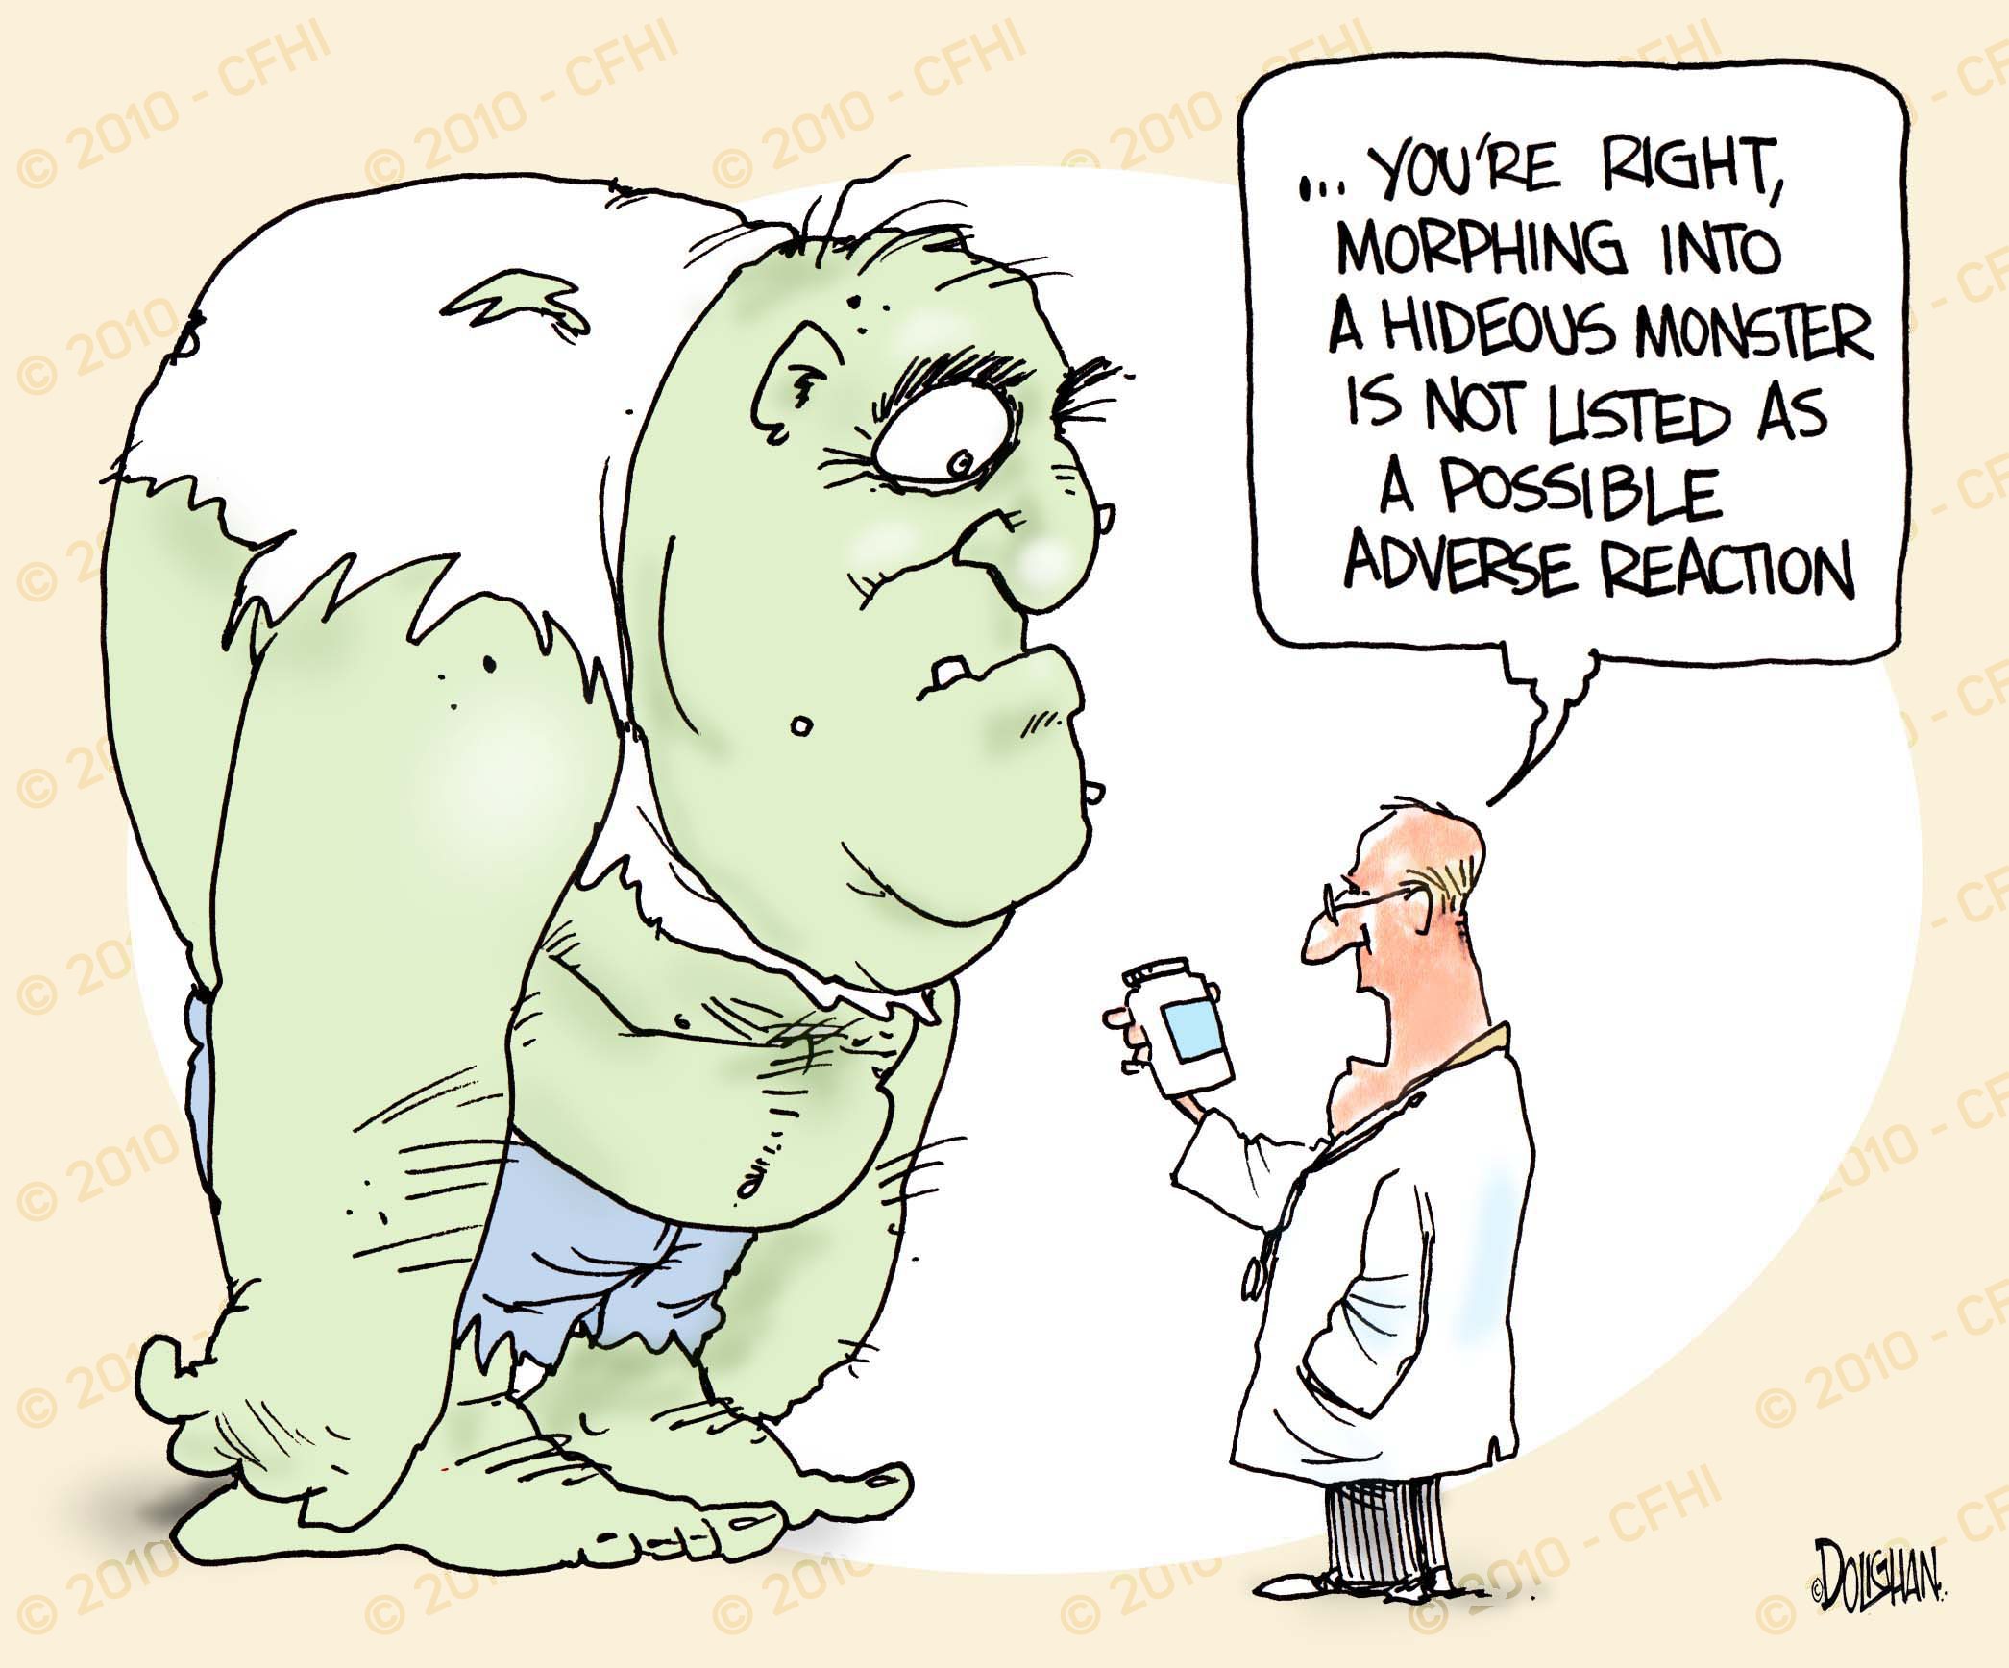
2. SECONDO INSEGNAMENTO
Ridurre il colesterolo LDL fino a livelli molto bassi è efficace e sicuro nella pratica clinica.

Slide 15
Clinical Efficacy and Safety of Achieving Very Low LDL-cholesterol Concentrations With the PCSK9 Inhibitor Evolocumab: A Prespecified Secondary Analysis of the FOURIER Trial
Robert P Giugliano, MD, SM; Terje R Pedersen, MD; Jeong-Gun Park, PhD; Gaetano M De Ferrari, MD; Zbigniew A Gaciong, MD, PhD; Richard Ceska, MD, PhD; Kalman Toth, MD, PhD, ScD; Ioanna Gouni-Berthold, MD; Jose Lopez-Miranda, MD; Francois Schiele, MD; Francois Mach, MD; Brian R Ott, MD; Estella Kanevsky, MS; Armando Lira-Pineda, MD; Ransi Somaratne, MD; Scott M Wasserman, MD; Anthony C Keech, MD; Peter S Sever, MD; Marc S Sabatine, MD, MPH
Giugliano RP, et al. Lancet. [published online ahead of print August 28, 2017]. doi: 10.1016/ S0140-6736(17)32290-0
Notes:
Giugliano RP, et al. Lancet. 2017: 1-A-1
Global Review
QC/Data review performed
GDL/GMAL reviewed (Ransi Somaratne/Cesar Cerezo)
Regional Review
Deck will need regional review (i.e. MAC)
Distribution
GDL/GMAL approved for external distribution pending local/regional regulatory approval (i.e. US may be restricted to leave-behind by MedInfo only)
Annotations
Available in deck as “Notes Page” view
NOTE: Deck includes some slides that are duplicates, but contain mg/dL vs mmol/L versions. Remove any notes and duplicate slide prior to local/regional approval

Slide 16
Distribution of Achieved LDL-C Level At Week 4 For Evolocumab and Placebo Groups
Placebo
Evolocumab
5
4
LDL-C at week 4 | n (%)
<20 mg/dL | 2,669 (10)
20 to <50 mg/dL | 8,003 (31)
50 to <70 mg/dL | 3,444 (13)
70 to <100 mg/dL | 7,471 (29)
≥ 100 mg/dL | 4,395 (17)
3
Proportion of patients (%)
2
1
0
0
25
50
75
100
125
150
175
200
225
250
LDL-C = low-density lipoprotein cholesterol n = 12,969 placebo; n = 13,013 evolocumab
LDL-C at Week 4 (mg/dL)
Giugliano RP, et al. Lancet. [published online ahead of print August 28, 2017]. doi: 10.1016/ S0140-6736(17)32290-0
Notes:
Giugliano RP, et al. Lancet. 2017:
4-Figure1

Slide 17
Relationship Between Achieved LDL-C Level at Week 4 and Risk for the Primary and Key Secondary Efficacy Composite Endpoints
Primary Endpoint (CV Death, MI, Stroke, Hospitalization for UA, or Coronary Revascularization)
Key Secondary Endpoint (CV Death, MI, or Stroke)
0.22
0.16
0.20
0.14
0.18
0.12
Adjusted event rate (probability)
0.16
0.10
0.14
0.12
0.08
0.10
0.06
0
0
0
25
50
75
100
125
150
175
0
25
50
75
100
125
150
175
LDL cholesterol at Week 4 (mg/dL)
LDL cholesterol at Week 4 (mg/dL)
Risk of the primary and secondary composite endpoints was progressively lower as the achieved LDL-C at week 4 was reduced
For the primary endpoint p = 0.0012 for the β coefficient. For the secondary endpoint p = 0.0001 for the β coefficient.
CV = cardiovascular, MI = myocardial infarction, UA = unstable angina. The blue line represents the hazard ratio and shaded areas are the 95% CIs of the regression model estimate. Giugliano RP, et al. Lancet. [published online ahead of print August 28, 2017]. doi: 10.1016/ S0140-6736(17)32290-0
Notes:
Giugliano RP, et al. Lancet. 2017:
6-Figure 3
Giugliano RP, et al. Lancet. 2017:
6-A-1–
6-B-1–
7-A-1

Slide 18
Event Rates and Adjusted Risk of Efficacy Endpoints by Achieved LDL-C Group at 4 Weeks
Endpoint | n (%) | Adjusted HR (95% CI) | P_{trend} of Adjusted HRs
Primary Efficacy Composite* <20 mg/dL 20-50 mg/dL 50-70 mg/dL 70-100 mg/dL ≥ 100 mg/dL | 217 (8.1) 769 (9.6) 354 (10.3) 793 (10.6) 521 (11.9) | 0.76 (0.64-0.90) 0.85 (0.76-0.96) 0.94 (0.82-1.09) 0.97 (0.86-1.09) referent | <0.0001
CV death, MI, or stroke <20 mg/dL 20-50 mg/dL 50-70 mg/dL 70-100 mg/dL ≥ 100 mg/dL | 134 (5.0) 455 (5.7) 223 (6.5) 498 (6.7) 345 (7.8) | 0.69 (0.56-0.85) 0.75 (0.64-0.86) 0.87 (0.73-1.04) 0.90 (0.78-1.04) referent | <0.0001
Cardiovascular death <20 mg/dL 20-50 mg/dL 50-70 mg/dL 70-100 mg/dL ≥ 100 mg/dL | 42 (1.6) 140 (1.7) 54 (1.6) 134 (1.8) 77 (1.8) | 0.99 (0.67-1.47) 1.07 (0.80-1.43) 0.99 (0.69-1.43) 1.14 (0.85-1.53) referent | 0.83
Myocardial infarction <20 mg/dL 20-50 mg/dL 50-70 mg/dL 70-100 mg/dL ≥ 100 mg/dL | 71 (2.7) 266 (3.3) 141 (4.1) 297 (4.0) 214 (4.9) | 0.59 (0.45-0.78) 0.69 (0.57-0.84) 0.87 (0.69-1.09) 0.85 (0.71-1.03) referent | <0.0001
*Primary efficacy composite = cardiovascular death, MI, stroke, coronary revascularization or hospitalization for unstable angina CI = confidence interval, CV = cardiovascular, MI = myocardial infarction HR = hazard ratio
Giugliano RP, et al. Lancet. [published online ahead of print August 28, 2017]. doi: 10.1016/ S0140-6736(17)32290-0
Notes:
Giugliano RP, et al. Lancet. 2017:
Supplement
Table S3

Slide 19
Event Rates and Adjusted Risk of Efficacy Endpoints by Achieved LDL-C Group at 4 Weeks continued
Endpoint | n (%) | Adjusted HR (95% CI) | P_{trend} of Adjusted HRs
Stroke <20 mg/dL 20-50 mg/dL 50-70 mg/dL 70-100 mg/dL ≥ 100 mg/dL | 45 (1.7) 103 (1.3) 56 (1.6) 134 (1.8) 92 (2.1) | 0.81 (0.55-1.18) 0.63 (0.47-0.85) 0.81 (0.57-1.14) 0.90 (0.68-1.20) referent | 0.0054
Coronary revascularization <20 mg/dL 20-50 mg/dL 50-70 mg/dL 70-100 mg/dL ≥ 100 mg/dL | 111 (4.2) 446 (5.6) 215 (6.2) 471 (6.3) 326 (7.4) | 0.63 (0.50-0.78) 0.78 (0.67-0.91) 0.91 (0.76-1.09) 0.91 (0.78-1.05) referent | <0.0001
Unstable angina <20 mg/dL 20-50 mg/dL 50-70 mg/dL 70-100 mg/dL ≥ 100 mg/dL | 44 (1.6) 132 (1.6) 51 (1.5) 129 (1.7) 80 (1.8) | 1.18 (0.80-1.74) 1.04 (0.78-1.39) 0.95 (0.66-1.37) 1.09 (0.82-1.47) referent | 0.73
All cause death <20 mg/dL 20-50 mg/dL 50-70 mg/dL 70-100 mg/dL ≥ 100 mg/dL | 73 (2.7) 240 (3.0) 101 (2.9) 225 (3.0) 141 (3.2) | 0.89 (0.66-1.20) 0.98 (0.79-1.23) 1.00 (0.77-1.31) 1.02 (0.82-1.27) referent | 0.47
CI = confidence interval, CV = cardiovascular, HR = hazard ratio
Giugliano RP, et al. Lancet. [published online ahead of print August 28, 2017]. doi: 10.1016/ S0140-6736(17)32290-0
Notes:
Giugliano RP, et al. Lancet. 2017:
Supplement
Table S3

Slide 20
Safety Events by Achieved LDL-C at 4 Weeks
Safety Event | Achieved LDL-C at Week 4 (mg/dL) |  |  |  |  | P_{trend}
 | <20 (N = 2,669) | 20 to <50 (N = 8,003) | 50 to <70 (N = 3,444) | 70 to <100 (N = 7,471) | ≥ 100 (N = 4,395)
Serious Adverse Events (N=6,106)
n (%) | 614 (23%) | 1,948 (24%) | 838 (24%) | 1,684 (23%) | 1,022 (23%) | 0.13
Adjusted OR (95% CI) | 0.97 (0.86-1.10) | 1.01 (0.92-1.11) | 1.01 (0.90-1.13) | 0.93 (0.84-1.02) | 1 (referent) | 0.30
Adverse Events* Leading to Discontinuation of Study Drug (N=900)
n (%) | 98 (4%) | 295 (4%) | 124 (4%) | 234 (3%) | 149 (3%) | 0.11
Adjusted OR (95% CI) | 1.08 (0.82-1.43) | 1.07 (0.86-1.33) | 1.07 (0.83-1.39) | 0.91 (0.73-1.14) | 1 (referent) | 0.13
AST or ALT Elevation >3 fold above the upper limits of normal (N=439)
n (%) | 41 (2%) | 120 (1%) | 76 (2%) | 119 (2%) | 83 (2%) | 0.19
Adjusted OR (95% CI) | 0.96 (0.64-1.43) | 0.87 (0.64-1.17) | 1.25 (0.90-1.74) | 0.91 (0.68-1.24) | 1 (referent) | 0.64
Creatine Kinase Elevation >5 Fold Above the Upper Limits of Normal (N=176)
n (%) | 18 (1%) | 55 (1%) | 19 (1%) | 58 (1%) | 26 (1%) | 0.99
Adjusted OR (95% CI) | 1.02 (0.53-1.96) | 1.07 (0.65-1.77) | 0.88 (0.47-1.65) | 1.23 (0.75-2.02) | 1 (referent) | 0.72
Neurocognitive Events (N=374)
n (%) | 49 (2%) | 122 (2%) | 51 (1%) | 100 (1%) | 52 (1%) | 0.019
Adjusted OR (95% CI) | 1.28 (0.84-1.96) | 1.10 (0.78-1.55) | 1.10 (0.73-1.65) | 0.97 (0.68-1.39) | 1 (referent) | 0.15
New Onset Diabetes Mellitus† (N=1,262)
n (%) | 135/1,655 (8%) | 389/4,863 (8%) | 162/1,886 (9%) | 356/4,603 (8%) | 220/2,778 (8%) | 0.63
Adjusted OR (95% CI) | 1.06 (0.83-1.35) | 1.00 (0.83-1.20) | 1.03 (0.83-1.30) | 0.95 (0.78-1.14) | 1 (referent) | 0.48
Cataract-related Adverse Events (N=430)
n (%) | 56 (2%) | 124 (2%) | 61 (2%) | 134 (2%) | 55 (1%) | 0.15
Adjusted OR (95% CI) | 1.54 (1.03-2.31) | 1.14 (0.82-1.60) | 1.34 (0.91-1.98) | 1.35 (0.96-1.89) | 1 (referent) | 0.43
*Excludes 17 patients with injection site reactions. †Denominator excludes patients who were diagnosed with diabetes mellitus before the week 4 visit. ALT = alanine aminotransferase, AST = aspartate aminotransferase, CI = confidence interval, LDL-C = low density lipoprotein-cholesterol, OR = odds ratio
Giugliano RP, et al. Lancet. [published online ahead of print August 28, 2017]. doi: 10.1016/ S0140-6736(17)32290-0
Notes:
Giugliano RP, et al. Lancet. 2017:
7-Table 2

Slide 21
Safety Events by Achieved LDL-C at 4 Weeks continued
Safety Event | Achieved LDL-C at Week 4 (mg/dL) |  |  |  |  | P_{trend}
 | <20 (N = 2,669) | 20 to <50 (N = 8,003) | 50 to <70 (N = 3,444) | 70 to <100 (N = 7,471) | ≥ 100 (N = 4,395)
New or Progressive Malignancy (N=621)
n (%) | 64 (2%) | 205 (3%) | 87 (3%) | 166 (2%) | 99 (2%) | 0.22
Adjusted OR (95% CI) | 0.90 (64-1.27) | 1.01 (0.78-1.31) | 1.04 (0.77-1.42) | 0.88 (0.67-1.15) | 1 (referent) | 0.72
Hemorrhagic Stroke (N=53)
n (%) | 3 (<1%) | 19 (<1%) | 7 (<1%) | 17 (<1%) | 7 (<1%) | 0.99
Adjusted HR (95% CI) | 0.71 (0.17 – 2.90) | 1.55 (0.62 – 3.85) | 1.39 (0.47 – 4.14) | 1.57 (0.62 – 3.98) | 1 (referent) | 0.91
Non-Cardiovascular Death (N=196)
n (%) | 25 (1%) | 86 (1%) | 34 (1%) | 66 (1%) | 45 (1%) | 0.67
Adjusted HR (95% CI) | 0.89 (0.53 – 1.50) | 1.06 (0.72 – 1.55) | 1.03 (0.65 – 1.64) | 0.89 (0.60 – 1.33) | 1 (referent) | 0.73
There were no significant differences in major safety events across the 5 very low achieved LDL-C groups
CI = confidence interval, LDL-C = low density lipoprotein-cholesterol, OR = odds ratio, HR = hazard ratio
Giugliano RP, et al. Lancet. [published online ahead of print August 28, 2017]. doi: 10.1016/ S0140-6736(17)32290-0
Notes:
Giugliano RP, et al. Lancet. 2017:
7-Table 2
Giugliano RP, et al. Lancet. 2017:
7-A-2

Slide 22
Post-Hoc Analysis of Achieved Ultra Low LDL-C at Week 4: Primary and Key Secondary Endpoints and Adverse Events
 | Ultra-low LDL cholesterol achieved at week 4 (mg/dL)
 | <10 (N = 504) |  |  |  | <15 (N = 1,335) |  |  |  | ≥ 100 (N = 4,395)
 | n (%) | Adjusted HR (95% CI) | P* |  | n (%) | Adjusted HR (95% CI) | P* |  | n (%)
Efficacy Endpoints
Primary efficacy endpoint | 37 (7.3) | 0.69 (0.49-0.97) | 0.0354 |  | 105 (7.9) | 0.71 (0.56-0.89) | 0.0031 |  | 521 (11.9)
CV death, MI, stroke | 22 (4.4) | 0.59 (0.37-0.92) | 0.0203 |  | 66 (4.9) | 0.66 (0.50-0.88) | 0.0049 |  | 345 (7.8)
 | n (%) | Adjusted OR (95% CI) | P* |  | n (%) | Adjusted OR (95% CI) | P* |  | n (%)
Safety Endpoints
Serious adverse events | 115 (22.8) | 0.94 (0.74-1.20) | 0.61 |  | 313 (23.4) | 0.96 (0.81-1.13) | 0.63 |  | 1,022 (23.3)
Adverse events leading to drug discontinuation† | 18 (3.6) | 1.08 (0.63-1.85) | 0.78 |  | 42 (3.1) | 0.89 (0.60-1.32) | 0.56 |  | 149 (3.4)
Major CV events progressively declined the lower the achieved LDL-C, and no differences in serious AEs or AEs leading to drug discontinuation were observed
*P value compared to the group achieving an LDL-C ≥ 2.6 mmoll/L at 4 weeks.
†Excludes injection site reactions There were too few of the other 8 prespecified safety events (ie, elevation in AST or ALT >3 fold above normal, new or recurrent malignancy (excluding non-melanoma skin cancer), cataract-related adverse events, elevation in creatine kinase >5 fold above normal, hemorrhagic stroke, neurocognitive adverse events, new onset diabetes mellitus, and non-cardiovascular death) for an adjusted analysis in the two ultra-low LDL-C groups.
Giugliano RP, et al. Lancet. [published online ahead of print August 28, 2017]. doi: 10.1016/ S0140-6736(17)32290-0
Notes:
Giugliano RP, et al. Lancet. 2017:
8-A-1
Giugliano RP, et al. Lancet. 2017:
Supplement Table S6

Slide 23
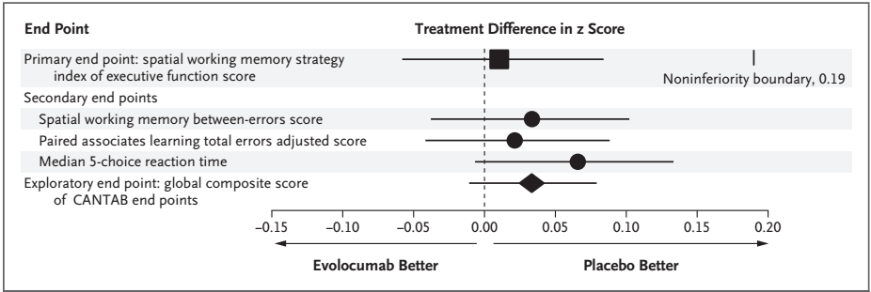
Sicurezza neuro-cognitiva…

Slide 24
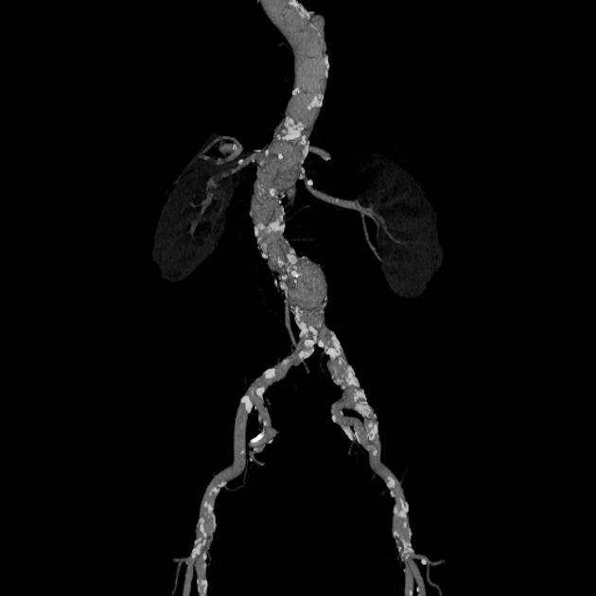
3. TERZO INSEGNAMENTO
Più è estesa la malattia aterosclerotica (coronarica e non coronarica) maggiore è il beneficio clinico che deriva dalla riduzione dei livelli di colesterolo LDL con inibizione di PCSK9.

Slide 32
Notes:
METHODS: FOURIER was a randomized trial of evolocumab versus placebo in 27564 patients with atherosclerotic disease on statin therapy followed for median of 2.2 years. Patients were identifed as having PAD at baseline if they had intermittent claudication and an ankle brachial index of <0.85 or if they had a prior peripheral vascular procedure. The primary end point was a composite of cardiovascular death, myocardial infarction, stroke, hospital admission for unstable angina, or coronary revascularization. The key secondary end point was a composite of cardiovascular death, myocardial infarction, or stroke. An additional outcome of interest was major adverse limb events defned as acute limb ischemia, major amputation, or urgent peripheral revascularization for ischemia.
RESULTS: Three thousand six hundred forty-two patients (13.2%) had PAD (1505 with no prior myocardial infarction or stroke). Evolocumab signifcantly reduced the primary end point consistently in patients with PAD (hazard ratio [HR] 0.79; 95% confdence interval [CI], 0.66–0.94; P=0.0098 and without PAD (HR 0.86; 95% CI, 0.80–0.93; P=0.0003; Pinteraction=0.40). For the key secondary end point, the HRs were 0.73 (0.59–0.91; P=0.0040) for those with PAD and 0.81 (0.73–0.90; P<0.0001) for those without PAD (Pinteraction=0.41). Because of their higher risk, patients with PAD had larger absolute risk reductions for the primary end point (3.5% with PAD, 1.6% without PAD) and the key secondary end point (3.5% with PAD, 1.4% without PAD). Evolocumab reduced the risk of major adverse limb events in all patients (HR, 0.58; 95% CI, 0.38–0.88; P=0.0093) with consistent effects in those with and without known PAD. There was a consistent relationship between lower achieved low-density lipoprotein cholesterol and lower risk of limb events (P=0.026 for the beta coeffcient) that extended down to <10 mg/dL.
CONCLUSIONS: Patients with PAD are at high risk of cardiovascular events, and PCSK9 inhibition with evolocumab signifcantly reduced that risk with large absolute risk reductions. Moreover, lowering of low-density lipoprotein cholesterol with evolocumab reduced the risk of major adverse limb events.

Slide 33
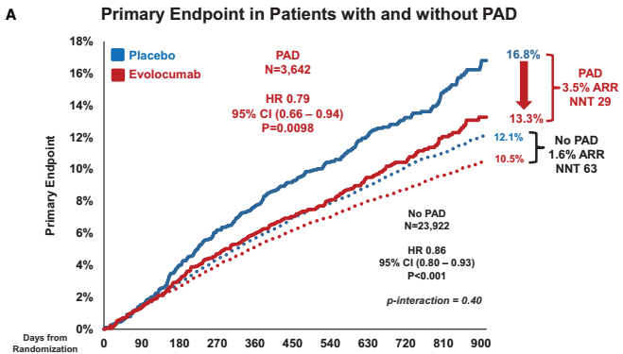
Notes:
Figure 2. Primary and key secondary end points in patients with and without peripheral artery disease. A, The primary composite end point (cardiovascular death, myocardial infarction, stroke, unstable angina, coronary revascularization) by treatment (evolocumab in red, placebo in blue) in patients with (solid lines) and without (dashed lines) symptomatic PAD. B, The key secondary composite end point (cardiovascular death, myocardial infarction, stroke) by treatment (evolocumab in red, placebo in blue) in patients with (solid lines) and without (dashed lines) symptomatic PAD. ARR indicates absolute risk reduction; CI, confdence interval; CV, cardiovascular; HR, hazard ratio; MI, myocardial infarction; NNT, number needed to treat; and PAD, peripheral artery disease.

Slide 34
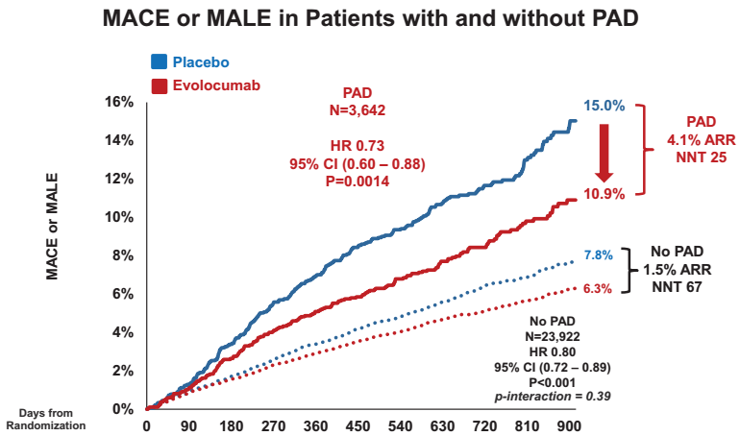
Notes:
Figure 4. Major adverse cardiovascular and limb events in patients with and without peripheral artery disease. The composite of major adverse cardiovascular events (MACE; cardiovascular death, myocardial infarction, or stroke) and major adverse limb events (MALE; acute limb ischemia, major amputation, or urgent revascularization) by treatment (evolocumab in red, placebo in blue) in patients with (solid lines) and without (dashed lines) symptomatic PAD. ARR indicates absolute risk reduction; CI, confidence interval; HR, hazard ratio; MACE, major adverse cardiovascular event; MALE, major adverse limb event; NNT, number needed to treat; and PAD, peripheral artery disease.

Slide 35
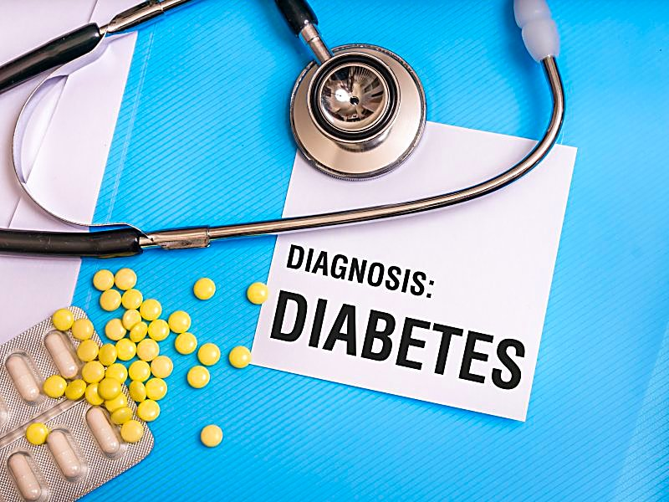
4. QUARTO INSEGNAMENTO
A differenza delle statine, ridurre il colesterolo con evolocumab non aumenta il rischio di diabete di nuova insorgenza.

Slide 36
Efficacia e sicurezza di evolocumab nei pazienti diabetici e non-diabetici
Lancet Diabetes Endocrinol. 2017 Dec;5(12):941-950.

Slide 37
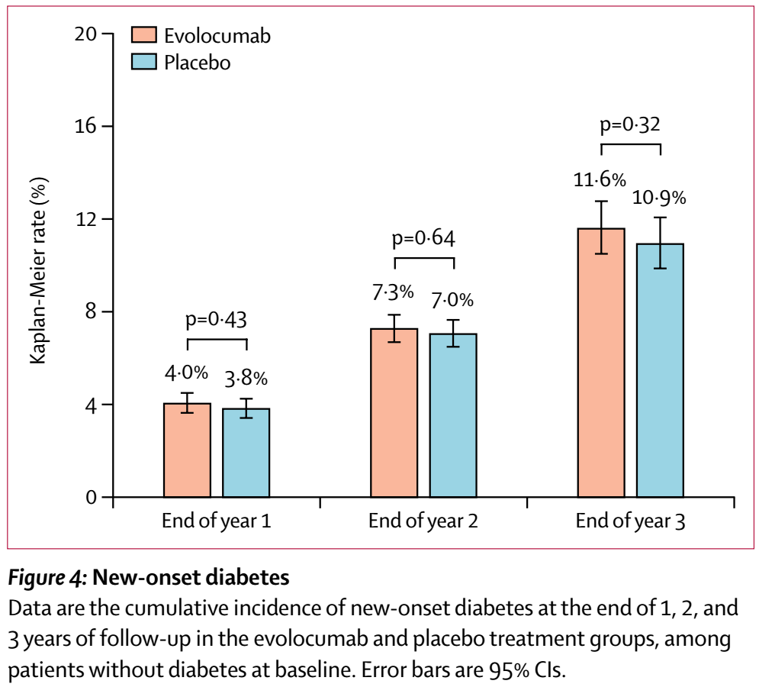
FOURIER e «new-onset diabetes»: nessuna differenza tra evolocumab e placebo

Slide 38
Take Home Messages…
Lo studio FOURIER ha dimostrato come la riduzione dei livelli di colesterolo LDL con Evolocumab determine una riduzione proporzionale degli eventi cardiovascolari maggiori.
L’utilizzo di Evolocumab si è dimostrato sicuro oltre che efficace, dimostrando un’incidenza di eventi avversi sovrapponibile al placebo.
L’efficacia di Evolocumab si è dimostrata più evidente nei pazienti con malattia aterosclerotica diffusa (sia coronarica che non coronarica).
A differenza della terapia con statine, l’utilizzo di evolocumab non determina un incremento del rischio di diabete di nuova insorgenza, dimostrandosi sicuro ed efficace nei pazienti diabetic e non diabetici.

Slide 39
Grazie dell’attenzione…
paolo.calabro@unicampania.it

