Slide 1
Ipotensione. Il problema critico nella terapia dell’Insufficienza Cardiaca Cronica.
Massimo Romano

Slide 3
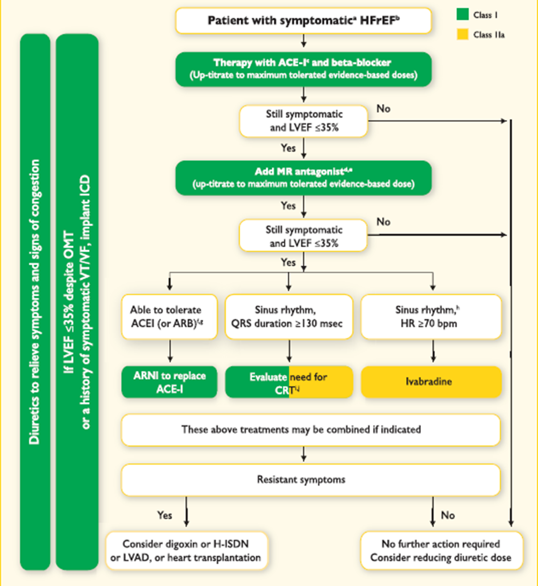

Slide 4
Fattori negativi nell’evoluzione dell’Insufficienza Cardiaca Cronica
Necessità di Elevate dosi di diuretici
Assenza di miglioramento clinico
Inadeguata «compliance» alla terapia
Dieta Incongrua
Terapia «fai da te»
Impossibilità a tollerare la terapia

Slide 5
Patients with HF due to LV systolic dysfunction, in New York Heart Association (NYHA) functional class III or IV, when adequately medicated, usually have systolic blood pressure (BP) levels as low as 90 mmHg, with no symptoms.

Slide 6
In some cases, of non-ischemic etiology, up to 80 mmHg of systolic pressure may be tolerated. A patient of this type, when presented with "normal" BP, 120x80 mmHg, may be submedicated, although these parameters may change, in cases of hypertensive heart disease.

Slide 7
Therefore, for the diagnosis of hypotension in these cases, we can not only rely on the absolute value of BP. Symptoms of hypotension, such as lightheadedness, dizziness, weakness, cold hands, asthenia, pre-syncope, or syncope, need to be present.

Slide 8
Risks of Hypotension
Optimal blood pressure is critical for maintaining adequate coronary and renal perfusion pressures, especially in patients with overt or subclinical vascular disease.

Slide 9
Risks of Hypotension
Patients with elevated left ventricular end diastolic pressures with hemodynamic congestion, those with pre-existing coronary artery disease, and collateral dependent areas of myocardial perfusion are at particular risk of jeopardizing coronary perfusion pressure with systemic hypotension.

Slide 10
Risks of Hypotension
In addition, symptomatic hypotensive episodes on therapy may contribute to nonadherence by patients and unwillingness by providers to optimize doses, leading to treatment failures.

Slide 11
Orthostatic hypotension (OH) is traditionally defined as a fall of >20 mmHg in systolic and/or >10 mmHg in diastolic blood pressure within 3 min of active standing.

Slide 12
OH has been classified as neurogenic and non-neurogenic.
Neurogenic OH is less common and is caused by multiple system atrophy, Parkinson’s disease, pure autonomic failure and neuropathies.
Non-neurogenic OH is more common and is associated with aging, prolonged recumbency, large meals, hypovolemia, medications, hypertension and other non-neurogenic disorders.

Slide 13
Heart failure (HF) is also considered to be an etiologic factor for non-neurogenic OH.
Conversely, the presence of OH strongly predicts the development of HF.

Slide 14
Postprandial hypotension has been defined as a decrease in systolic blood pressure of >20 mm Hg or a decrease below 90 mm Hg from a pressure of >100 mm Hg within 2 hours after a meal.
Carbohydrate-rich meals predispose patients to more immediate decreases in blood pressure compared with meals containing mostly protein or fat.

Slide 15
Warm meals (50°C) appear to cause a greater decrease in postprandial blood pressure than meals served cold (5°C).
Postprandial hypotension can occur after any meal, but breakfast and lunch appear to be associated with the most pronounced decrease in blood pressure, resulting in more severe symptoms.

Slide 16
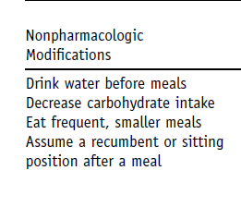
Treatment Options for Postprandial Hypotension

Slide 17
PRESSIONE ARTERIOSA
FREQUENZA CARDIACA
CONTRATTILITA’

Slide 18
Pulse pressure was determined by subtracting the diastolic from the systolic blood pressure.
higher Pulse Pressure
remained an independent predictor of total and cardiovascular mortality
(total mortality relative risk, 1.05 per 10 mm Hg increment;
95% confidence interval, 1.01 to 1.10;
p = 0.02).

Slide 19
mean arterial pressure was calculated by using the formula: [(systolic blood pressure) + (2 x diastolic blood pressure)]/3
Mean arterial pressure
was inversely related to
total and cardiovascular mortality (total mortality relative risk, 0.89;
95% confidence interval, 0.85 to 0.94;
P < ,0.0001).

Slide 20
For each 10 mm Hg increase in Pulse Pressure there was a 5% increase in the risk of death.

Slide 21
A lower Mean Arterial Pressure was predictive of increased mortality with
an 11% increase for each 10 mm Hg decrement in baseline mean arterial pressure.

Slide 22
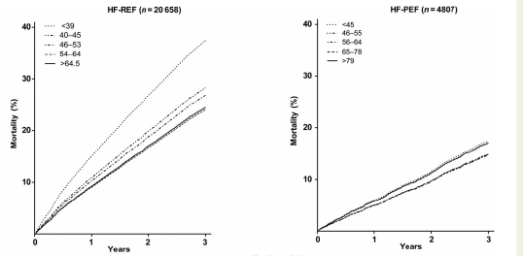

Slide 23
Lower pulse pressure was an independent predictor of mortality in patients with HF-REF, particularly in those with an LVEF >30% and systolic blood pressure ,140 mmHg.
Overall, this relationship between pulse pressure and outcome was not consistently observed among patients with HF-PEF.

Slide 24
ARTERIAL PRESSURE
IN HEART FAILURE
TRIALS

Slide 25
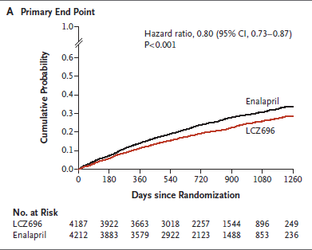

Slide 27
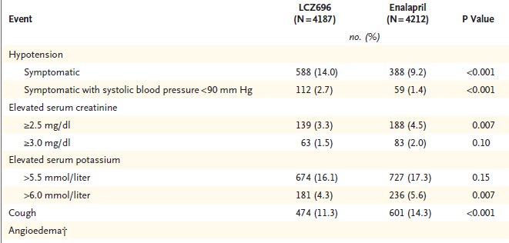

Slide 28
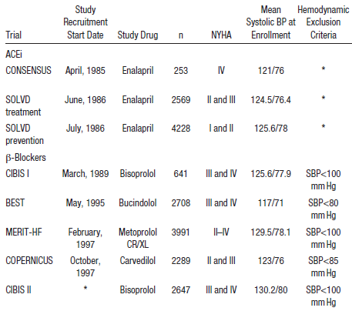

Slide 29
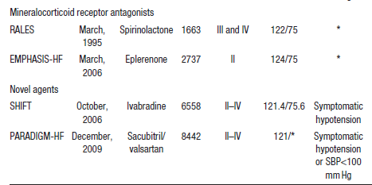

Slide 30
Circ Heart Fail. 2015;8:826–831.
Almost all disease-modifying therapies in HFrEF cause blood pressure lowering as an intended or unintended consequence.
Low systolic blood pressure (SBP), which may reflect the extent of myocardial reserve, is one of the strongest determinants of clinical course in ambulatory and hospitalized patients with HFrEF.2

Slide 31
Circ Heart Fail. 2015;8:826–831.
Although neurohormonal blockers are often titrated based on in-clinic vital sign assessment, 24-hour ambulatory blood pressures in these patients show substantial diurnal variation.

Slide 32
In addition, symptomatic hypotensive episodes on therapy may contribute to nonadherence by patients and unwillingness by providers to optimize doses, leading to treatment failures.

Slide 33
The step-wise addition of neurohormonal agents contributed to significant daytime and especially nocturnal hypotensive episodes,
which were associated with an increase in cardiovascular events, despite stable pre- and post-treatment in-clinic blood pressure measurements.
J Card Fail. 2008;14:555–560.

Slide 34
In the Organized Program to Initiate Lifesaving
Treatment in Hospitalized Patients with Heart
Failure (OPTIMIZE-HF) registry,
patients with SBP <120 mmHg at the time of
hospital presentation experienced in-hospital and postdischarge mortality rates of 6.2% and 14.9%, respectively, compared with 1.4% and 4.7% in patients with SBP >160 mmHg.

Slide 35
In a recent analysis from the Systolic Heart Failure Treatment with the If Inhibitor Ivabradine (SHIFT) trial,
every 10-mmHg reduction in SBP was associated with an increased risk of all-cause mortality by 12% in patients with chronic HFrEF on background contemporary medical therapies.

Slide 36
PRESSIONE ARTERIOSA
FREQUENZA CARDIACA
CONTRATTILITA’

Slide 37
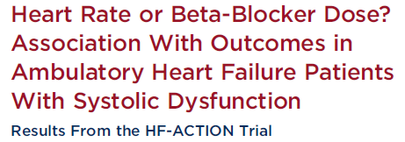
n. 2331 HF patients
This study aimed to compare whether reduced heart rate (HR) or higher beta blocker (BB) dose affected outcomes to a greater extent in the HF-ACTION (Heart Failure: A Controlled Trial Investigating Outcomes of Exercise Training) trial population.

Slide 38
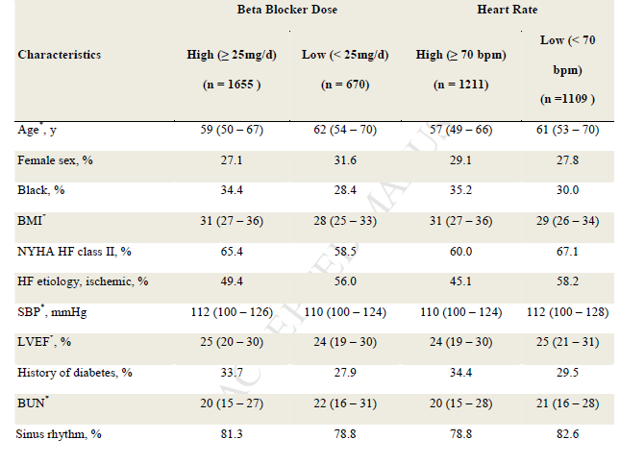

Slide 39
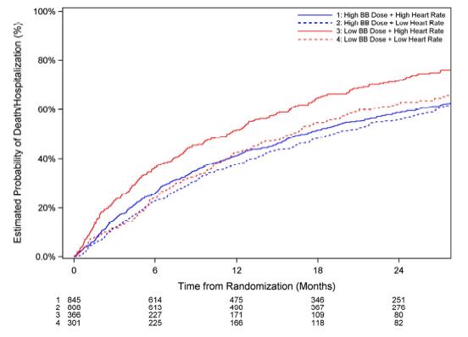

Slide 40
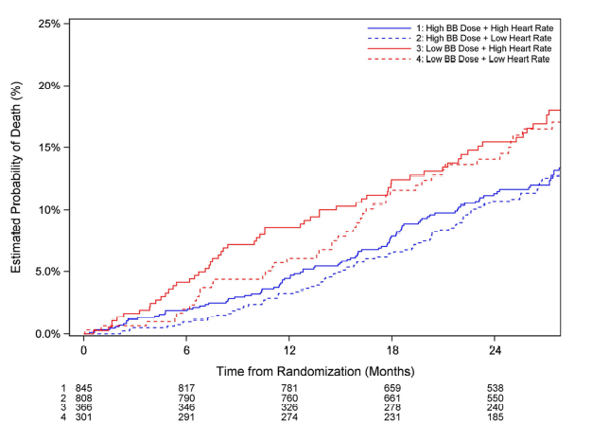

Slide 41
This study found an association between higher doses of beta-blockade and an improvement in the primary composite endpoint of all-cause death/hospitalization, regardless of baseline HR being high or low.

Slide 42
Conclusions
There were more associated improvements in outcomes with higher BB dose than with reduced HR in this well-treated HF cohort with systolic dysfunction, which suggests that titration of BB doses may confer a greater benefit than reduction of HR in such patients.

Slide 43
CRT Ups Systolic BP, Hints Analysis Steve Stiles
Three randomized studies assessed the effect of CRT plus optimal medical therapy (n=1637) vs optimal meds only (n=727) and included COMPANION and CARE-HF.

Slide 44
CRT Ups Systolic BP, Hints Analysis Steve Stiles
Collectively, they showed average systolic BP to be 3.9 mm Hg higher (p=0.007) and pulse pressure 4.3 mm Hg higher (p<0.001) across the device-therapy groups compared with the control groups.

Slide 45
CRT Ups Systolic BP, Hints Analysis Steve Stiles
Blood-pressure elevations may be protective in patients with heart failure from dilated cardiomyopathy, the authors observe, but whether they have survival value independent of improved LVEF in patients with CRT remains to be demonstrated.

Slide 47
General approaches for most HF patients with low BP.
Avoid overuse of medications that cause hypotension, such as α-blockers, calcium-channel blockers, nitrates, PDE-5 inhibitors.
Avoid inappropriate overdosing of diuretics. Separate timing of medications that cause hypotension apart from each other. Assess and treat possible noncardiac causes of hypotension.
Avoid abrupt withdrawal of ACEI or β-blocker without a compelling clinical indication.

Slide 48
Approaches for HF patients with asymptomatic low BP before initiation of HF medications
Initial occasional low BP is usually transient and most patients tolerate HF medications.
It is not unreasonable to start β-blockers after intermediate doses of ACEI are achieved.
Initiate and uptitrate GDMT slowly and cautiously with close follow-up.

Slide 49
Approaches for patients with HF with asymptomatic low BP after initiation of HF medications
Do not reduce or discontinue ACEI or β-blockers for asymptomatic low BP measurements.
With improvement of HF status with GDMT and/or CRT, BP profile usually improves.

Slide 50
HF patients with symptomatic hypotension
Hypotension may be because of advanced systolic HF and/or noncardiac causes.
Initial occasional hypotension or dizziness usually resolves as HF improves with GDMT and/or CRT.
Additional HF medications may need to be adjusted before consideration of any changes in ACEI or β-blockers

Slide 51
Take Home Message
Ipotensione è un problema critico nel Paziente con Insufficienza Cardiaca Cronica e non va mai sottovalutata;
Terapia «sartoriale»;
Titolare il betabloccante al massimo dosaggio compatibile con le condizioni generali.

